Slide 1

Health & Safety Day Projects
Administrative Report
Salinas City Council Meeting
February 15, 2022

Slide 2
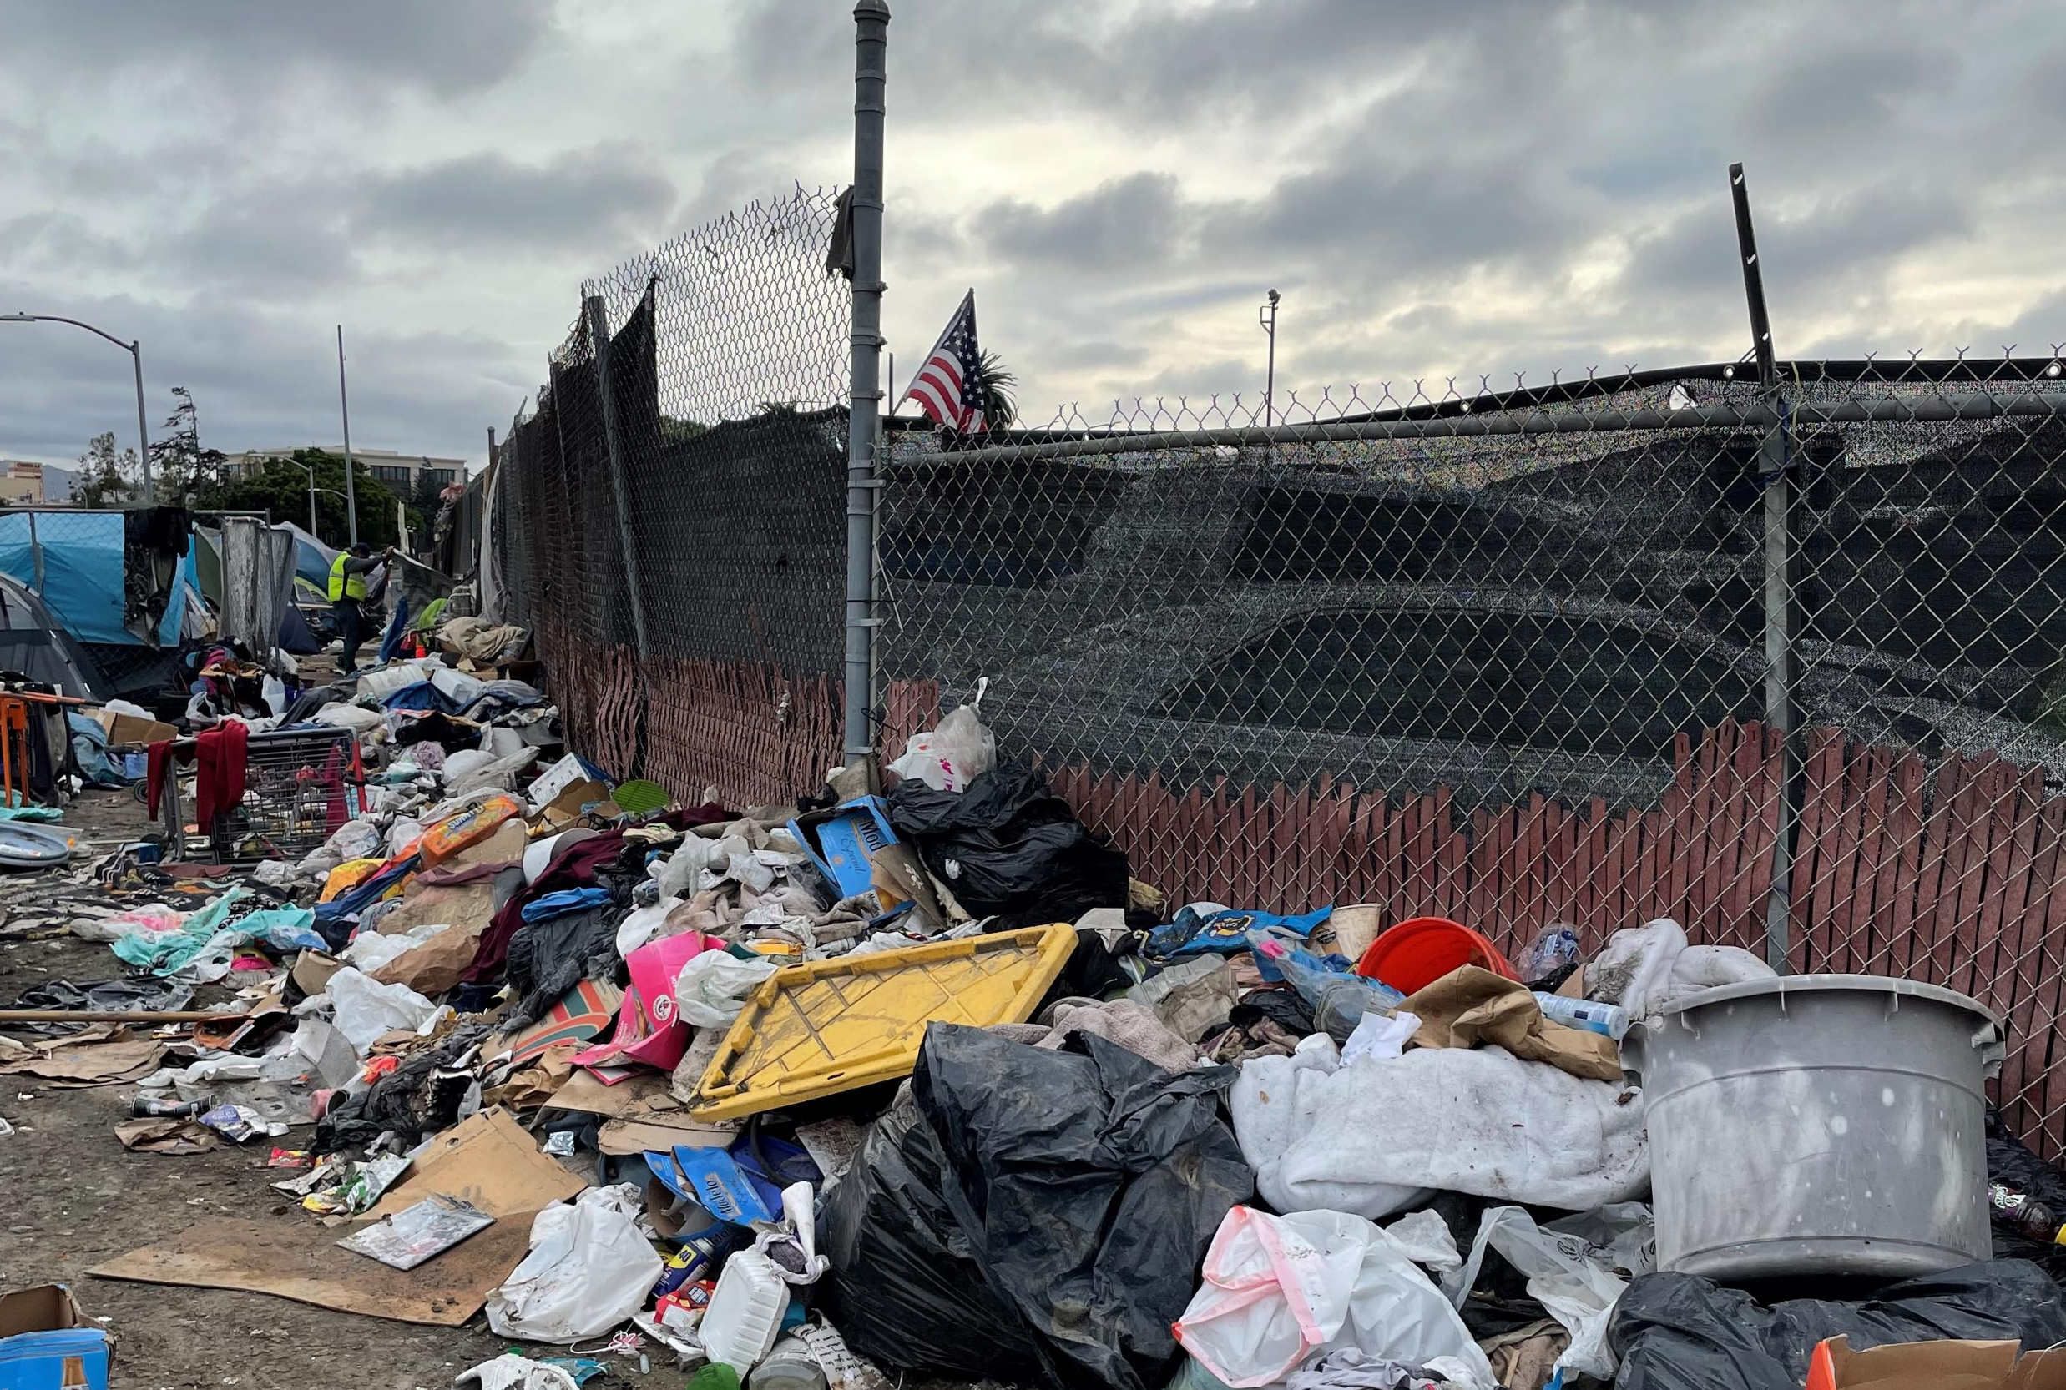
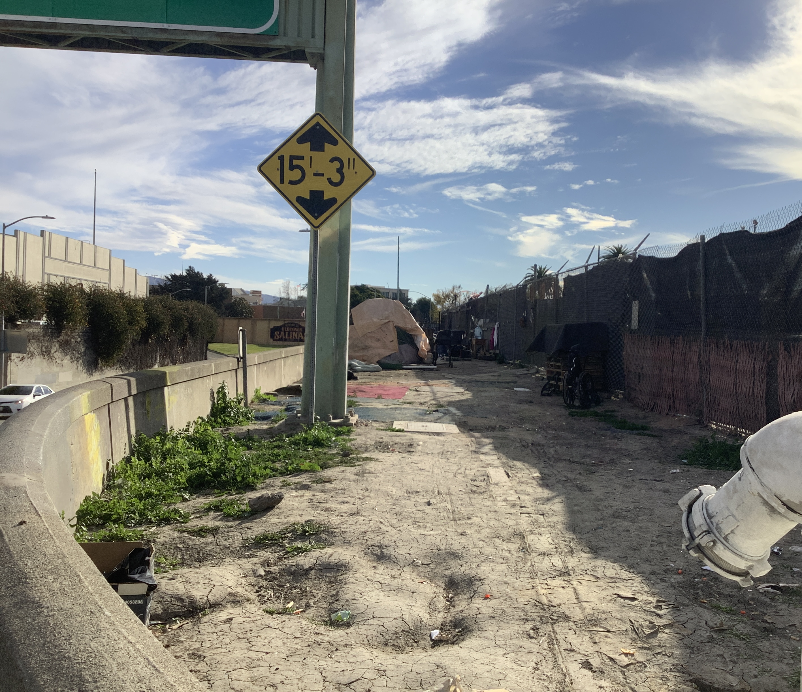
Executive Summary
45 Main Street
(Overpass near Chinatown)
Health & Safety Conversations
Community–Level Discussions
Collaboration with Encampment Residents
Program Alignment with Partners
Short- & Long-Term Goals

Slide 3
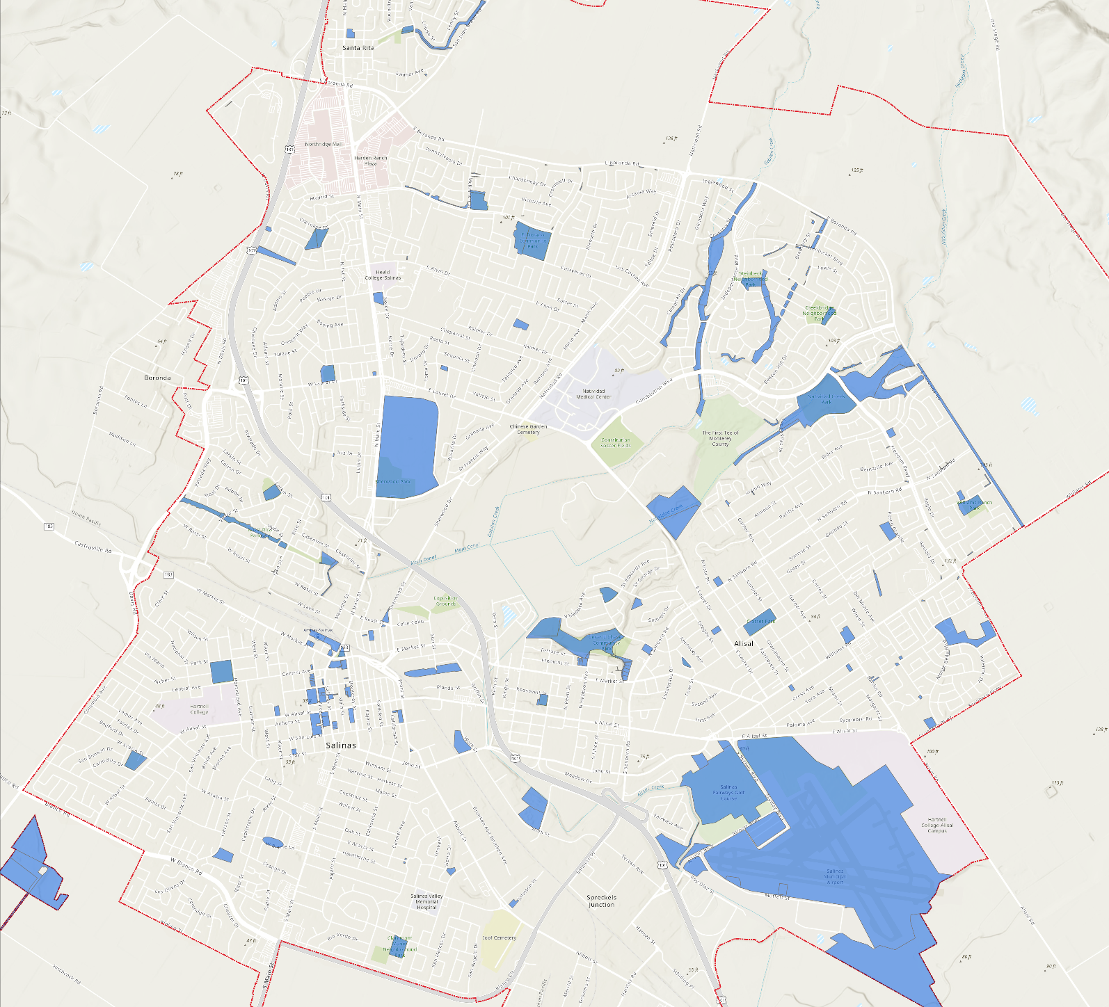
City-Owned Properties

Slide 4
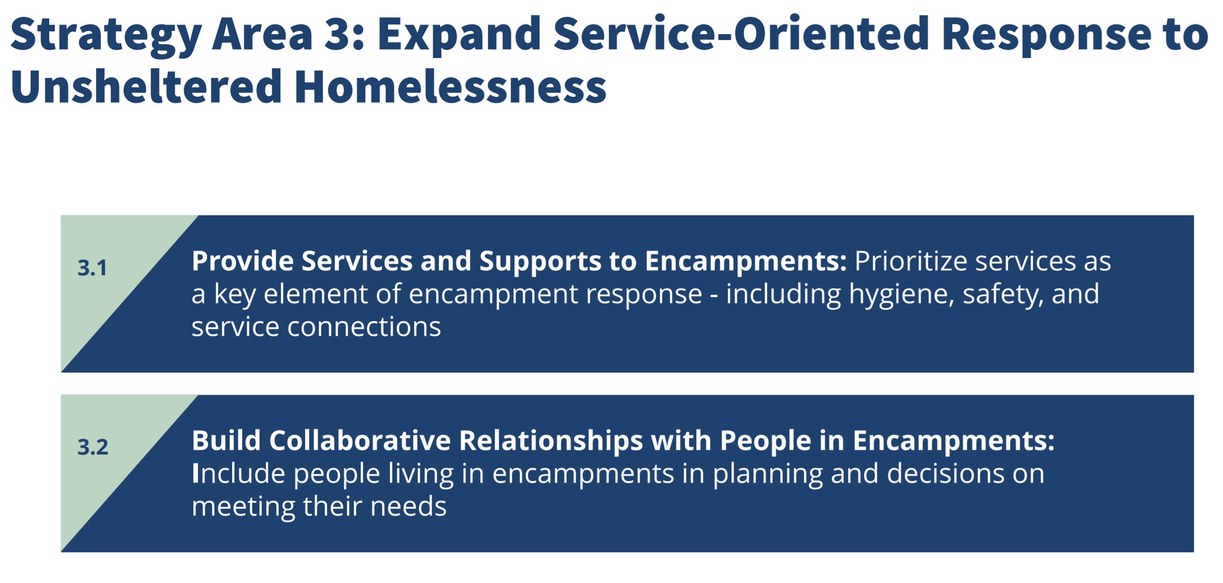
Lead Me Home Plan Update

Slide 5
Purpose & Approach
Safe, livable Salinas for all residents through outreach, engagement, and connection to available services and resources
Balance health, sanitation and safety needs all residents through community-level discussions

Slide 6
Standards & Best Practices
Identifying Type of Health & Safety Day
Date Setting & Noticing
Personal Property Bins Day Before & Day Of
Backpacks for Personal Property
Post-Health & Safety Day Activities
Pre-Health & Safety Day Engagement

Slide 7
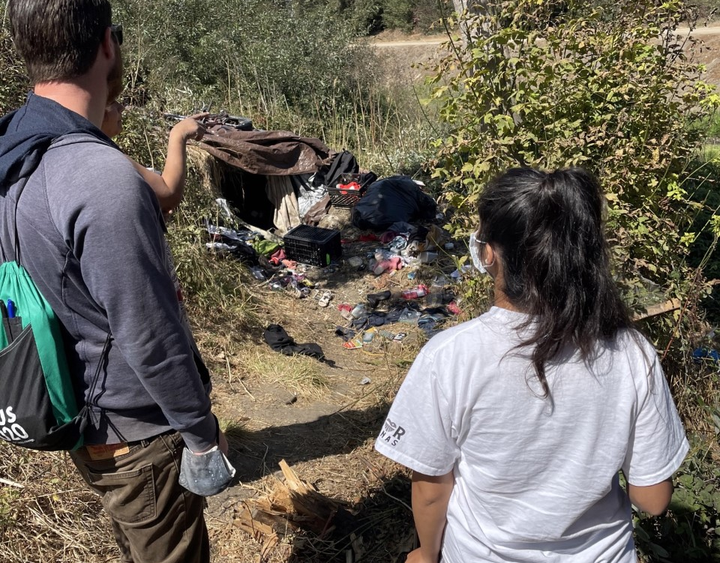
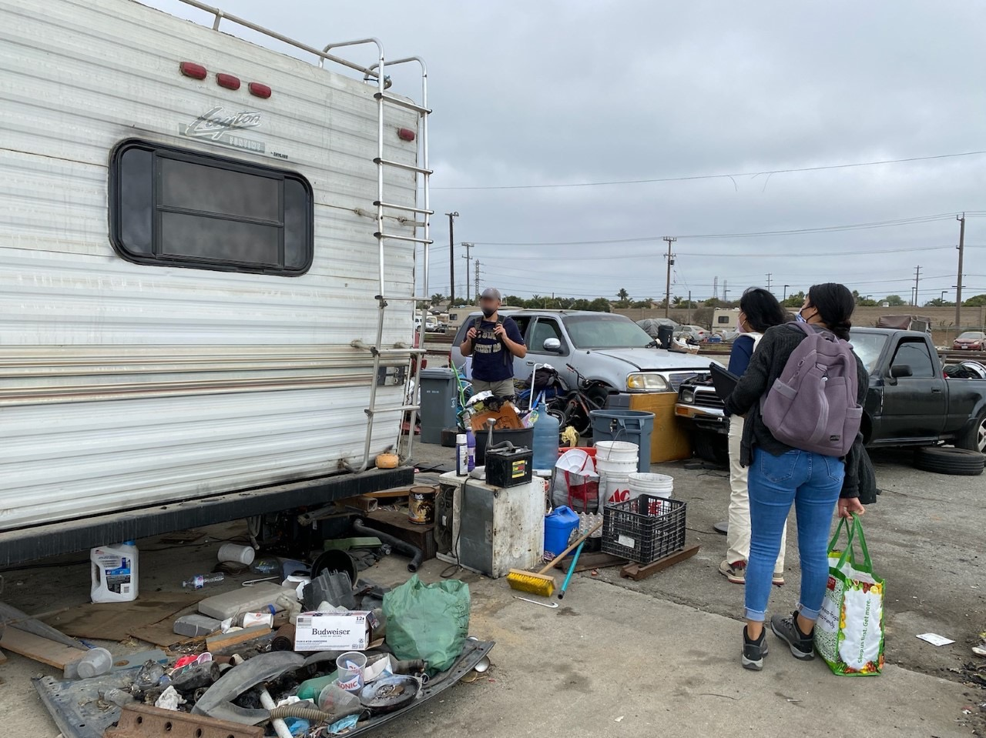
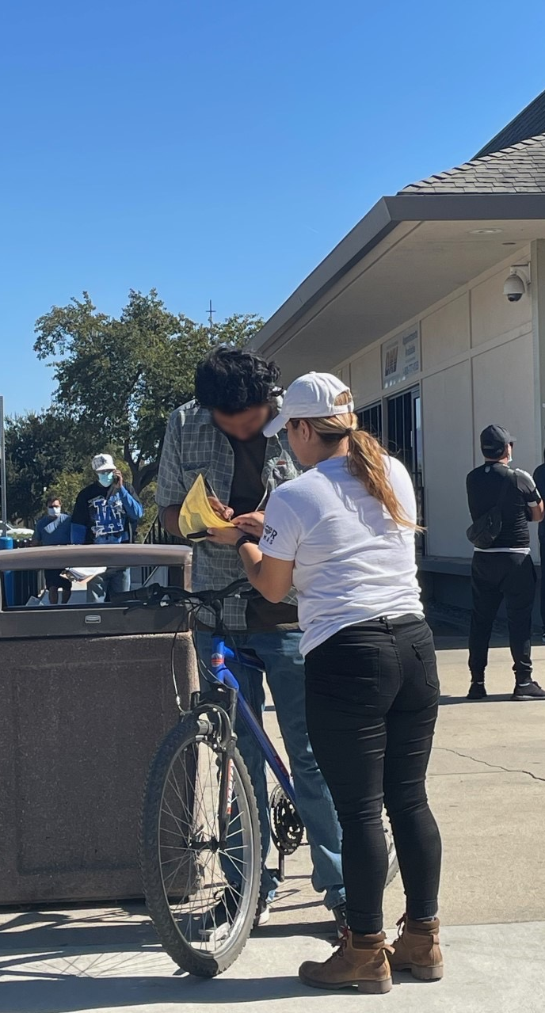
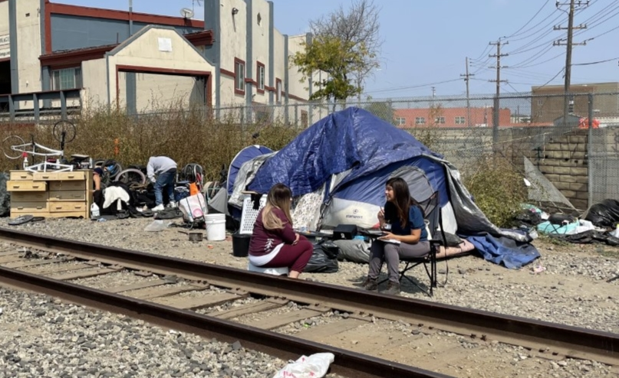
Outreach &
Connection to Resources
At least 14 days – no immediate health & safety issues
More than 14 days when needed
Connection to resources as available
Salinas Outreach & Response Team (SORT)

Slide 8
Pandemic Support
Almost 1,200 unsheltered residents (2019 Census Tract)
SORT: 1 FT Community Development Analyst & 4 PT Outreach Assistants
50-100 monthly donations of raincoats, hygiene items, thermal underwear
Over 500 hygiene items purchased & distributed
Over 40,000 meals distributed
Over 10,000 pieces of PPE

Slide 9
Post-Health & Safety Days
Collaboration with Partners
Community-Level Discussions to Identify Needs & Goals
Connection to Services & Resources

Slide 10
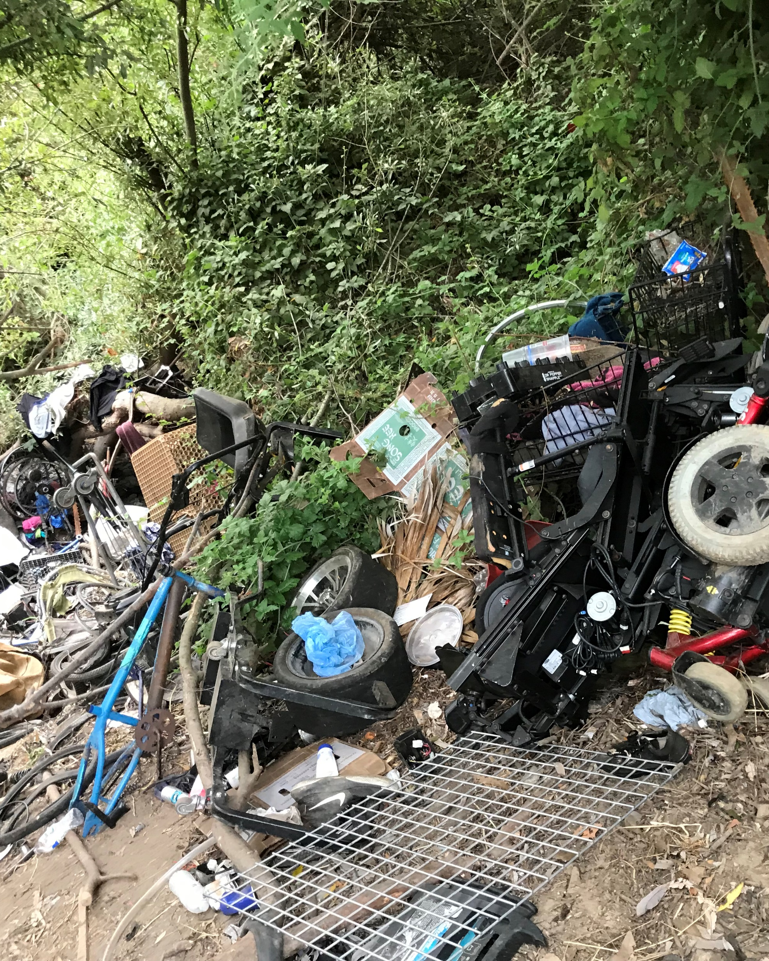
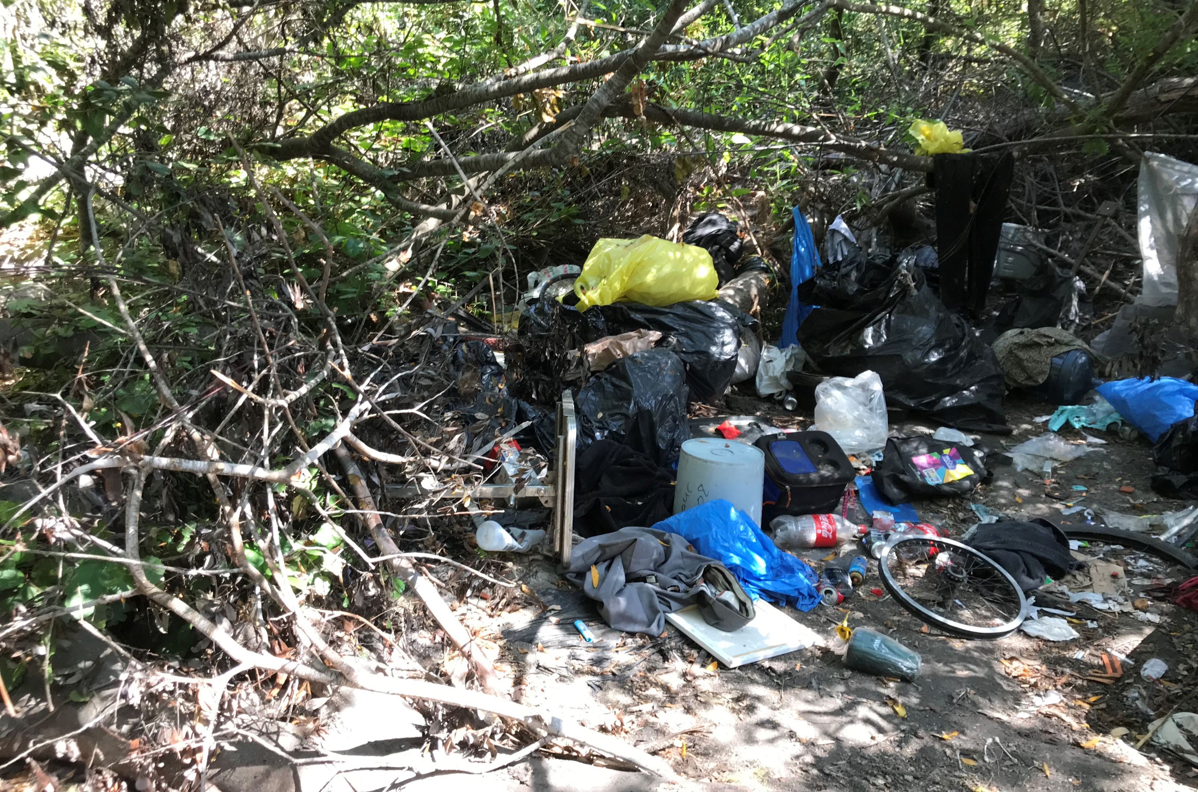
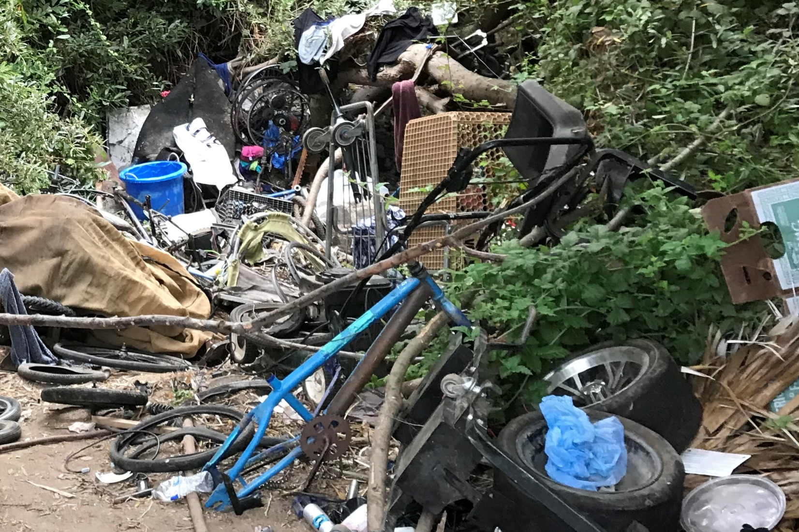
National Pollutant Discharge Elimination System (NPDES)

Slide 11
Upcoming Health & Safety Days
1 Mar.
Alisal Creek from John St. To Elvee Dr.
15 Mar.
29 Mar.
TBD
TBD

Slide 12
Additional Support for Homeless Residents
Applying for $4.1 million Encampment Grant
Proactive Engagement & Litter Reduction
Sanitation Stations
Porta Potty Placements
Mobile Showers in Chinatown
5-Year Plan to Reduce Homelessness

Slide 13
Questions?

