Slide 1
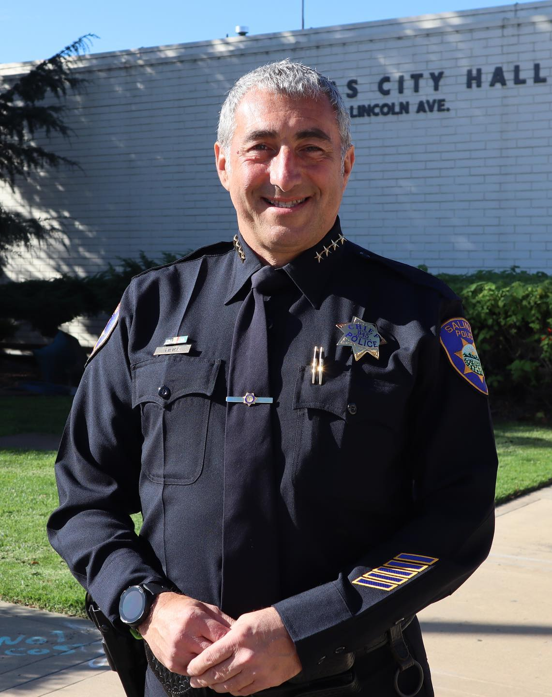


Police Officer Staffing and
Call Prioritization
“We can do anything, but we can’t do everything and still keep our community the safest it can be.”
January 9, 2023
Presenter:
Chief Roberto Filice

Slide 2
Current staffing levels (as of 1/1/2023)
18 Officer Vacancies (14 funded and 4 frozen)
143 Sworn Positions Filled
        This does not include the 11 Sworn positions permanently eliminated as part of the FY 23 Budget process
        4 Recruits in Academy
        3 Officers in Field Training
        12 Officers out on Medical (Total Disability or Light Duty)
        5 Officers out on Protected Leave
Only 119 Fully Trained Officers on Duty

Slide 3
Officer departures at spd
        Since July 1, 2019, the Police Department has lost 46 Sworn Officers
        13 Officers resigned to accept a position with another jurisdiction
        4 Officers retired to pursue a career outside of law enforcement (construction, real estate, etc.)
        Officers are retiring with less years of service:
          FY 20 Average: 26.1 years of service
          FY 21 Average: 22.6 years of service
          FY 22 Average: 20.4 years of service

Slide 4
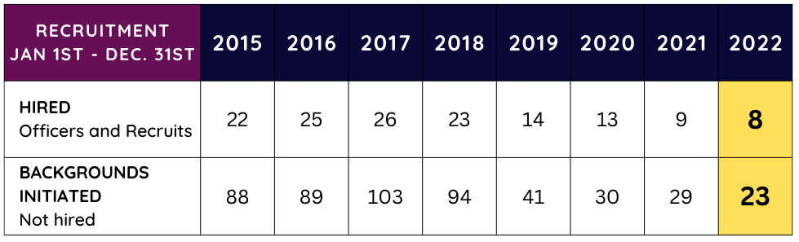
Recruitment challenges
        Applicants for Police Officer and Police Recruit positions continue to decline in quantity and quality
        Between January 2014 and May 2022, the City of Salinas received 2,603 applications for sworn police officer positions

Slide 5
Moving forward
        SPD is at critical staffing levels and data indicates this trend will be ongoing
        SPD must implement a Police Call Prioritization and Call Response Strategy to ensure in-person police officer response is dedicated to the highest priority calls
        Some calls for service will receive a delayed or alternate response

Slide 6
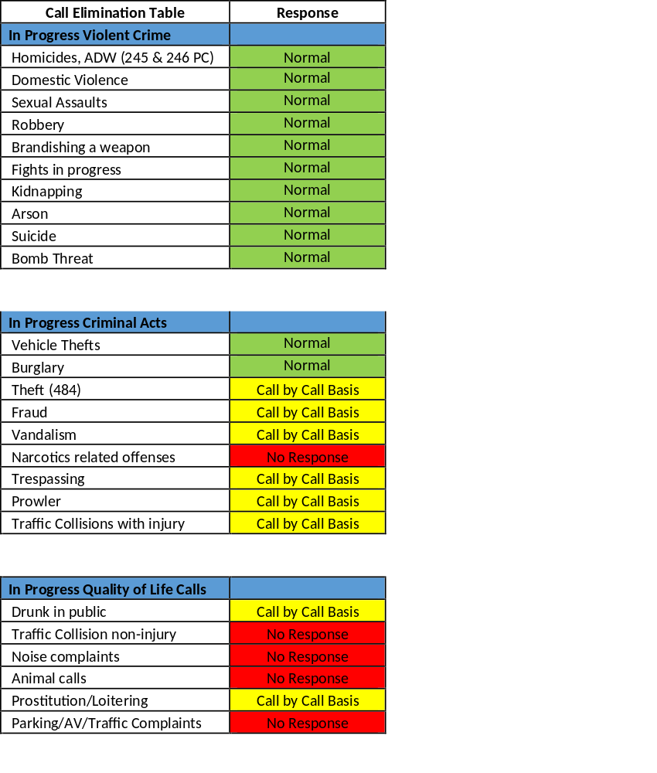



NEW PRIORITIZATION AND CALL RESPONSE
Call Elimination Tables & Response

Slide 7
IN CLOSING
        The decision to implement these changes was taken after careful consideration and consultation with sworn staff
        We must address our retention and recruitment challenges with a multi-prong approach strategies
        Thank you for your ongoing support of the brave men and women who serve our community – your support is critical

