Slide 1

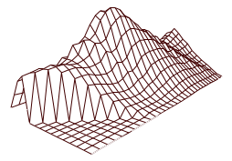
City of Salinas Redistricting
Public Hearing #4
Post-2020 Census Redistricting not Necessary
March 8, 2022
Shelley Lapkoff, Ph.D. & Jeanne Gobalet, Ph.D. LAPKOFF & GOBALET DEMOGRAPHIC RESEARCH, INC. www.demographers.com Oakland and Saratoga, California

Slide 2
What is Redistricting?
Every 10 years, cities must redistrict (adjust Council District boundaries to equalize total populations) using the new Census counts
Federal and state laws apply
Cities must adopt new boundaries before
April 17, 2022
The new Council Districts will be used until after Census 2030 data are released

Slide 3
Legal guidelines that demographers follow:
Federal Law & Supreme Court Decisions:
        Population equality
        Voting Rights Act
        No Racial Gerrymandering
California Fair Maps Act (AB 849, 2019), as amended by
AB 1276 (2020):
        Required Redistricting criteria
        Public outreach

Slide 4
#1 Redistricting Priority: Population Equality
Council Districts need to be nearly equal in population (some leeway is permitted)
Ideal district population = 1/6 of the 2020 Census population
  City of Salinas=164,231 total population; 1/6=27,372 is ideal Council District population
Plan deviation = Difference between the least and most populous districts, divided by the ideal trustee population
  10% deviation is permitted = 2,737 persons (27,372 x 10%)

Slide 5
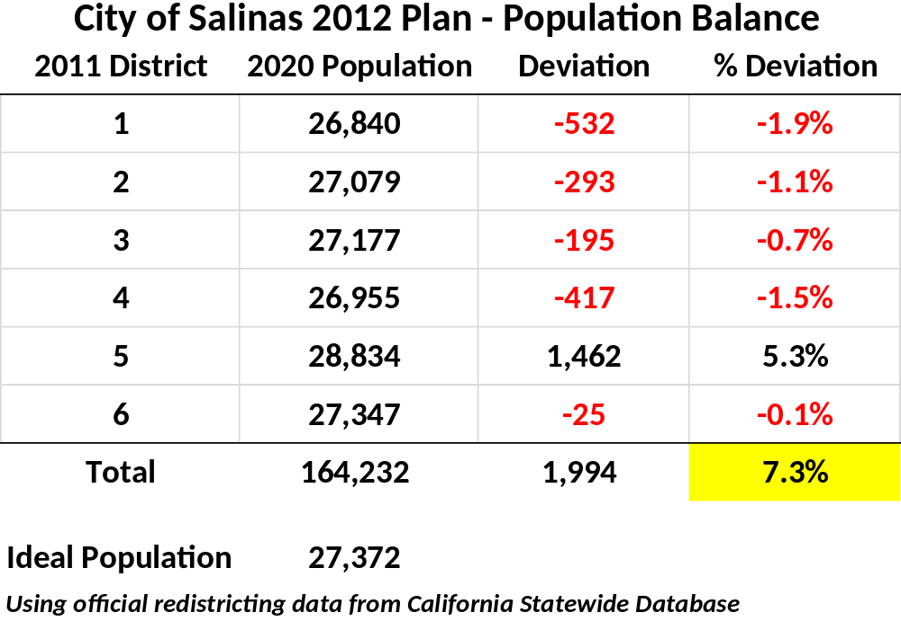
Current Council Districts Populations (Official 2020 Redistricting Data)

Slide 6
California’s FAIR MAPS Act (AB 849, 2019) applies to cities and counties. It requires that cities:
Encourage residents to participate in the redistricting process by
        Maintaining a redistricting website for 10 years
        Providing translation services upon request
        Offering multiple ways for the public to provide testimony and feedback (in writing and electronically)

Slide 7
California’s FAIR MAPS Act (AB 849, 2019) continued
Hold at least 4 public hearings, with specific protocols:
    At least one meeting held before demographers begin to draft maps
    At least one meeting after 6 pm or on a weekend
    Meetings have definite start times
    5 days notice for public hearings; adopted plan must be published and available 7 days prior to adoption

Slide 8
Next Steps
If the Council wishes, current districts may be used without adjustment until after Census 2030
Tonight’s hearing is the last of the four required public hearings
The Council should pass a resolution documenting its decision
Demographer/Staff will notify the Registrar of Voters about the Council’s decision

Slide 9
Questions?

Slide 10
Appendix

Slide 11
Current Plan: Council District 1

Slide 12
Current Plan: Council District 2

Slide 13
Current Plan: Council District 3

Slide 14
Current Plan: Council District 4

Slide 15
Current Plan: Council District 5

Slide 16
Current Plan: Council District 6

Slide 17
Definitions
Redistricting | Adjusting election district boundaries to equalize total populations. Required after each new U.S. Census.
Community of interest | Geographical area where people share common social and economic interests and should be in a single election district or be considered when drawing boundaries.
Advisory Redistricting Commission (ARC) | Appointed group that recommends a redistricting plan to the governing body
Population equality | Districts need to have (almost) equal Census 2020 populations
Voting Rights Act | Federal law that protects minority voting rights
Gerrymander | To design odd-shaped election districts to achieve a purpose like reducing minority voting power or increasing a political party’s representation
Deviation/plan deviation | A measure of how equal the Districts’ total populations are
Redistricting criteria | Required and optional guidelines to consider when drawing boundaries

