Slide 1

City of Salinas
Audit Presentation
Fiscal Year Ended June 30, 2021
Presented by:
Patricia Kaufman, CPA Audit Partner & Jacinto Acosta Bernal, Audit Manager

Slide 2
Reports Issued
Audited Basic Financial Statements
Single Audit Report
Required Communications Letter

Slide 3
Audit Results and Observations
Basic financial statements
  Unmodified opinion – Best opinion we can give
Single audit
  Unmodified opinion on each of the major federal programs

Slide 4
Required Communication
No new accounting policies adopted.
Noted no transactions entered into by the governmental unit that lacked authoritative guidance or consensus.
All significant transactions have been recognized in the proper period.
Accounting estimates - deemed appropriate.
Significant financial statement disclosures – deemed neutral, consistent and clear.
Encountered no difficulties in dealing with management. Expanded time commitment was required.

Slide 5
Required Communication - Continued
Corrected all material misstatements; uncorrected misstatements were deemed immaterial individually and in the aggregate.
No disagreements with management arose during our audit.
Management will provide us with certain representations prior to finalizing report.
No consultations with other accountants.
Other Matters – Reporting on RSI and Supplementary Information (Not Audited).

Slide 6
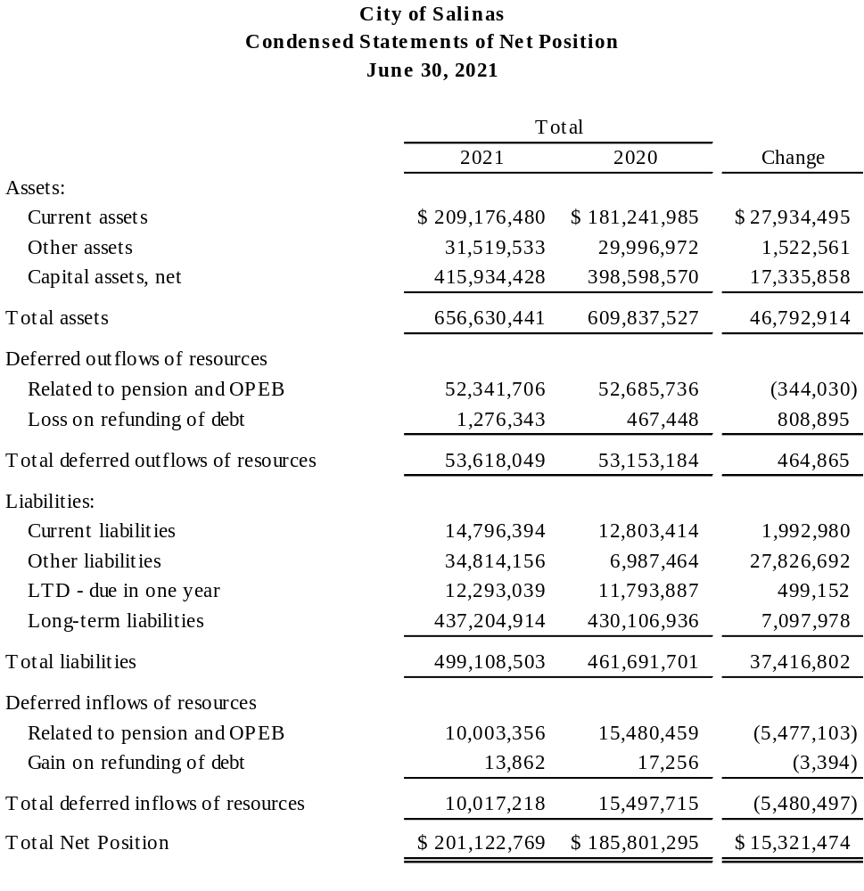

Slide 7
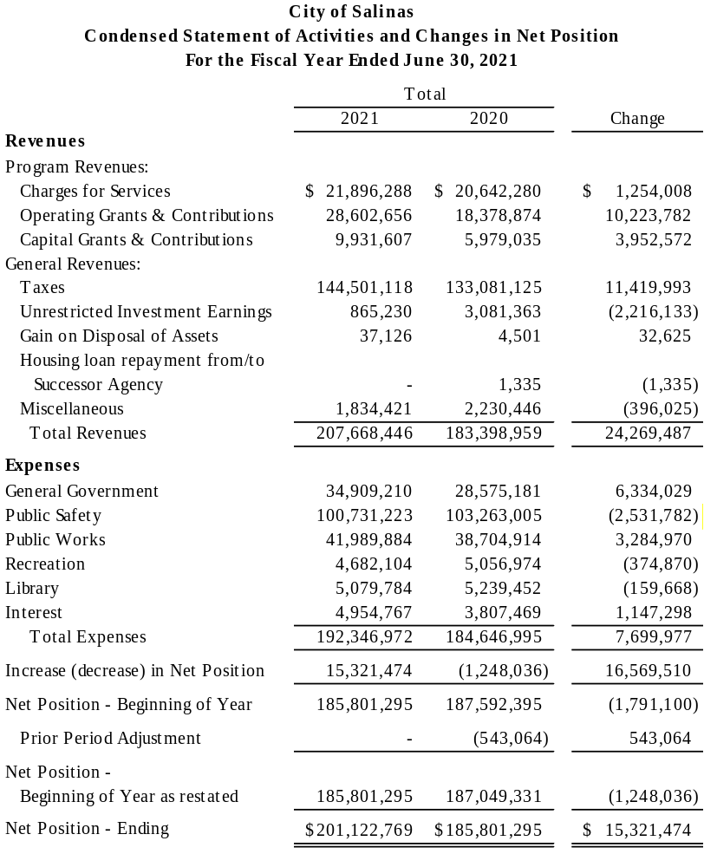

Slide 8
Yellow Book Report
(Government Auditing Standards)
Management Letter
Material Weakness:
  Internal controls over performing the accounting period close were not applied consistently over the prior year.

Slide 9
Major Programs
CDBG – Entitlement Cluster (CFDA 14.218)
  $1,683,461 Federal Expenditures
  $963,767, Provided to Subrecipients
Edward Byrne Memorial Justice Assistance Grant Program (CFDA 16.738)
  $220,459 Federal Expenditures
  $22,615 Provided to Subrecipients
COVID-19 Coronavirus Relief Fund (CFDA 21.019)
  $2,002,977 Federal Expenditures
COVID-19 Emergency Rental Assistance Program (CFDA 21.023)
  $816,245 Federal Expenditures

Slide 10
Compliance Report
Single audit –
  Unmodified opinion on each of the major federal programs
The compliance report addresses findings related to your internal control structure, laws and regulations, and federal grant requirements – The following were considered material weaknesses:
  Allowable Costs and Activities, Eligibility Compliance and Control Finding
  Special Tests – Compliance and Control Finding
  Subrecipients – Compliance and Control Finding

Slide 11

Questions
Thank you!

