Slide 1

PUBLIC HEARING:
PUD 2020-002, CUP 2020-030, TM 2022-001, AND ER 2020-018 (IS-MND) LOCATED SOUTHEAST OF THE JOHN STREET AND ABBOTT STREET INTERSECTION IN THE CO – FG-4 (COMMERCIAL OFFICE – ABBOTT STREET FOCUSED GROWTH OVERLAY) AND IG (INDUSTRIAL – GENERAL) ZONING DISTRICT
Bobby Latino, Associate Planner
Community Development Department
Salinas City Council
Tuesday, June 11, 2024

Slide 2
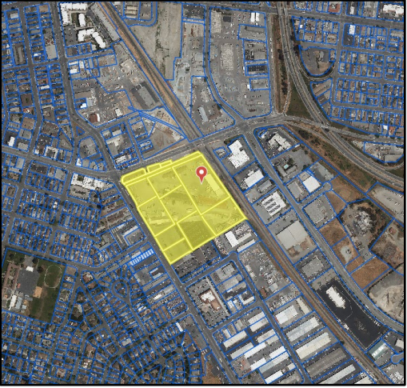
Background
PUD for a seven-phase, Mixed Use Development
CUP for MU Development in the CO Zoning District
CUP for 70,000 square-foot Extended Stay, Hotel with 111 guest rooms (Phase 1)
TM to reconfigure 14 lots into 9 lots

Slide 3
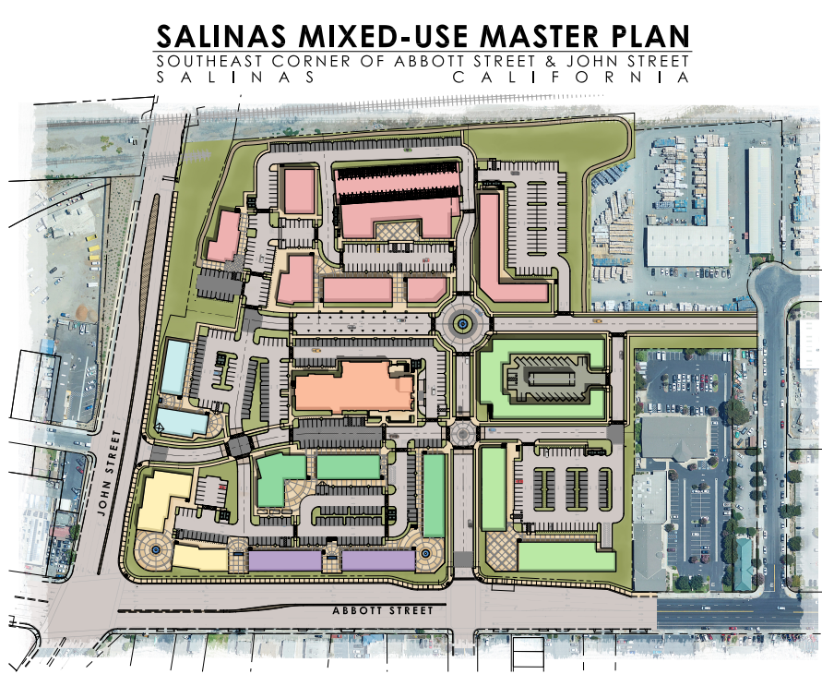
PUD
Modifies following requirements:
  Off-street parking (except Hotel)
  Usable Open Space
  3 & 4 -Bedroom mix
  Hotel siting on street
  Reduces or eliminates 5’ parking lot island dimension

Slide 4
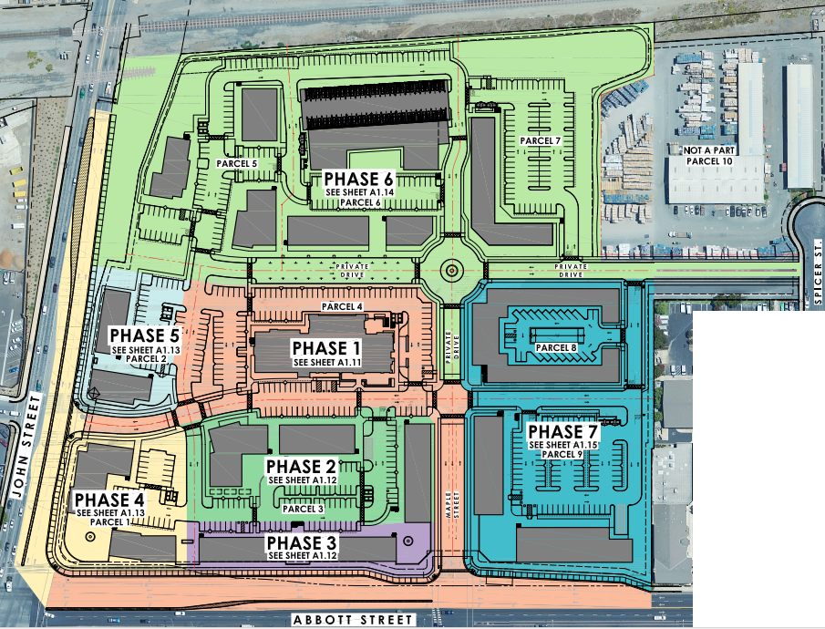
Seven Phases

Slide 5
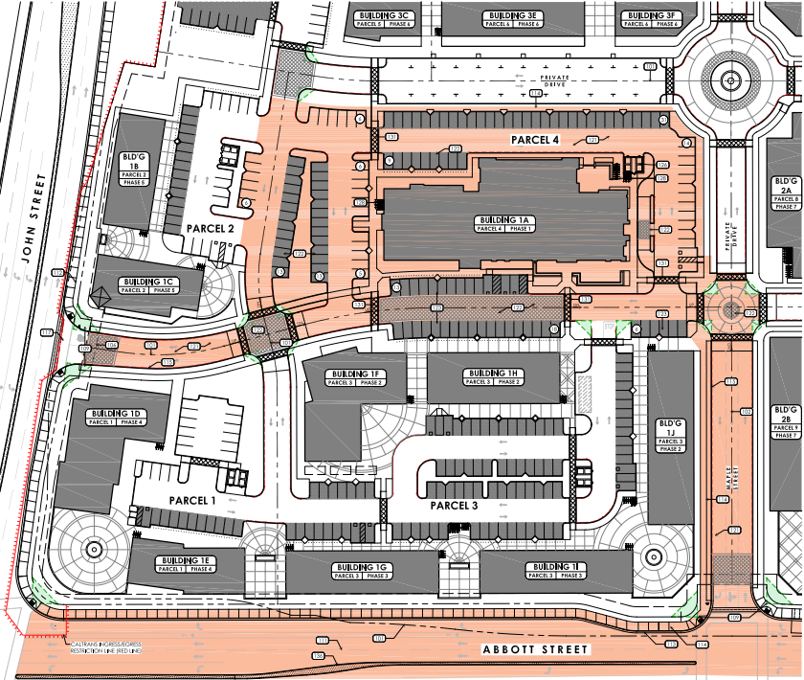
Phase 1
Conditions of approval:
  Extension of Maple Street private drive
  Temporary landscaping improvements along John and Abbott Street frontages
  Phase I Landscape Plan
  Compliance with on-site and off-site improvements
  Compliance with Noise Memorandum
  Compliance with Extended Stay Hotel regulations
Notes:
Abbott Street improvements, demonstration of compliance w/ Cal trans (encroachment permit required) with Maple St. signalization and dedication of ROW to City for appropriate turn lane onto John Street. Right-only turn onto John Street from private drive.
Per Bldg. Code habitable rooms cannot exceed 45 db. Site is in contour range of 65 db.
Max. stay = 10 months
Off-street-=1.25 per guest room and 1 per 50 s.f. of banquet area
Floor area = 150 s.f. per room w/ toilet, sink, shower/tub
Common area = 500 s.f.
Laundry = ind. Or common w/ at least 1 dryer/washer per 25 rooms

Slide 6
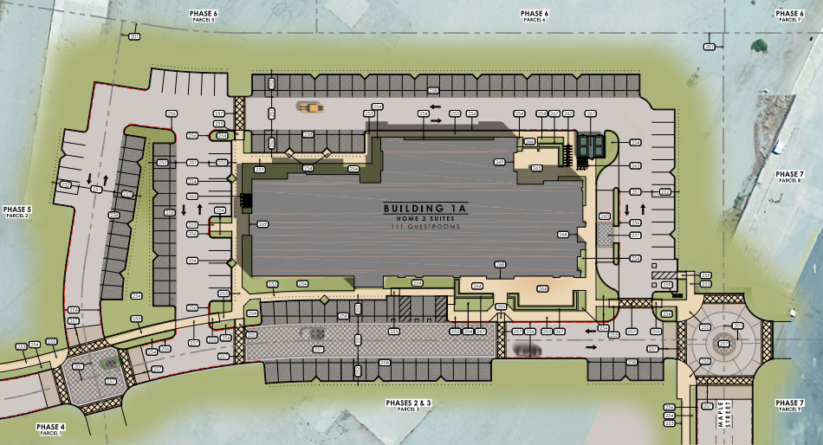
Extended Stay Site Plan

Slide 7
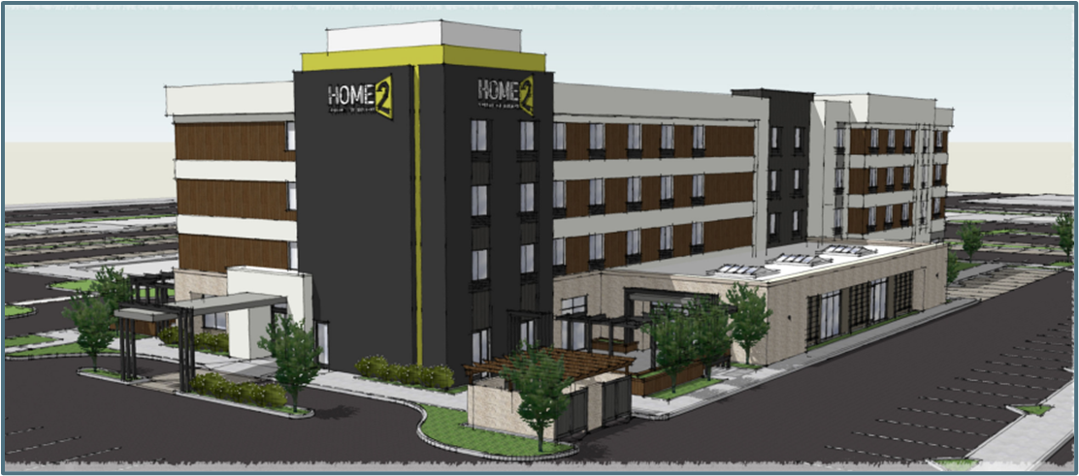
Extended Stay Hotel Rendering

Slide 8
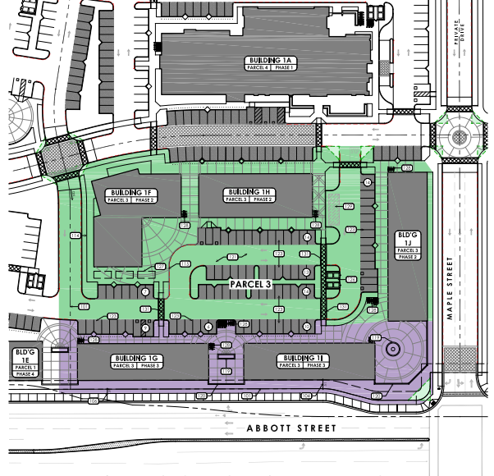
Phase 2
MU development with 3 buildings
  On a 3-acre lot shared with Phase 2
  Approx. 23,000 s.f.,
  Approx. 12,200 s.f.
  Approx. 15,000 s.f.
  Approx. 28 dwelling units
  Subject to subsequent administrative SPR for compliance with PUD

Slide 9
Phase 3
MU development with 2 buildings
  On a 3-acre lot shared with Phase 2
  Both approx. 6,400 s.f.
  Retail and office uses
  Subject to subsequent administrative SPR for compliance with PUD

Slide 10
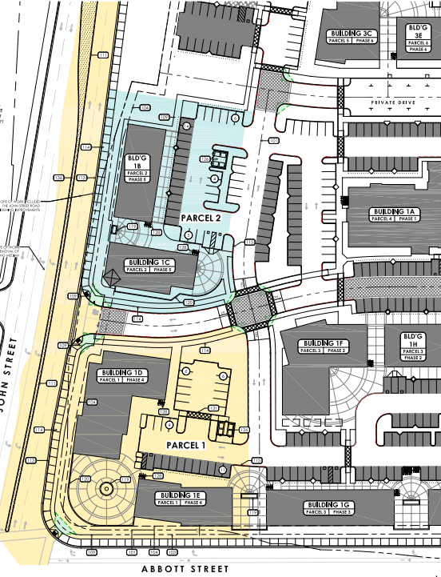
Phase 4
MU development with 2 buildings
  On a 1.3-acre lot.
  Approx. 8,500 s.f.
  Approx. 5,500 s.f.
  Retail uses
  John Street off-site improvements
  Subject to subsequent administrative SPR for compliance with PUD

Slide 11
Phase 5
MU development with 2 buildings
  Both approx. 5,500 s.f.
  Retail uses.
  On a 1.1-acre lot.
  Subject to subsequent administrative SPR for compliance with PUD

Slide 12
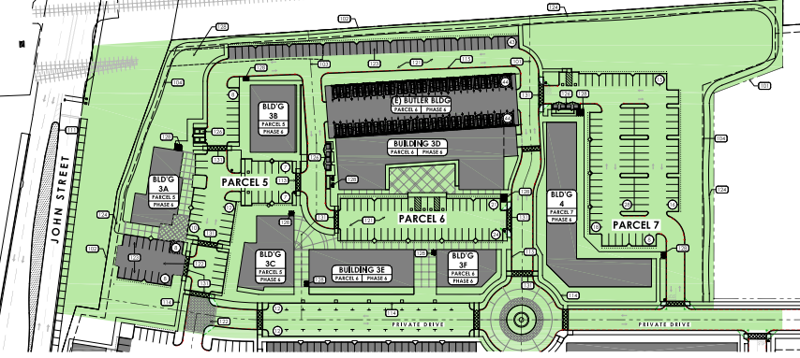
Phase 6
MU development with 6 buildings
  On 3 lots totaling 6.5 acres
  Spicer Street private drive extension
  Approx. 128,000 s.f. of mixed retail/residential uses.
  Approx. 51,000 s.f. residential.
  Subject to subsequent administrative SPR for compliance with PUD

Slide 13
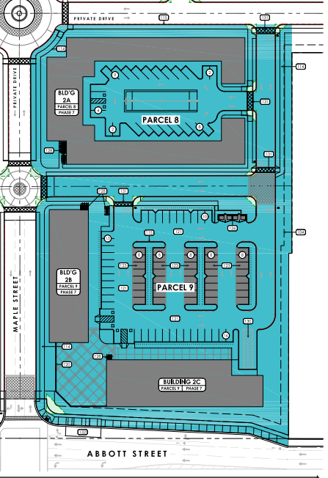
Phase 7
MU development:
  Upon development, requires amendment to CUP 2018-010 (remove (e) SVMH parking lot from this site).
  On 2 lots totaling 4.4 acres
  1 residential building:
    Approx. 83,800 s.f.
  2 retail/office bldgs.
    Approx. 17,000 s.f.
    Approx. 20,800 s.f.
  Subject to subsequent SPR for compliance with PUD.

Slide 14
Seven Phases

Slide 15
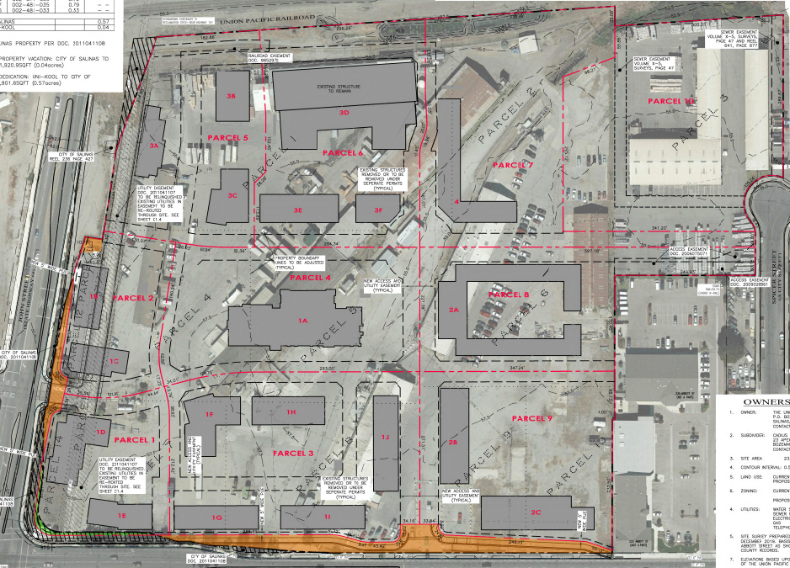
Tentative Map
Reconfigure 14 lots into 9 lots.
Final Map approval required by CC and recordation prior to issuance of BPs.
Notes:
All privately owned lands and private easements, together with their associated improvements, will be maintained through a Common Area Maintenance Agreement .

Slide 16
Analysis
General Plan:
  Consistent with GP Policies: LU-1.1, LU-1.2, LU-2.1, LU-2.4, LU-2.5, LU-3.7, and LU-3.8.
Zoning Code:
  CO zoning provides areas for offices, personal services, financial services, mixed use residential, and residential uses.
  FG-4 is to focus growth at high potential, under-utilized sites:
  Density under current zoning: net density of 10 dwelling units per net acre, or approx. 197 dwelling units.
    However, the General Plan Update (currently underway), may ultimately increase allowable density on the project site. Therefore, the IS-MND analyzed additional density of up to 242 dwelling units, if permitted in the future.
Notes:
LU-1.1 = balanced land use pattern by mix of uses in under utilized area
LU-1.2 = accommodate projected growth by developing 242 dwelling units
LU-2.1 = min. growth impacts to Agric. By infill dev.
LU-2.4 = infill dev by within focused growth overlay and maintain compact city form
LU-2.5 = no neg. impact to future growth and env. With IS/MND demonstrating no significant impacts and mit. Measures.
LU-3.7 = rev. comm. And ind. Area by dev. Comm/ res. Along Abbott an rev. (e) comm. Area.
LU-3.8 = encourage production of essential worker housing by providing 242 dwelling units to serve essential worker pop.
FG-4 = Provide standards that will enhance the city and its neighborhoods. Create incentives for mixed use neighborhoods that are active, pedestrian-friendly, safe, and welcoming.

Slide 17
Analysis
Affordable Housing Plan
  Project exceeds 10 dwelling units, therefore, subject to the Inclusionary Housing Ordinance.
  Applicant commits to offering the appropriate amount of residential rental units to the Section 8 Housing Choice Voucher Program (8% very low and 4% lower income) based on total number of units allowed per the density calculations.
    These units would be evenly distributed among the different unit types in the development and throughout the different phases in the development.
  The applicant would also pay a Rental Housing Impact Fee for production of off-site affordable units.
  No deed restriction is required.

Slide 18
Analysis
Environmental impacts of the project have been analyzed in accordance with CEQA.
An IS was prepared and based upon review of the IS, the proposed project will not have a significant effect on the environment because of the mitigation measures outlined in the MMRP.
Traffic and Transportation Commission recommended approval on 3-9-23.
Planning Commission recommended CC approval on 5-29-24.
Housing and Land use Committee recommended CC approval on 6-4-24.
Notes:
The IS-MND was routed to responsible agencies on 2-10-23 and posted at the County Clerk’s Office on 2-10-23; deadline for comments was 3-13-23. State Clearinghouse received the document on 2-10-23; the deadline for Clearinghouse comments was 3-13-23 (SCH Number 20223020282).
AQ-1 = Prior to issuance of grading permits, the following measures shall be implemented:
All mobile off-road equipment (wheeled or tracked) greater than 50 horsepower used during construction activities shall meet the USEPA Tier 4 interim standards. Tier 4 certification can be for the original equipment or equipment that is retrofitted to meet the Tier 4 interim standards.
Alternative Fuel (natural gas, propane, electric, etc.) construction equipment shall be incorporated where available. These requirements shall be incorporated into the contract agreement with the construction contractor. A copy of the equipment’s certification or model year specifications shall be available upon request for all equipment on-site.
Electricity shall be supplied to the site from the existing power grid to support the electric construction equipment. If connection to the grid is determined to be infeasible for portions of the project, a non-diesel fueled generator shall be used.
The project would comply with the CARB Air Toxics Control Measure that limits diesel powered equipment and vehicle idling to no more than five minutes at a location, and the CARB In-Use Off-Road Diesel Vehicle Regulation; compliance with these would minimize emissions of TACs during construction.
BIO-1 = For all phases of the proposed project that contain trees, construction, grading, site preparation and other ground disturbance activities required for future development, including vegetation or tree removal, shall not occur during the general avian nesting season (February 1 – August 31), if feasible. If breeding season avoidance is not feasible, the applicant shall retain a qualified biologist, as approved by the City of Salinas, to conduct a preconstruction nesting bird survey to determine the presence/absence, location, and status of nests on or adjacent to the project site. The extent of the survey buffer area surrounding the site shall be established by the qualified biologist to ensure that direct and indirect effects to nesting birds are avoided. To avoid the destruction of active nests and to protect the reproductive success of birds protected by the CFGC, nesting bird surveys shall be performed not more than 14 days prior to scheduled vegetation clearance. In the event that active nests are discovered, a minimum buffer of 300 feet for raptors and 50-foot radius avoidance buffers for passerines shall be established around such active nests and no construction or personnel shall be allowed within the buffer areas until a qualified biologist has determined that the nest is no longer active (e.g., the nestlings have fledged and are no longer reliant on the nest). No ground disturbing activities shall occur within this buffer until the qualified biologist has confirmed that breeding/nesting is completed, and the young have fledged the nest. Nesting bird surveys are not required for construction activities occurring between September 1 and January 31.
CUL-1 = If archaeological resources are encountered during ground-disturbing activities, work within 50 feet shall be halted and the project archaeologist meeting the Secretary of the Interior’s Professional Qualification Standards for archeology (National Park Service 1983) shall be contacted immediately to evaluate the find pursuant to Public Resources Code Section 21083.2. If necessary, the evaluation may require preparation of a treatment plan and archaeological testing for CRHR eligibility. If the discovery proves to be significant under CEQA and cannot be avoided by the project, additional work may be warranted, such as data recovery excavation, to mitigate any significant impacts to significant resources. If the resource is of Native American origin, implementation of Mitigation Measures TCR-1 may be required. Any reports required to document and/or evaluate unanticipated discoveries shall be submitted to the City for review and approval and submitted to the NWIC after completion. Recommendations contained therein shall be implemented throughout the remainder of ground disturbance activities.
HAZ-1 = Prior to issuance of a grading permit, the project applicant shall retain a qualified environmental professional (EP), as defined by the American Society of Testing and Materials (ASTM) E-1527, to prepare a Phase I ESA in accordance with standard ASTM methodologies to assess the project site (including development Lots 4, 5, and 6). The project applicant shall submit the Phase I ESA to the Central Coast RWQCB project manager of the open Cleanup Program Site case. Additionally, the project applicant shall submit the following documents to the Central Coast RWQCB Cleanup project manager:
Current development plan and any modifications to the development plan for Lots 1-9
All environmental documents completed for the project (Lots 1-9), including this HMTS
All future environmental documents completed for the project (Lots 1-9)
Upon submittal of the information above, the Central Coast RWQCB may require actions such as: development of subsurface investigation workplans; completion of soil, soil vapor, and/or groundwater subsurface investigations; installation of soil vapor or groundwater monitoring wells; soil excavation and offsite disposal; completion of human health risk assessments; and/or completion of remediation reports or case closure documents. Subsurface soil, soil vapor, and groundwater investigations, if required, shall be conducted in accordance with a sampling plan that shall be reviewed and approved by the Central Coast RWQCB.
The Central Coast RWQCB closure and agency approval documents shall be submitted and reviewed by the City prior to issuance of grading permits.
It should also be noted that the Central Coast RWQCB may determine that Monterey County HMMS or the DTSC may be best suited to perform the cleanup oversight agency duties for the assessment and/or remediation of this project. Should the cleanup oversight agency be transferred from the RWQCB to the Monterey County HMMS or the DTSC, this and other mitigation measures will still apply.
HAZ-2 = The project applicant shall retain a qualified environmental consultant (Professional Geologist [PG] or Professional Engineer [PE]) to prepare subsurface investigations, as required by the Central Coast RWQCB, prior to construction. The subsurface investigations may include sampling of the following suspect release areas:
Stained asphalt and concrete flooring
Drainage trench with unlined effluent ponds and discolored fluids
Onsite hazardous materials storage and abandoned unidentified wastes
Onsite ASTs (waste oil and ammonia)
Former onsite USTs
Former onsite auto repair, machine shop, and gasoline station
Former (potentially remaining onsite) railroad tracks and spurs
Former oil storage warehouse
Additionally, these subsurface investigations may include, but are not limited to, completion of:
Geophysical surveys
Soil, soil vapor, and/or groundwater sampling assessments
Laboratory analysis for TPH, VOCs, SVOCs, OCPs, and metals
The subsurface investigations shall provide recommendations to address identified hazards and indicate when to apply those recommended actions in relation to proposed project activities. As part of the subsurface investigation, analytical results shall be screened against the San Francisco Bay RWQCB environmental screening levels (ESLs). These ESLs are risk-based screening levels for direct exposure of a construction worker under various depth and land use scenarios.
Appropriate steps shall be undertaken to protect site workers during project construction and if necessary, the public during project operation. This would include the preparation of a Soil and Soil Vapor Management Plan (see Mitigation Measure HAZ-3).
If contaminants are detected at concentrations exceeding hazardous waste screening thresholds for contaminants in soil (CCR Title 22, Section 66261.24), appropriate steps shall be undertaken to protect site workers during project construction and if necessary, the public during project operation (see Mitigation Measures HAZ-3, HAZ-4, and HAZ-5).
HAZ-3 = The project applicant shall retain a qualified environmental consultant (PG or PE) to prepare a Soil and Soil Vapor Management Plan (SSVMP) prior to construction. Where groundwater impacts are identified during implementation of Mitigation Measure HAZ-2, a groundwater management section shall be added to the SSVMP. The SSVMP, or equivalent document, shall be prepared to address onsite handling and management of impacted soils, soil vapor, or other impacted wastes, and reduce hazards to construction workers and offsite receptors during construction. The plan must establish remedial measures and/or soil management practices to ensure construction worker safety, the health of future workers and visitors, and the offsite migration of contaminants from the site. These measures and practices may include, but are not limited to:
Stockpile management including stormwater pollution prevention and the installation of Best Management Practices (BMPs)
Proper disposal procedures of contaminated materials
Monitoring and reporting
A health and safety plan for contractors working at the site that addresses the safety and health hazards of each phase of site construction activities with the requirements and procedures for employee protection
The health and safety plan will also outline proper soil handling procedures and health and safety requirements to minimize worker and public exposure to hazardous materials during construction.
Prior to demolition and grading (construction), the City shall confirm the Central Coast RWQCB’s approval of the SSVMP. The project applicant shall review and implement the SSVMP prior to demolition and grading (construction).
If odorous or visually stained soils, other indications of hydrocarbon piping or equipment, or debris are encountered during ground-disturbing activities, work in the immediate area shall be halted and a qualified environmental consultant shall be contacted immediately to evaluate the situation. Work may continue on other parts of the project while impacted soil investigation and/or remediation takes place.
HAZ-4 = Where soil is known to be impacted, or is identified during implementation of Mitigation Measure HAZ-2 (subsurface investigation) to be present, within the construction envelope at chemical concentrations exceeding hazardous waste screening thresholds for contaminants in soil (CCR Title 22, Section 66261.24), the project applicant shall retain a qualified environmental consultant (PG or PE), to conduct additional analytical testing and recommend soil disposal recommendations, or consider other remedial engineering controls, as necessary.
The qualified environmental consultant shall utilize the development site analytical results for waste characterization purposes prior to offsite transportation or disposal of potentially impacted soils or other impacted wastes. The qualified environmental consultant shall provide disposal recommendations and arrange for proper disposal of the waste soils or other impacted wastes (as necessary), and/or provide recommendations for remedial engineering controls, if appropriate.
Remediation of impacted soils and/or implementation of remedial engineering controls may require additional delineation of impacts; additional analytical testing per landfill or recycling facility requirements; soil excavation; and offsite disposal or recycling.
The City shall confirm the Central Coast RWQCB’s approval of the development site disposal recommendations prior to transportation of waste soils offsite and review and approve remedial engineering controls, prior to construction. The project applicant shall review and implement the disposal recommendations prior to transportation of waste soils offsite and review and implement the remedial engineering controls prior to construction.
HAZ-5 = Where soil vapor is known (or is identified during implementation of Mitigation Measures HAZ-2, HAZ-3, or HAZ-4) to be present at chemical concentrations exceeding the ESLs for sub-slab/soil gas (vapor) intrusion, the project applicant shall retain a qualified environmental consultant (PG or PE) or other qualified person to prepare a vapor mitigation system design for the proposed project.
The plan shall include, but is not limited to:
Design specifications
Material specifications
Installation requirements
Monitoring requirements
The project applicant shall design and implement engineering measures or institutional controls (e.g., soil vapor barrier) to prevent potential soil vapor intrusion into new residences or businesses in accordance with the measures included in the DTSC’s Vapor Intrusion Guidance Document – Final (October 2011) and Vapor Intrusion Mitigation Advisory, Revision 1 (October 2011).
Engineering measures or institutional controls shall be submitted to the City’s Permit Services Division and Current Planning Division prior to the issuance of any grading or building permits. Said engineering measures and institutional controls shall be peer reviewed by a qualified third-party contractor hired by the City at the project applicant’s expense to confirm such measures and controls comply with applicable regulations.
Consultation with the DTSC or a local cleanup agency may be required to confirm the appropriateness of the measures and controls.
The project applicant and/or contractor shall retain a qualified professional to certify that the accepted measures and controls are properly constructed and functioning at each residence. Written verification shall be submitted to the City.
The efficacy of the measures and controls shall be confirmed and certified by a qualified professional pursuant to the construction quality assurance/quality control testing guidance of the DTSC’s Vapor Intrusion Guidance Document – Final (October 2011).
The project applicant and contractor shall incorporate a sub-slab vapor barrier during construction, the implementation of which would prevent the potential for soil gas VOCs from migrating to indoor air.
The City shall confirm the Central Coast RWQCB’s approval of the Vapor Mitigation System Design prior to construction. The project applicant shall review the Vapor Mitigation System Design and install the system during construction.
TRA-1 = The applicant for future office use development shall prepare and implement a VMT Reduction Program that reduces VMT generated by the office components of the project to VMT per employee of 6.6 or less. The VMT Reduction Program shall be reviewed and approved by the City prior to approval of permits for proposed office uses. The strategies shall include the following:
Reduce Transit Headways and Improve On-Street Bike Facilities. Queue jump lanes shall be installed for northbound MST buses at the Maple Street and Abbott Street intersection, and bike lanes shall be installed along project site frontages with John Street and Abbott Street. The project applicant shall pay for the cost of installation of queue jump lanes and bike lanes.
Safe and Well-Lit Access to Transit. Office uses shall include pedestrian facility improvements along street frontages, which shall include exterior lighting along project frontages served by transit.
Preferential Carpool/Vanpool Parking Spaces. Office uses shall include reserved carpool/vanpool spaces close to the building entrances based on the City’s parking requirements.
Designated Parking Spaces for Car Sharing Vehicles. Office uses shall provide designated parking spaces for car sharing vehicles.
Bike Charging Facility. Office uses shall include a secure bike charging facility on site.
Pedestrian Network Improvements. Office uses shall involve pedestrian network improvements throughout and around the project site that encourage people to walk.
Multimodal Wayfinding Signage. Office uses shall include multimodal wayfinding signage to orient users to locations of sustainable transportation.
Bicycle Repair Station/Services. Office uses shall include on-site bicycle repair tools and space to use them to support on-going use of bicycles for transportation.
TCR-1 = In the event that cultural resources of Native American origin are identified during grading or construction, all earth disturbing work within the vicinity of the find shall be temporarily suspended or redirected until a qualified archaeologist has evaluated the nature and significance of the find; an appropriate Native American representative, based on the nature of the find, is consulted; and mitigation measures are put in place for the disposition and protection of any find pursuant to Public Resources Code Section 21083.2. If the City, in consultation with local Native Americans, determines that the resource is a tribal cultural resource and thus significant under CEQA, a mitigation plan shall be prepared and implemented in accordance with state guidelines and in consultation with local Native American group(s) prior to continuation of any earth disturbing work within the vicinity of the find. The plan shall include avoidance of the resource or, if avoidance of the resource is infeasible, shall outline the appropriate treatment of the resource in coordination with the appropriate local Native American tribal representative and, if applicable, a qualified archaeologist. Examples of appropriate mitigation for tribal cultural resources include, but are not limited to, protecting the cultural character and integrity of the resource, protecting traditional use of the resource, protecting the confidentiality of the resource, or heritage recovery.

Slide 19
Recommendation
A motion to adopt a Resolution affirming the findings and:
  Adopt the proposed MND and MMRP pursuant to section 15074 of the CEQA Guidelines;
  Approve PUD 2020-002 for seven-phase Master Site Plan and alternative development standards;
  Approve CUP 2022-030 for the Mixed Use Development and the Extended Stay Hotel; and
  Approve a TM 2022-001 to reconfigure 14 lots into 9 lots.

Slide 20
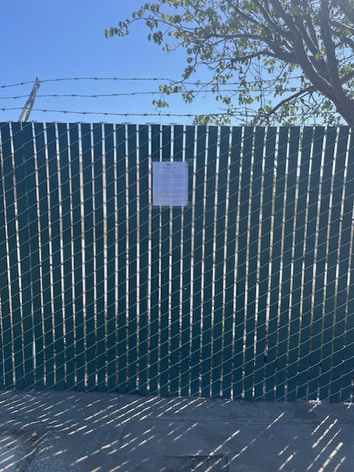
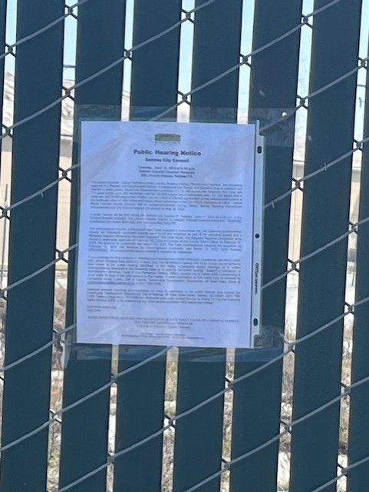
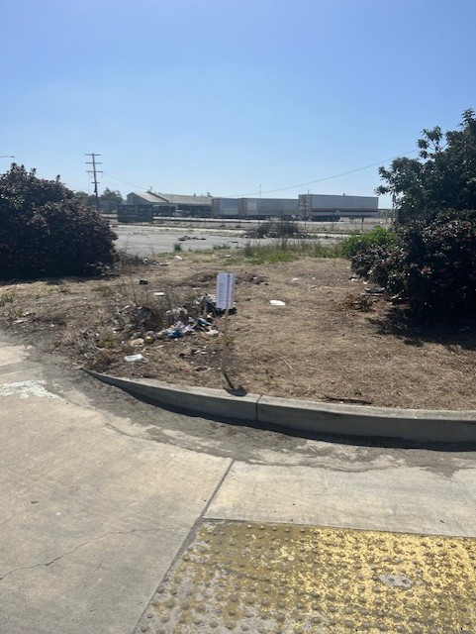
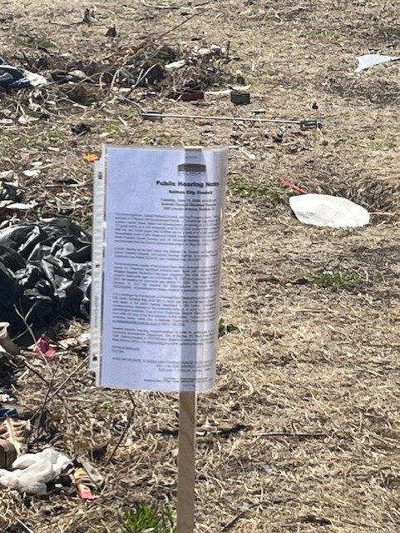
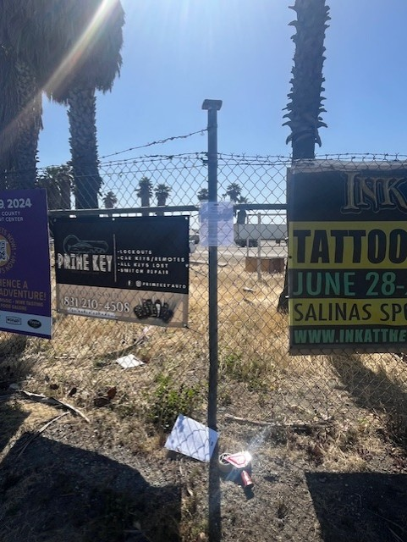
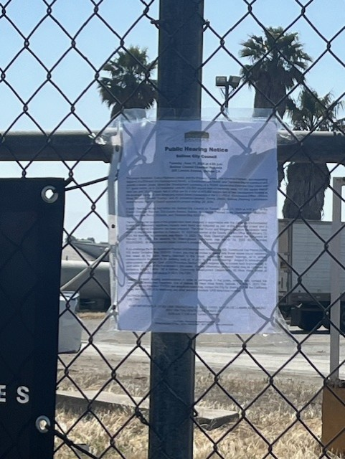
Public Noticing
Posted and Mailed on 5-31-24.
Published in the Monterey County Weekly on 5-20-24.

