Slide 1

2024 HOUSING ELEMENT
ANNUAL PROGRESS REPORT
March 25, 2025
City Council
Luis Rodriguez & Monica-Flores Ponce

Slide 2
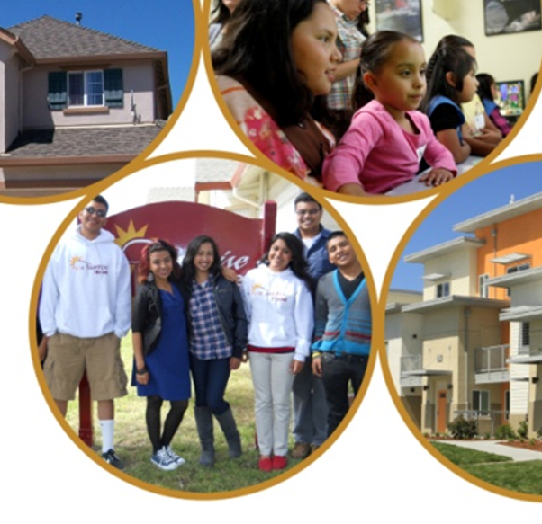
Background
Annual Progress Report provides the City’s accomplishments and programs updates on the General Plan: 2023-2031 Housing Element
Due April 1 , 2025 to:
  California Department of Housing and Community Development (HCD)
  Governor’s Office of Land Use and Climate Innovation (LCI)

Slide 3
6th Cycle Regional Housing Needs Allocation (RHNA) Progress
Income Category | RHNA Goal | 2023 | 2024 | 2025 | 2026 | 2027 | 2028 | 2029 | 2030 | 2031 | Total Units to Date | Total Remaining Units | Achieved
Very Low | 920 |  |  |  |  |  |  |  |  |  | 0 | 920 | 0%
Low | 600 |  |  |  |  |  |  |  |  |  | 0 | 600 | 0%
Moderate | 1,692 |  |  |  |  |  |  |  |  |  | 0 | 1,692 | 0%
Above Moderate | 3,462 | 1 | 221 |  |  |  |  |  |  |  | 222 | 3,240 | 6%
Total RHNA | 6,674 | 1 | 221 |  |  |  |  |  |  |  | 222 | 6,452 | 3%
Notes:
Vincent

Slide 4
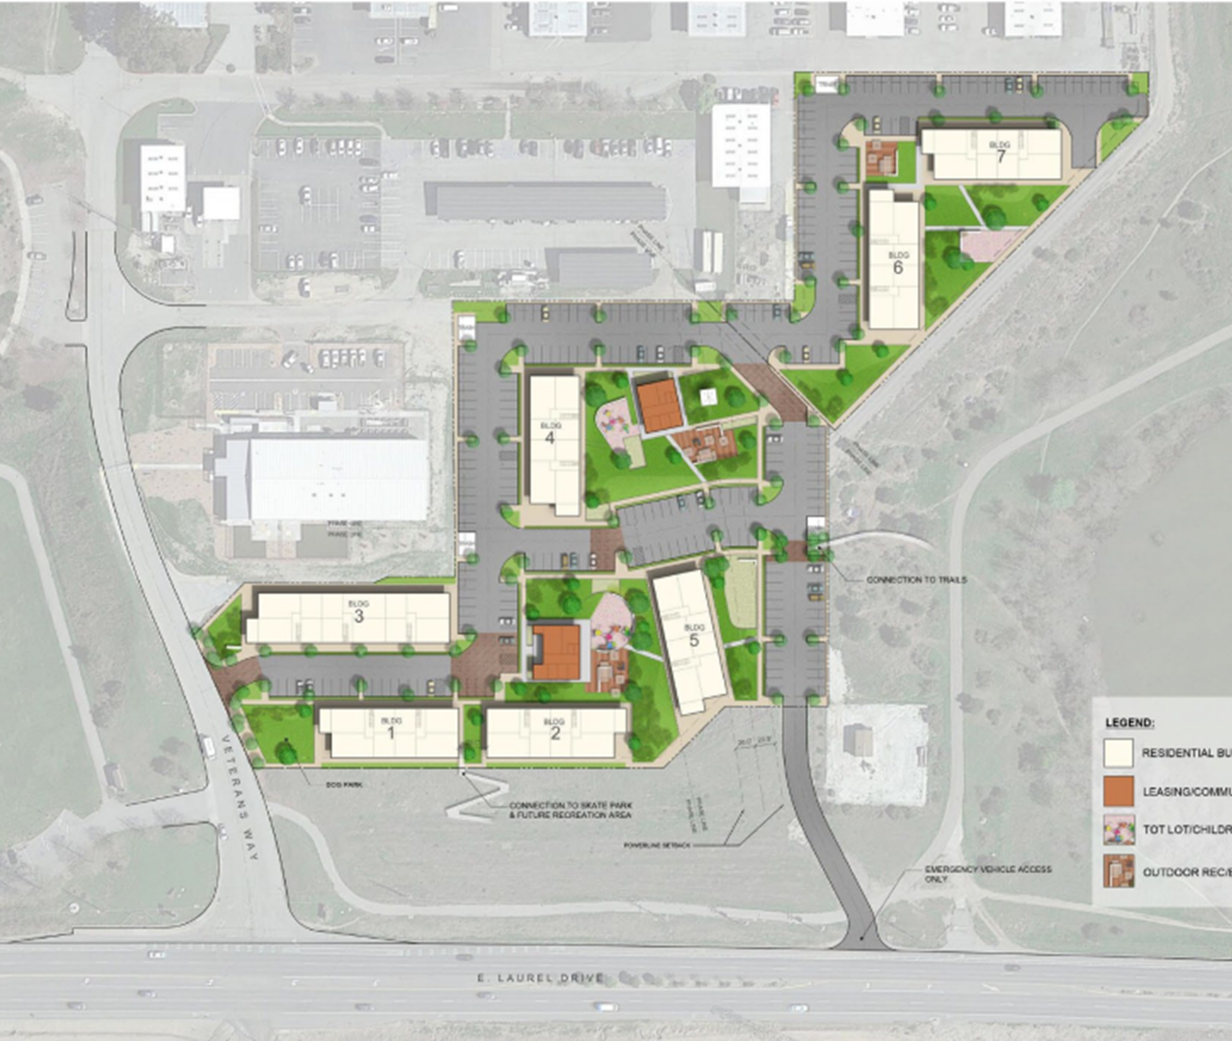
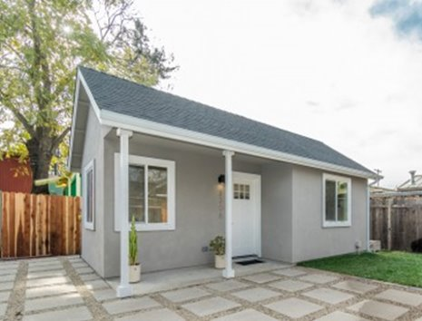
2024
Housing Production Summary
Housing Category | Issued | Units Approved/Finalized
Housing Development Applications | 11 | 0
Building Permits | 221 | 221
Certificates of Occupancy | 115 | 115
Housing Development
ADU's

Slide 5
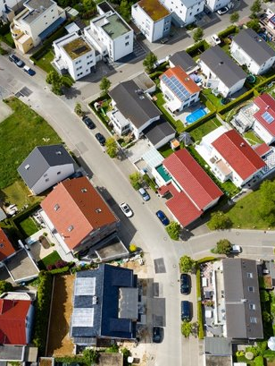
2024 Award Funds
$2.1M - Community Development Block Grant
$0.7M - Home Investment Partnership
Funding Opportunities
Pending Award Notification
Up to $1.6 Million - Local Housing Trust Fund
Up to $1.25 - Prohousing Incentive Program Rd. 3

Slide 6
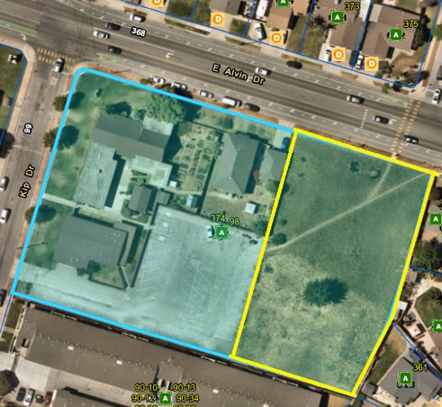
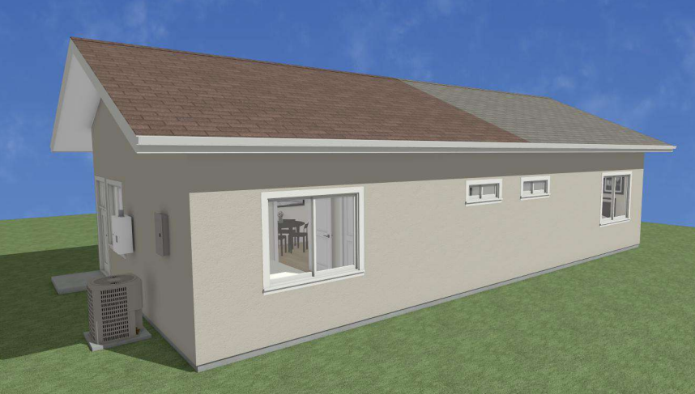
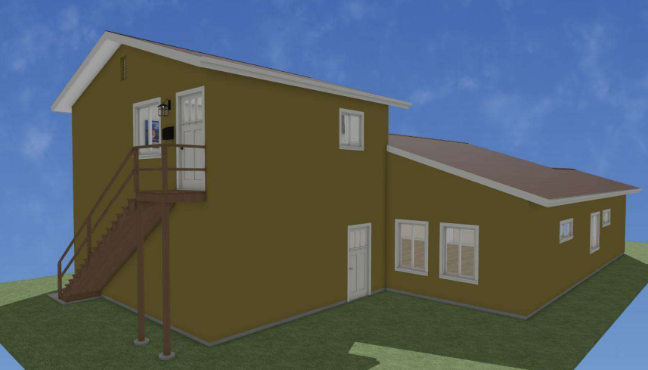
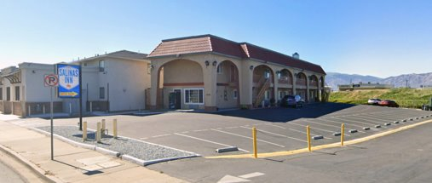
Affordable Housing Projects
Project Details | 98 Kip Dr. | CHISPA ADU’s | Fairview Ave.
Fiscal Year | 2021 | 2020-2021 | 2020
Funding Source | PLHA | PLHA | PLHA, PIP
Funding Awarded | $645,000 | $390,000 | $2,500,000
Affordable Units | 36 | 3 | 45
Status | Land Acquisition | Entitlement in Progress | Property Acquisition
Target Population | Senior | Workforce | Permanent Supportive Housing
Notes:
Senior (60%), Workforce (120%), PSH (30%)
Complete parcel is currently owned by a church. The parcel is getting split and the church will be selling the empty lot to CHISPA for the development of a 100% affordable senior housing project
Rendering for 617 and 619 Fremont St – part of the Wesley Oaks development. They will be detached ADU's for current garages
Rendering for 138 Carr Avenue- part of the Wesley Oaks Development. Will be constructed over the garage of the current home
Former Salinas Inn motel will be acquired by the housing Authority with the support of the City of Salinas and the County of Monterey. Will be a permanent supportive housing project for individuals experiencing homelessness.

Slide 7
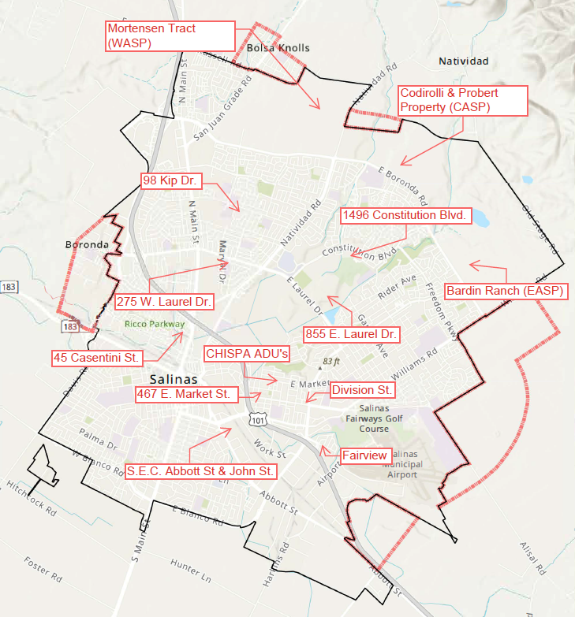
Housing Pipeline
Map

Slide 8
Housing Pipeline
Project | Units | Status | Housing Type
S.E.C. Abbott St & John St | 242 | Approved | Rental / Commercial
467 Market St. | 75 | Entitlement in Progress | Rental (Affordable)
98 Kip Drive | 36 | Land acquisition in Progress | Rental (Affordable)
275 E Laurel | 11 | Entitlement in Progress | Rental (Affordable)
1496 Constitution Blvd | 50 | Approved | Rental (Inclusionary)
200 Casentini St. | 77 | Entitlement in Progress | Rental (Inclusionary)
Codirolli & Probert Property (CASP) | 1674 | Entitlement in Progress | Rental/Ownership (Inclusionary)
Notes:
Add ADU, 855 E. Laurel, Fairview, and Division St.

Slide 9
Housing Pipeline Contd.
Project | Units | Status | Housing Type
Bardin Ranch (EASP) | 850 | Pre-Application | TBD (Inclusionary)
Mortenson Tract | 343 | Pre-Application | TBD (Inclusionary)
CHISPA ADU's | 3 | Entitlement in Progress | Rental (Affordable)
855 E. Laurel Drive | 132 | Pre-Development | Rental (Affordable)
Fairview Avenue | 45 | Property Acquisition | Rental (Affordable)
Division Street Properties | 48 | Entitlement Process | Rental (Affordable)
Total | 3,586
Notes:
Add ADU, 855 E. Laurel, Fairview, and Division St.

Slide 10
Rental Registration & Rent Stabilization
Approved by City Council September 2024
Effective January 1, 2025
Residential Rental Registration Ordinance
Requires landlords to register their rental properties with the City
Rental Stabilization Ordinance
Limits rent increased for applicable rental units
Tenant Anti-Harassment Protections Ordinance
Prohibits landlord behavior that harass or intimidate tenants
Just Cause Eviction and Tenant Protection Ordinance
Establishes criteria for lawful evictions to prevent unjust tenant displacement
Notes:
Luis

Slide 11
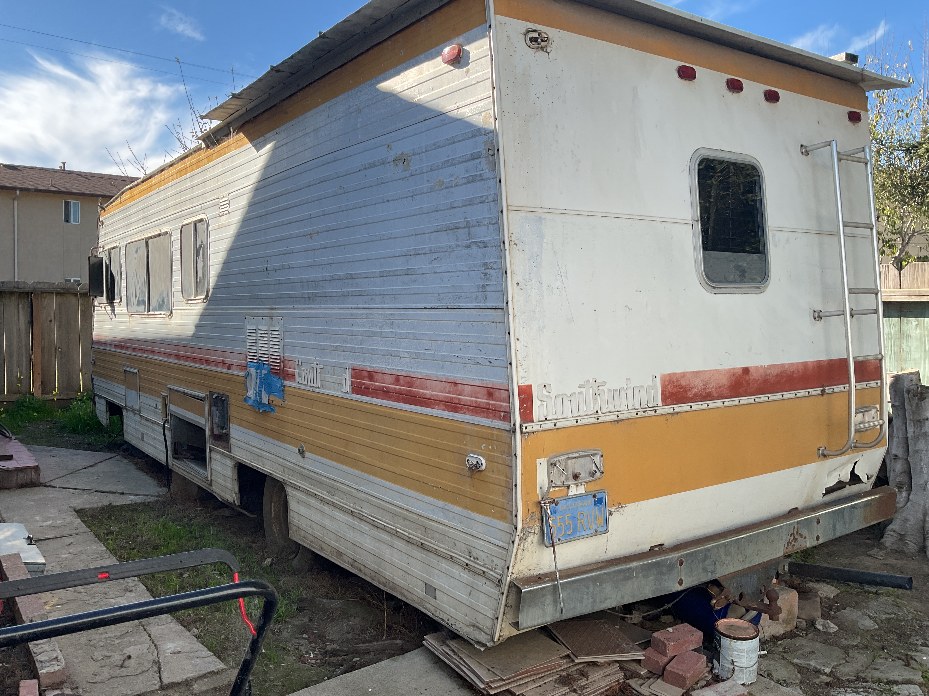
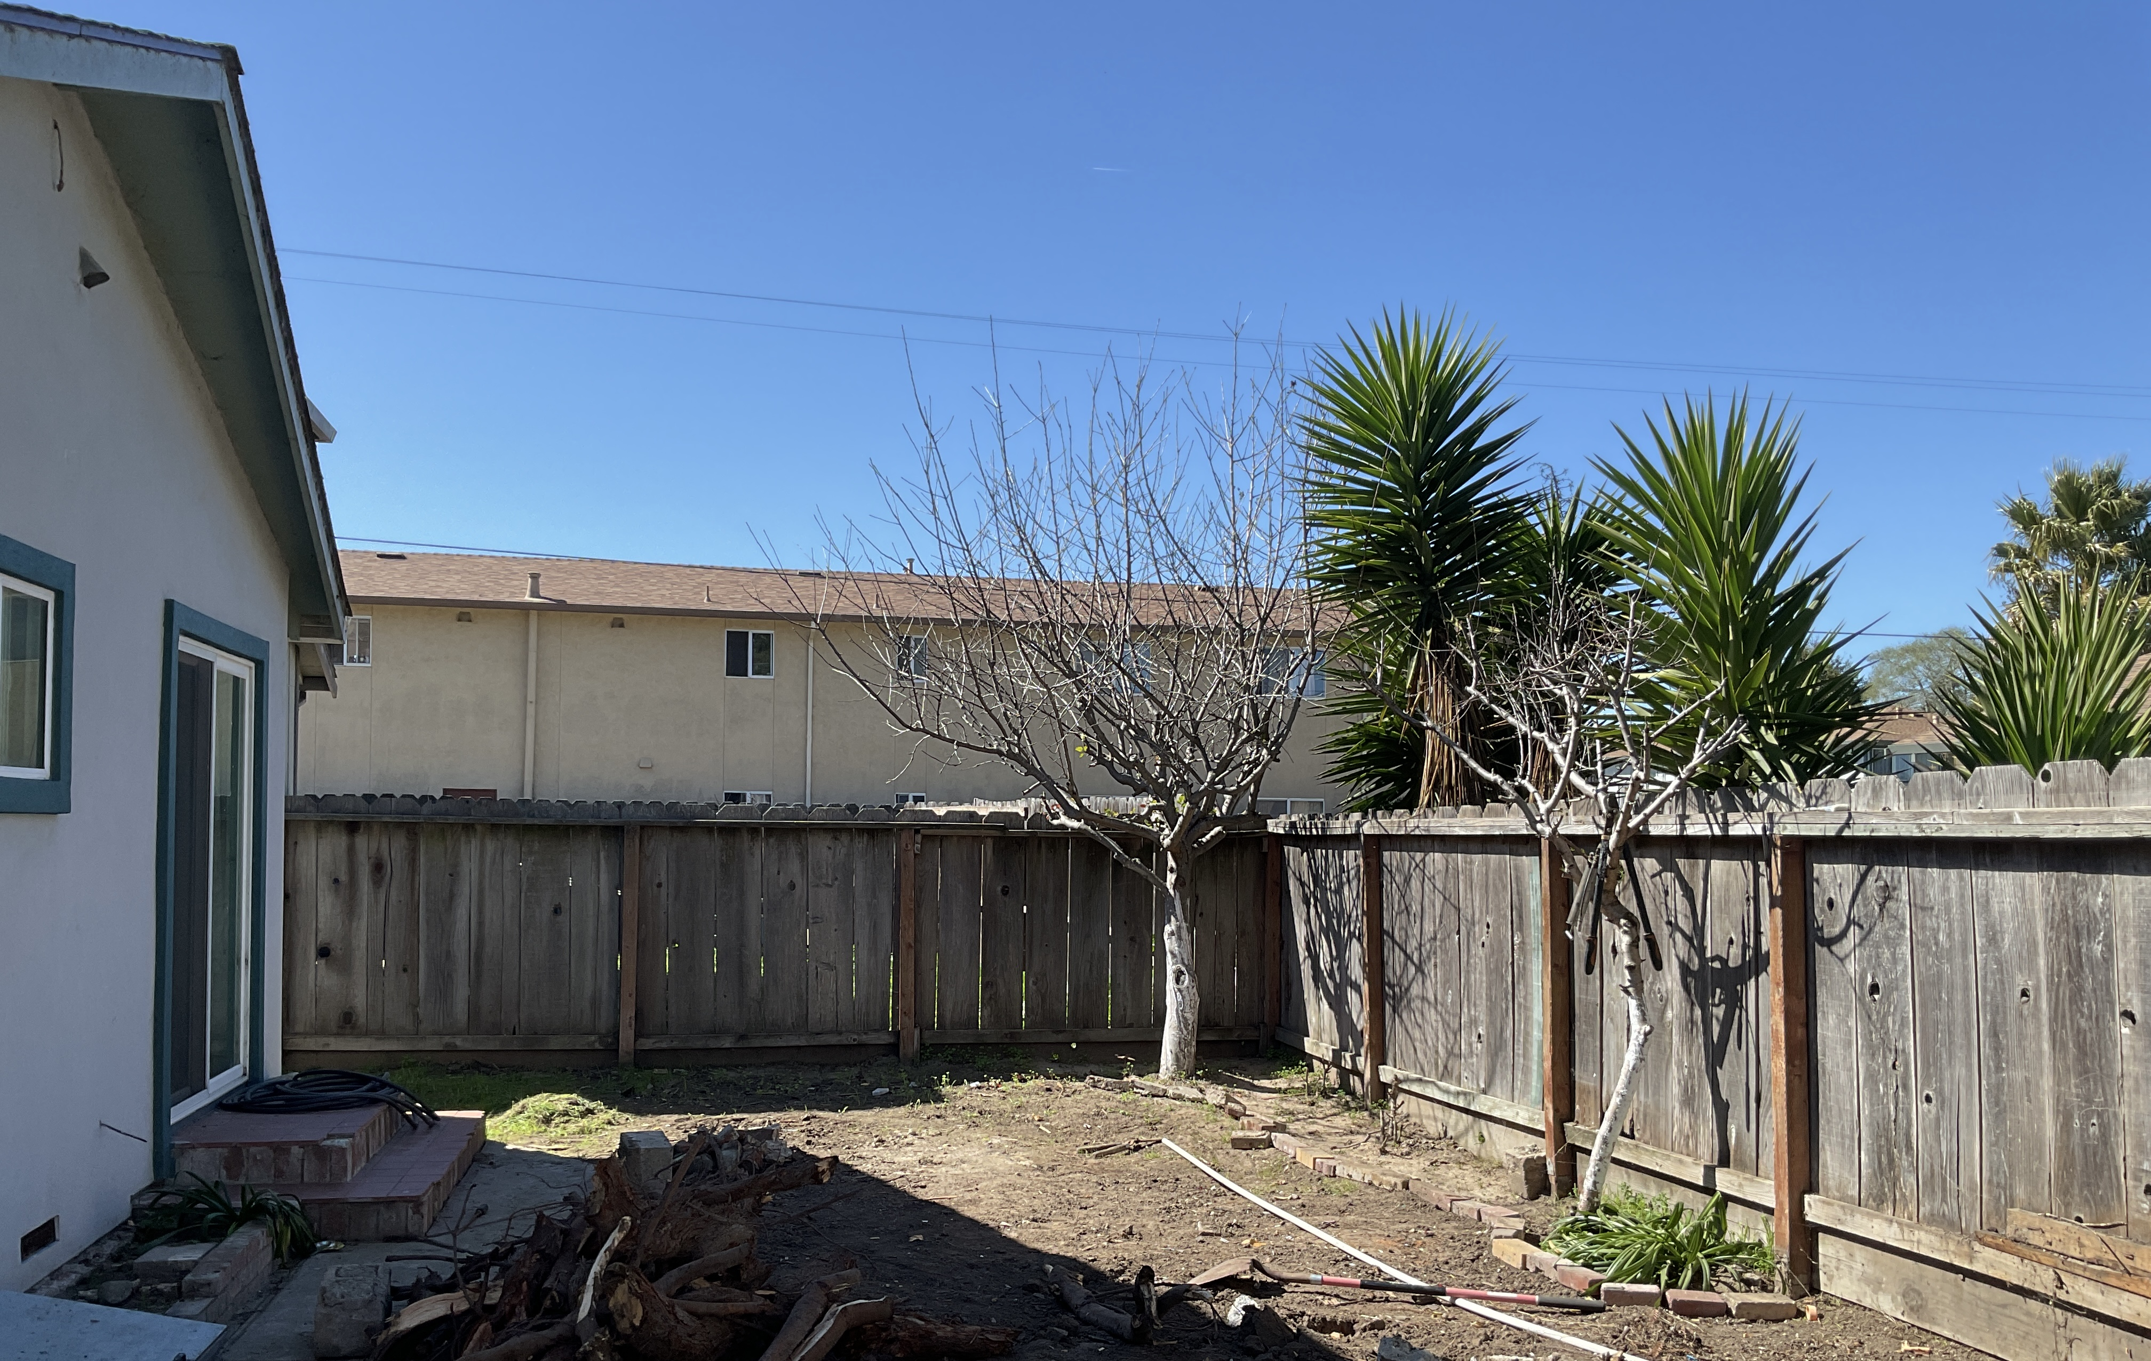
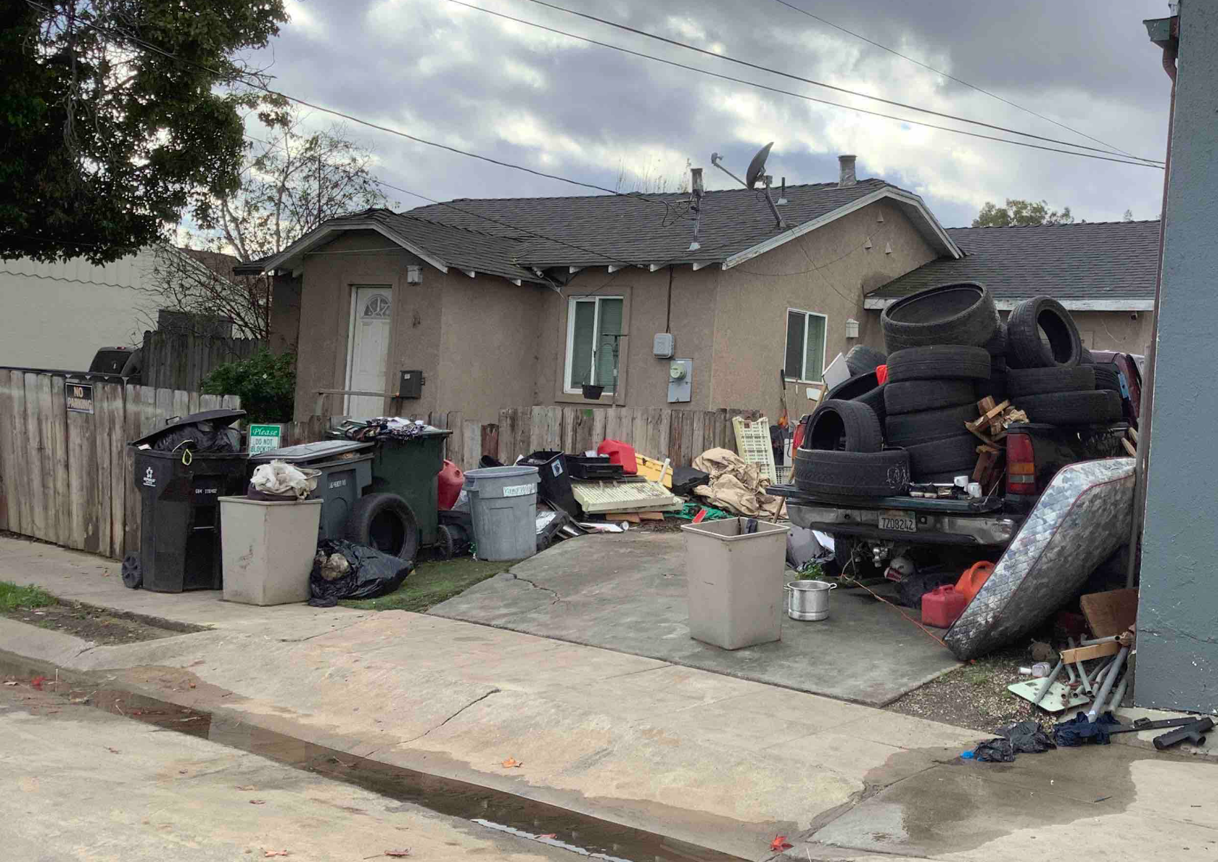
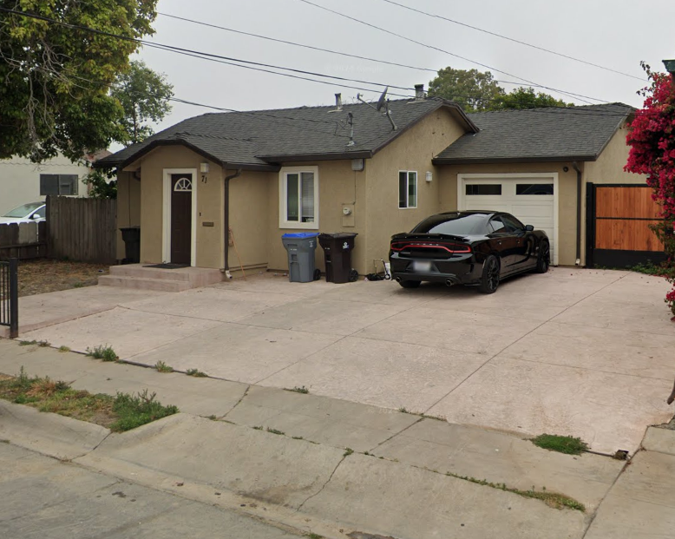
Neighborhood Blight Elimination
Code Enforcement in 2024
Cases Opened – 1750
Cases Closed – 1251
Neighborhood
Blight Elimination
Before
After

Slide 12
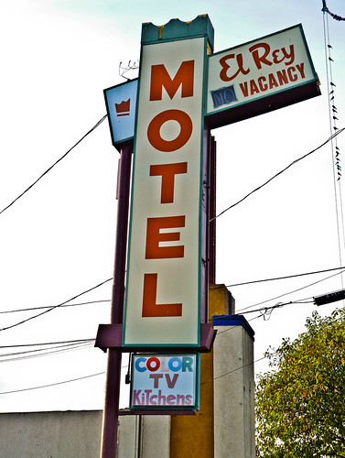
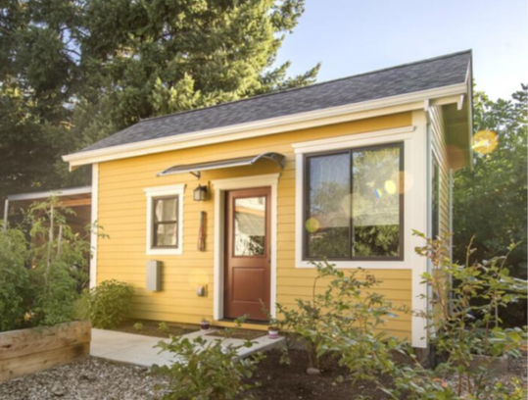
Accomplishments
  ADU’s
  216 permits issued
  115 permits finalized
  Properties Acquired
  443 W. Market St.

Slide 13
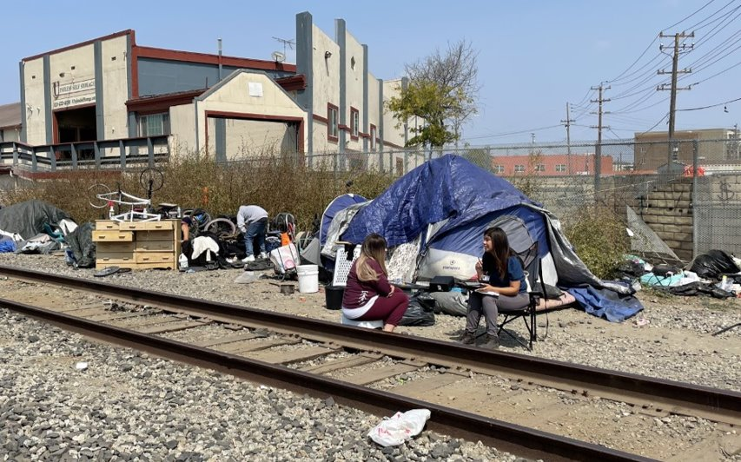
Salinas Outreach & Response Team (SORT)
2024 Calendar year | Assisted
Individuals | 291
Referred to Shelter | 36
Housed | 45
Services rendered | 2,321

Slide 14
Next Steps
Submit 2024 Housing Element Annual Progress Report to HCD and LCI on or before April 1, 2025

Slide 15
Recommendation
It is recommended that City Council adopt a resolution approving the City of Salinas 2024 Housing Element Annual Progress Report and authorizing its submittal to the California Department of Housing and Community Development and the Governer's Office of Land Use and Climate Innovation as required by Government Code Section 65400(b).

Slide 16
Questions?
For more information, contact the Housing Division
(831) 758-7334
https://www.cityofsalinas.org/Your-Government/Departments/Community-Development

