Slide 1

Commercial Cannabis Industry
2022 Annual Update
Courtney Grossman, Planning Manager
Community Development Department
August 22, 2023

Slide 2
Salinas Cannabis Industry
An annual update to City Council on the cannabis industry is required by SMC Sec. 5-07.49
The City issues two types of commercial cannabis business permits: Commercial Cannabis Permits (CCP) and Administrative Permits (AP)
  CCPs are applicable to Cultivation, Delivery, Dispensary, Distribution, and Manufacturing
  APs are applicable to Testing Laboratories, Small Distribution (business premises under 500 square feet), Research and Development Facilities, and Nurseries
Notes:
The State of California has identified 20 different subtypes of cannabis businesses, organized by license type. Each commercial cannabis business type, as defined by the City, corresponds to a specified State license

Slide 3
Commercial Cannabis Permit Status
The City has issued 19 permits out of a total of 23:
  At permit quota for dispensary, distribution, and manufacturing
  9 businesses are operational and have received a certificate of occupancy
  11 businesses are not operational – only 5 have shown recent activity
Business Type | Permit Quota | Active Permits* | Operational Businesses*
Cultivation | 5 | 3 | 1
Delivery | 3 | 1 | 1
Dispensary | 5 | 5 | 3
Distribution | 5 | 5 | 2
Manufacturing | 5 | 5 | 2
Total | 23 | 19 | 9
*As of July 2023.
Notes:
2023 will focus on revocations of inactive permits

Slide 4
Fiscal Impact of Cannabis
The City collects monitoring fees to compensate for costs relating to monitoring and enforcement of commercial cannabis businesses
Approximately $169,824 in monitoring fees were collected in 2022
  Over $13,000 in permit application and renewal fees to cover application processing expenses was collected.
Monitoring Department | 2022 Total
Police | $78,216
Community Development Department | $20,826
City Attorney’s Office | $6,831
Financial Consultant | $63,951 (estimate)
Total: | $169,824
Notes:
SCI replaced MGO as the financial consultant in 2023. Monitoring fees are collected at-cost from the businesses.

Slide 5
Employment & Community Impacts
In 2020 there were three crimes tied to cannabis operations in Salinas
    Conducting business and transporting product without a license
    Embezzlement
    Robbery
In 2021, no crimes identified, no data for 2022
In 2020 approximately 393 people were directly employed by cannabis businesses
In 2021, approximately 323 people were employed, no data for 2022

Slide 6
Tax Revenue
Cannabis Business Tax effective January 1, 2017
  In December 2019, Council voted to forgo a scheduled tax increase under SMC Sec. 19A.10.070
  Tax applies to Cultivation (including Nurseries), Manufacturing, Dispensary, and Delivery
  Manufacturing and Cultivations rates reduced 50% in Q4 2022
Business Type | Current Rate
Cultivation | $7 per square foot (was $15)
Delivery | 5% of Gross Receipts
Dispensary | 5% of Gross Receipts
Distribution | N/A
Manufacturing | 2.5% of Gross Receipts (was 5%)
Nurseries | $2 per square foot
Testing Laboratory | N/A
Notes:
Tax increase would have been:
2020 Rate
$25 per square foot
10% of Gross Receipts
10% of Gross Receipts
N/A
10% of Gross Receipts
$5 per square foot
N/A

Slide 7
Tax Revenue
Taxes for 2020, excluding some 4th quarter numbers, were over $1.8M
  Tax revenue increased by 12 percent from 2019 to 2020
  Tax revenue in 2021 exceeded $2M, but declined to $1.5M in 2022
Year | Q1 | Q2 | Q3 | Q4
2018 | $120,736 | $143,838 | $328,894 | $276,979
2019 | $343,833 | $432,000 | $409,701 | $442,778
2020 | $470,916 | $503,765 | $357,502 | $509.849
2021 | $536,363 | $525,501 | $514,153 | $457,919
2022 | $455,822 | $381,604 | $383,861 | $298,658
Q = quarter (three month period)
Notes:
Late payment of taxes has been a recurring issue.
As of the date of this report, all operational businesses are up to date.

Slide 8
Industry Challenges
Economic challenges and inflation during the previous year
Reductions in the price per pound of cannabis due to the growing of more product than there are storefronts to sell
Regulatory burdens from State and local levels
Businesses with CCPs in Salinas not becoming operational
Competition with the illegal market, an issue directly reported from CCP holders
Reductions in tax rates in Quarter 4 2022

Slide 9
City Regulatory Challenges
Potential Municipal Code Updates:
  Establish time extensions and limit indefinite extensions, consistent with planning entitlement requirements
  Address Inactive Permits / create opportunities for new permits
  Address cannabis uses in the Zoning Code
  Reconsider sensitive use restrictions to allow for more flexible siting – GIS
  Reconsider CCP application process
  Establish a single date for permit renewals
Notes:
The Zoning Code currently does not address cannabis uses, requiring staff to determine compatibility based on equating a cannabis use to a similar non-cannabis use
Permitting: The SMC stipulates a Cannabis Selection Committee to review and award permits; however, limited detail is provided as to how the application rounds should be conducted. The SMC could be revised to ensure consistency and best practices in future permitting rounds; or, the City could consider an alternate method for awarding CCPs.

Slide 10
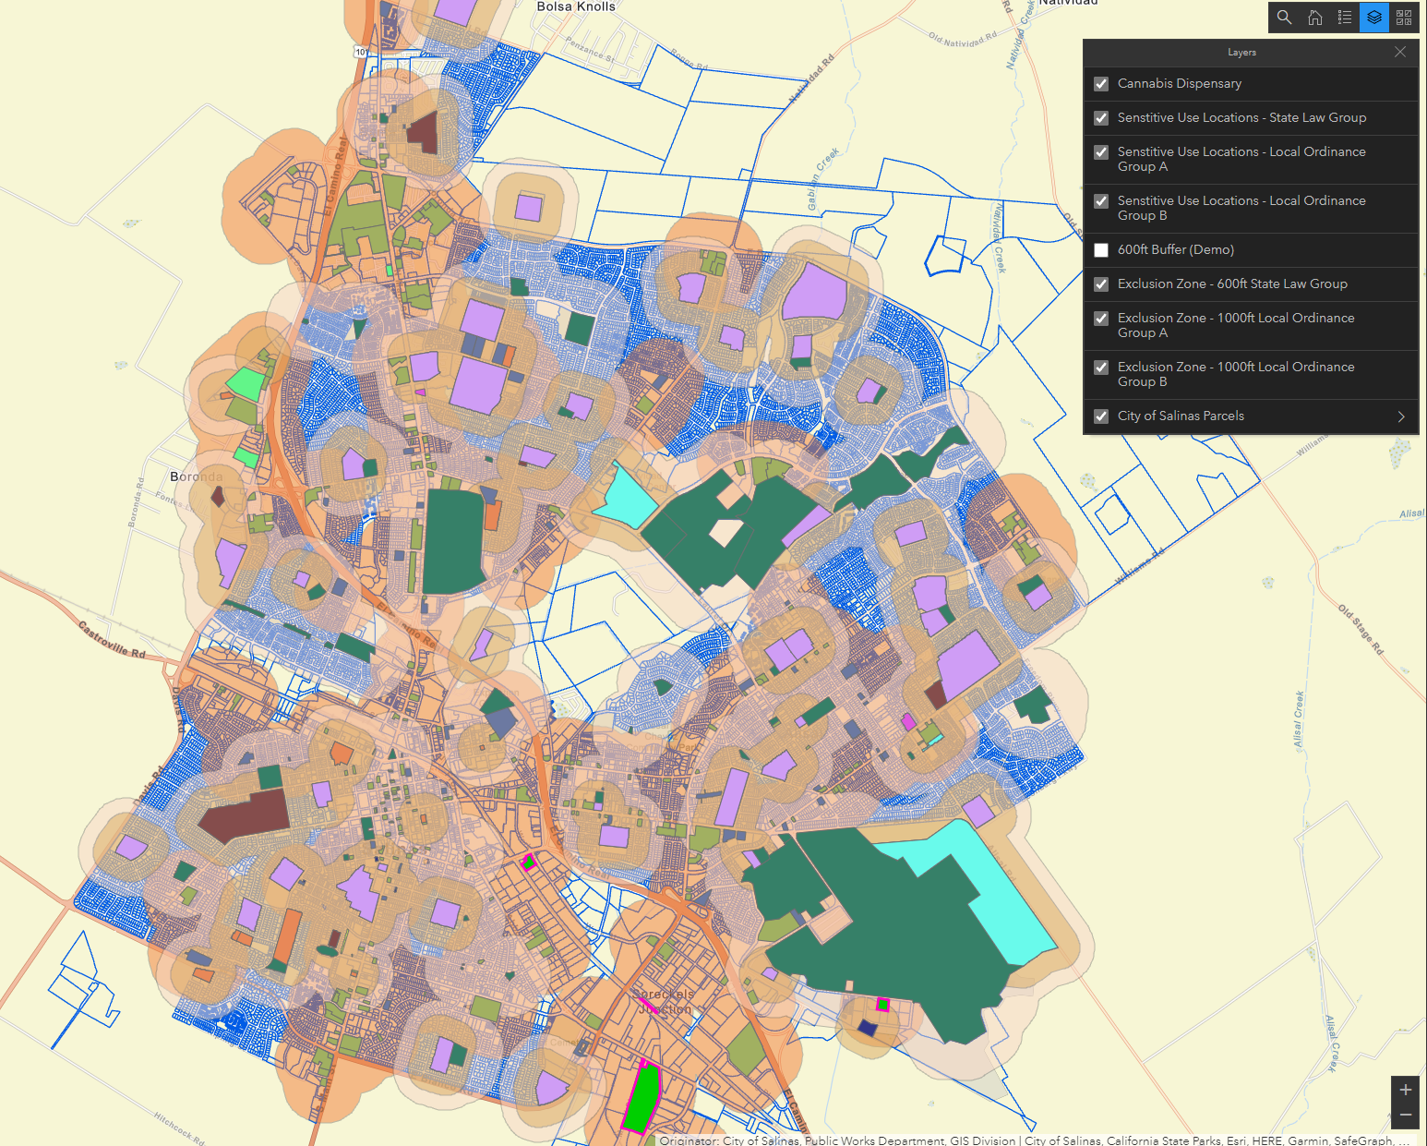
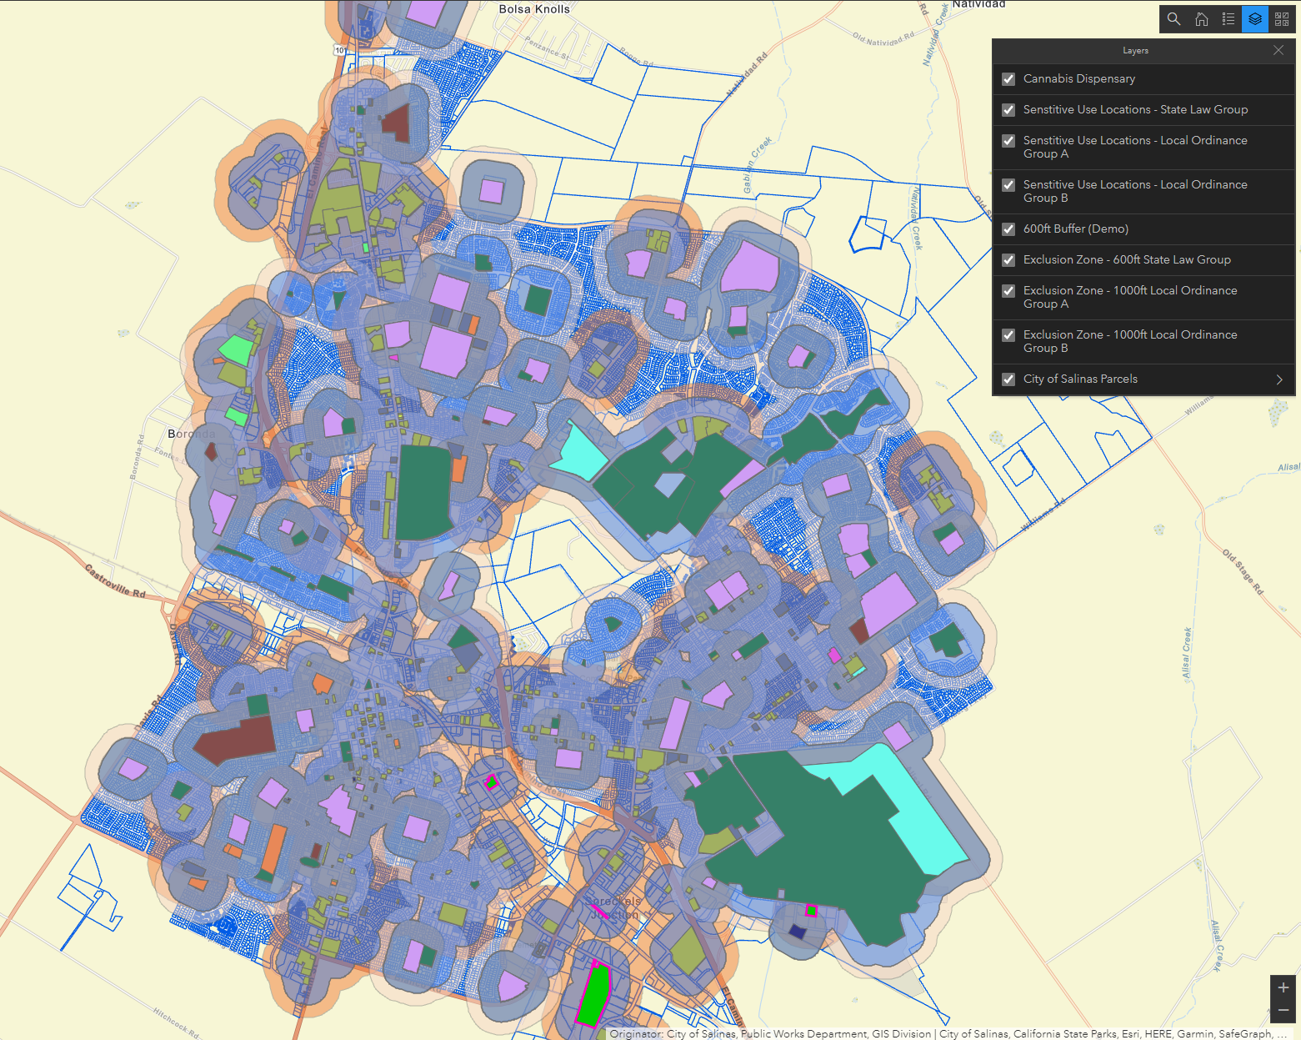
Proximity to Sensitive Uses:
1,000’ Map 600’ Map
Notes:
Potential Municipal Code Update to change buffer distance from 1,000 feet to 600’

Slide 11
Conclusion
The Salinas cannabis industry has demonstrated stabilization with some of the main permit holders
Challenges for other permit holders to become operational
Requires substantial staff resource and consultants
The City is covering most of its costs with monitoring and permit fees
Updates to the Municipal Code and permitting process could improve transparency, consistency, and create a more streamlined process

Slide 12
End of Presentation

Slide 13
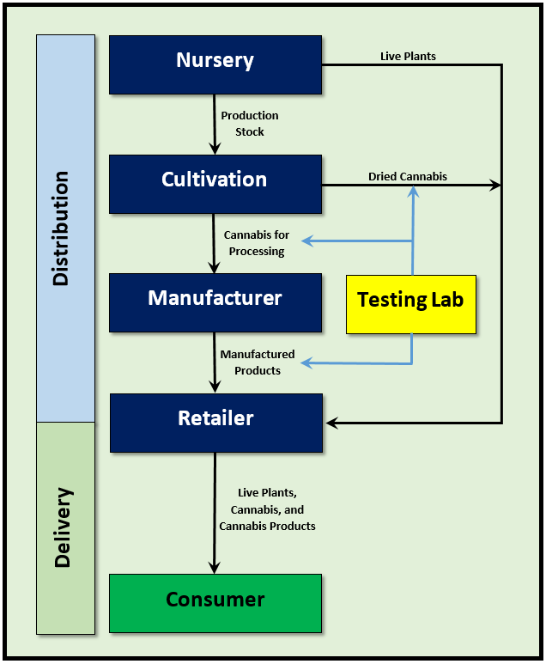
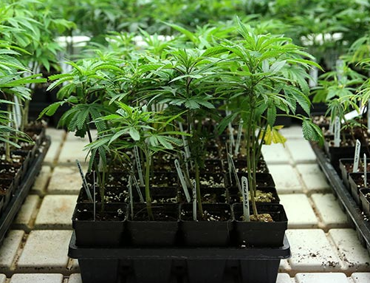
The Cannabis Industry
Nursery
Grows/Clones Immature Plants
Sells to Retailer and Cultivation
Statewide Market
Taxed at $2/square foot
Administrative Permit
No Maximum
None Approved
None Operating

Slide 14
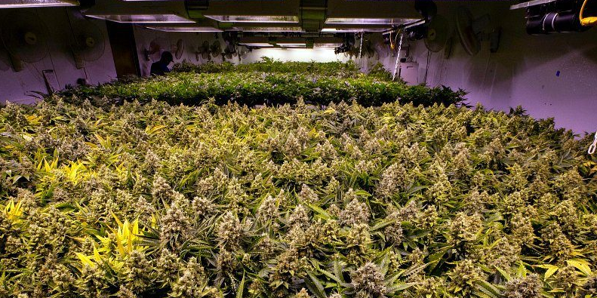
The Cannabis Industry
Cultivation
Grows/Harvests Mature Plants
Sells to Retailer and Manufacturer
Statewide Market
Taxed at $15/square foot
CC Permit
Five Maximum
Three Approved
One Operating

Slide 15
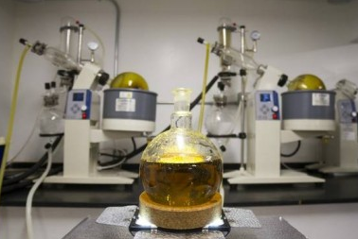
The Cannabis Industry
Manufacturer
Oil Extraction/Infusion, Product Manufacture
Sells to Retailer
Statewide Market
Taxed at 5% GR
CC Permit
Five Maximum
Four Approved
Two Operating

Slide 16
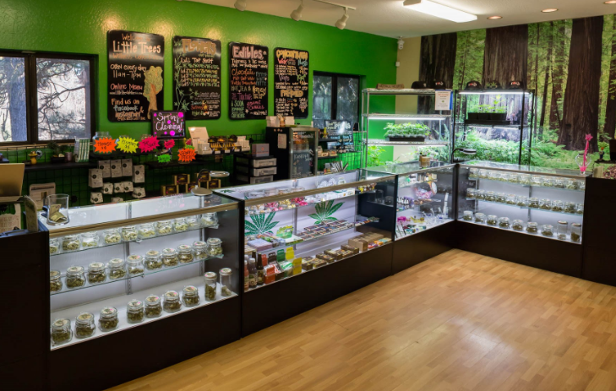
The Cannabis Industry
Retailer (Dispensary)
Sells Directly to the Consumer
Storefront
Local Market
Taxed at 5% GR
CC Permit
Five Maximum
Five Approved
Three Operating

Slide 17

The Cannabis Industry
Retailer (Delivery)
Sells Directly to the Consumer
Non-Storefront
Regional Market
Taxed at 5% GR
CC Permit
Three Maximum
Three Approved
Three Operating

Slide 18
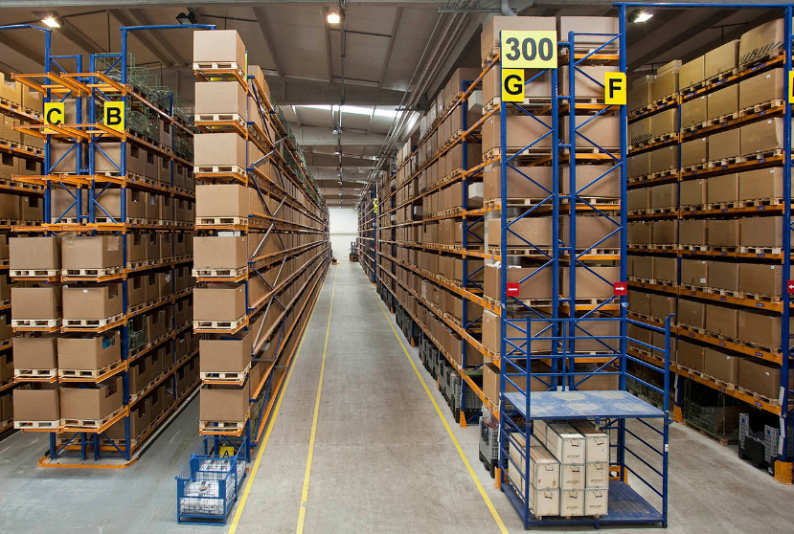
The Cannabis Industry
Distribution
Moves Product Between Licensees
Acts as Broker and Collects State Taxes
Statewide Market
Not Taxed
CC Permit
Five Maximum
Four Approved
Two Operating

Slide 19
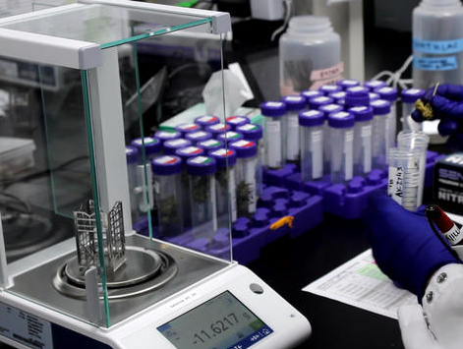
The Cannabis Industry
Testing Lab
Ensures Product Safety and Potency
Tests Samples When Product is Moved
Local/Regional Market
Not Taxed
Administrative Permit
No Maximum
Two Approved
Two Operating

