Slide 1

2021 Weed Abatement Program
Code Enforcement Division
Recommended Motion:
A motion to approve the attached resolution approving
charges and establishing liens for unpaid charges as part of
the 2021 Weed Abatement Program.
Lorenzo Sanchez, Code Enforcement Manager
Community Development Department
January 11, 2022

Slide 2
Background
Section 14-28 of the City Code requires a public hearing to review the Weed Abatement Program and the work performed.
The Weed Abatement program:
  eliminates dangerous conditions
  enhances public safety
  eliminates visual blight in neighborhoods
The hearing allows Council to consider all protests and objections from property owners whose properties were abated by the City.

Slide 3
Due Process
Inspections of properties that were previously put on notice for unsafe, overgrown weeds
Notice of Violation & 10-day Abatement Notice with Administrative Citation
If non-compliant, contact City contractor
Notice of Pendency recorded
Contractor completes abatement work (+25% City Administrative Fee)
Repeat violators issued Administrative Citation ($100, $200, $500)

Slide 4
Discussion
 | Charges | Paid | Outstanding
Abatement Amount | $ 3,600.00 | $ - | $ 3,600.00
25% Admin. Fee | $ 900.00 | $ - | $ 900.00
Citations Issued | $ 300.00 | $ - | $ 300.00
Total | $ 4,800.00 | $ - | $ 4,800.00
District | Total Cases | Abatements
District 1 | 7 | 0
District 2 | 7 | 0
District 3 | 26 | 3
District 4 | 23 | 0
District 5 | 14 | 0
District 6 | 9 | 1
 | 2019 | 2020 | 2021
Weeds Cases | 151 | 117 | 86
Voluntary Compliance | 148 | 116 | 82
Properties Abated | 3 | 1 | 4

Slide 5
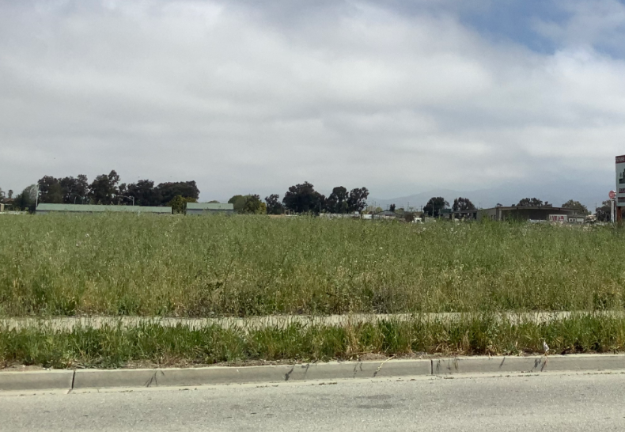
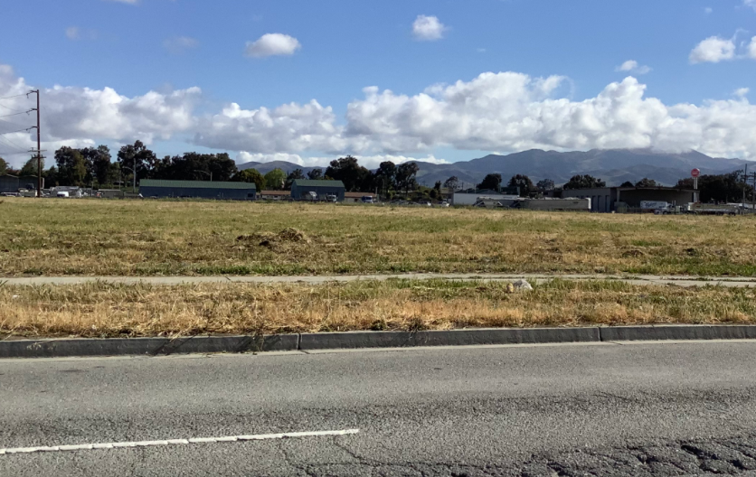
Before & After

Slide 6
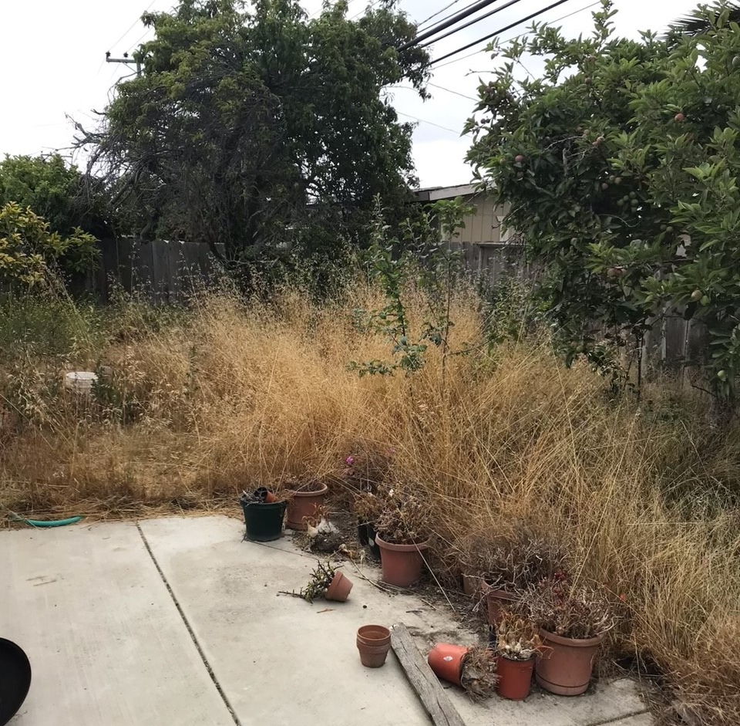
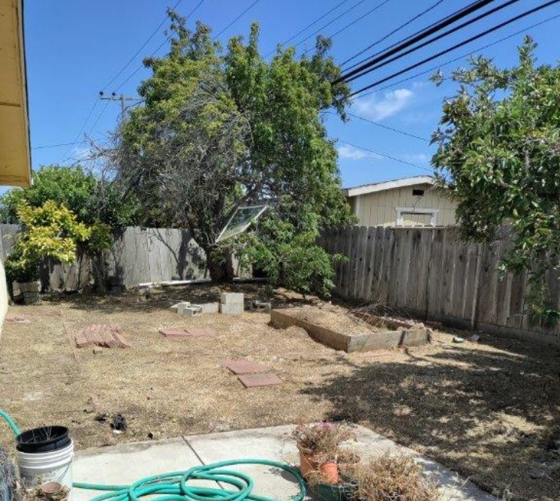
Before & After

Slide 7
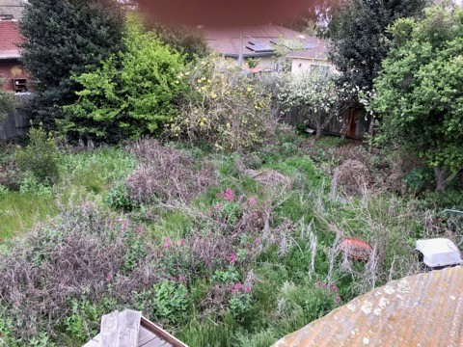
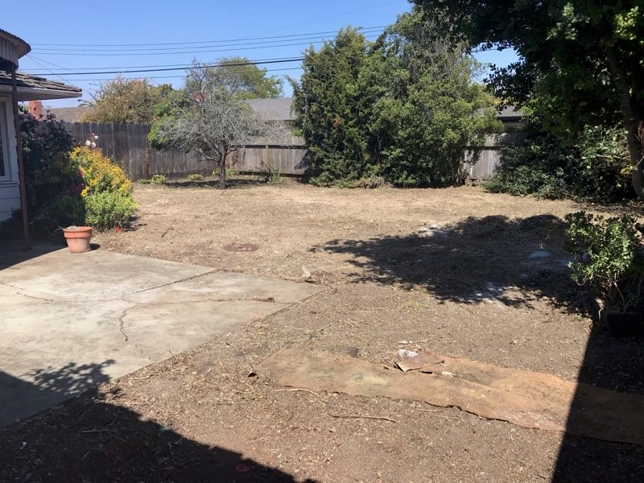
Before & After

Slide 8
Recommendation
Adopt a resolution approving $4,800.00 in charges for the abatement of weeds on a property within the City of Salinas, including administrative fees and outstanding administrative citations, and direct the Finance Director to collect those charges from the property owners.

