Slide 1

INCLUSIONARY HOUSING
DOWNTOWN EXEMPTION
[SALINAS MUNICIPAL CODE SECTION 17-8(d)]
Megan Hunter, Community Development Director
City Council
November 15, 2022

Slide 2
Background
  2003 - Start 1992 Inclusionary Housing Ordinance (IHO) Update
  2005 – IHO Update is adopted
  2008 - Great Recession negatively impacts housing production
  2014 – 2nd Update to IHO is initiated.
  2017 – 2nd IHO Update is adopted to create a more flexible ordinance
  Downtown Vibrancy Plan is being updated at same time as IHO.
  2017 HTMA identified significant market risks to Downtown housing development and untested market.

Slide 3
Discussion
  In 2017, Council supported Downtown Exemption due to number of low-income units already in downtown and findings of 2017 HTMA Study
  Council did not set expiration date because Housing Element recommended ordinance be re-evaluated every 5 years
  Update was planned to start in 2022, but was postponed because of limited staff capacity as result of pandemic response
  Council requested a report on the Inclusionary Housing Ordinance and evaluation of Downtown Exemption
  As a result, staff completed a 2022 HTMA Update that was presented on September 13th

Slide 4
Discussion
  On October 18th, Council directed staff to eliminate Downtown Exemption for new residential construction
  City Council recommended the Downtown Exemption be preserved to ensure future Adaptive Reuse Projects are economically viable
  The 2018 Adaptive Reuse Ordinance incentivizes the conversion of older, underutilized commercial buildings to residential use
  The 2022 HTMA Study identified existing barriers to residential development especially for Adaptive Reuse Projects
  Even with the Adaptive Reuse Ordinance and Downtown Exemption, only 69 units permitted due to risk & associated costs

Slide 5
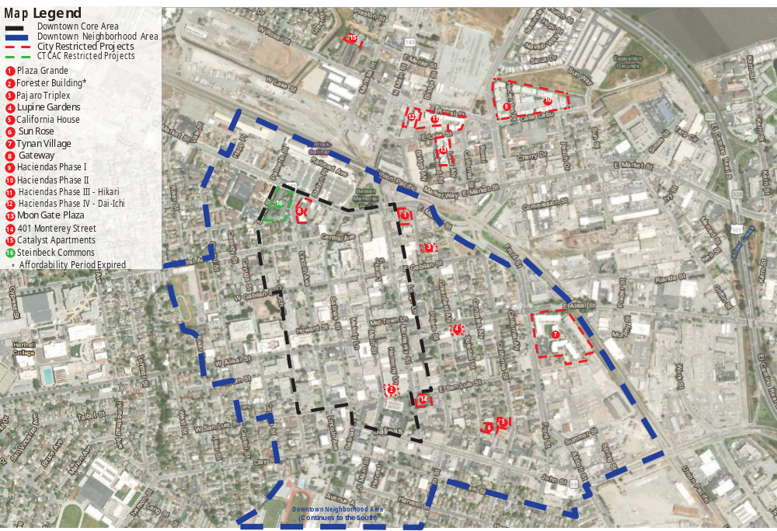
Map of Downtown Area Affordable Housing Projects
but to preserve for Adaptive Reuse Projects
but to preserve for Adaptive Reuse Projects
but to preserve for Adaptive Reuse Projects

Slide 6
CEQA
  “Not a Project” as defined by the California Environmental Quality Act (CEQA) Section 15378. In addition, CEQA Guidelines Section 15061 includes the general rule that CEQA applies only to activities which have the potential for causing a significant effect on the environment. Any subsequent discretionary projects resulting from this action will be assessed for CEQA applicability.

Slide 7
Recommendation
  A motion to adopt an Ordinance amending Article 3 (Housing) of Chapter 17 (Housing), Section 17-8(d) of the Salinas Municipal Code as follows:
This article shall not apply to any of the following:
…
  d) Residential developments Adaptive reuse projects as defined by Section 37-50.015 in the Zoning Code that are located in the downtown area (Central City Overlay District). unless the city council by resolution determines that, based on market conditions, the provisions of this article will be applied in the downtown area.

