Slide 1

2025 General Plan Annual Progress Report
March 10, 2026
Housing and Land Use Committee
Grant Leonard, Planning Manager

Slide 2
Agenda
APR Accomplishments
Visión Salinas 2040 Progress
  GPU Timeline
Notes:
Good afternoon. Cities and Counties are required to submit annual progress reports on their General Plans by April 1 to the Governor’s Office of Land Use and Climate Innovation, formerly Planning and Research, and the state department of Housing and Community Development. The Housing Element has specific forms and requirements, so it is under its own separate cover. The APR records City of Salinas accomplishments in implementing the General Plan in 2025. which I’ll share some highlights of today. I’ll also discuss what we accomplished in the VS2040 General Plan Update in 2024 and the next steps in that process. Today’s report is primarily about the existing General Plan, but we will be back this spring with at least one study session on the update before releasing a public review draft.

Slide 3


Draft Annual Progress Report Highlights
Current Planning
Development
Engineering
Front Counter Customers: 1,564
Front Counter Customers: 1,046
Permits Issued: 941
Plans Checked: 2,634
Completed Inspections: 5,794
Increase in on time building plan reviews from 2024: 23%
Permits approved in fewer cycles year over year
Finaled construction permits increased by 19%
Small increase in approved permits
Approved Planning Applications: 535

Slide 4
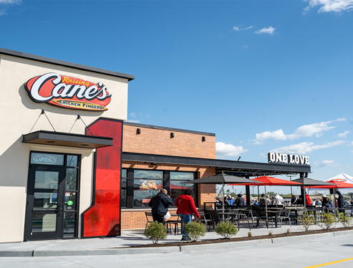
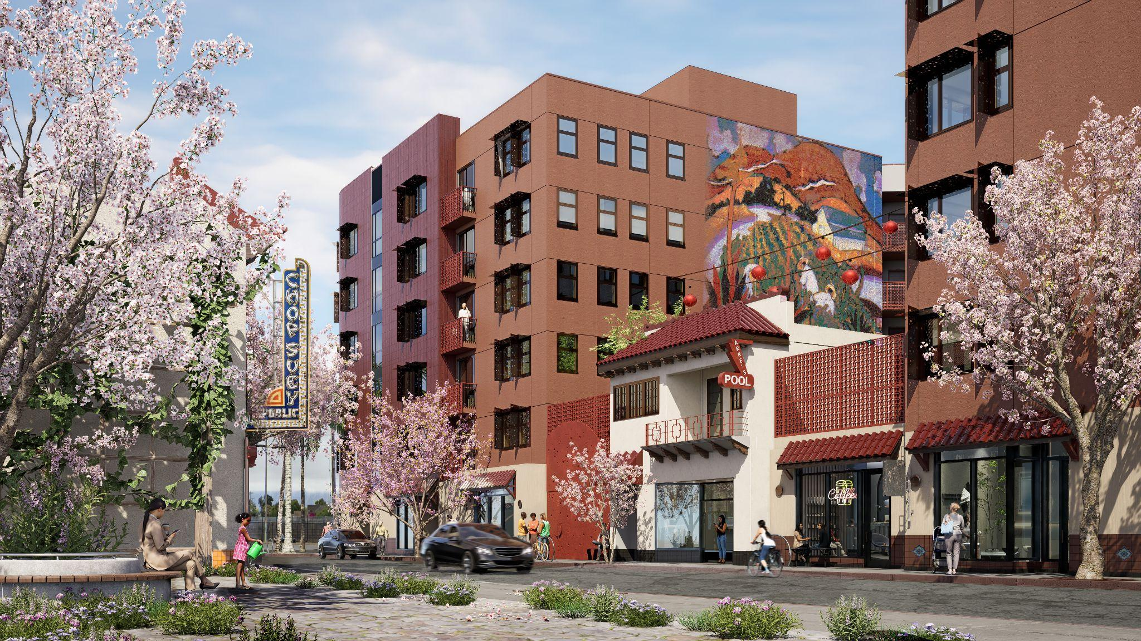
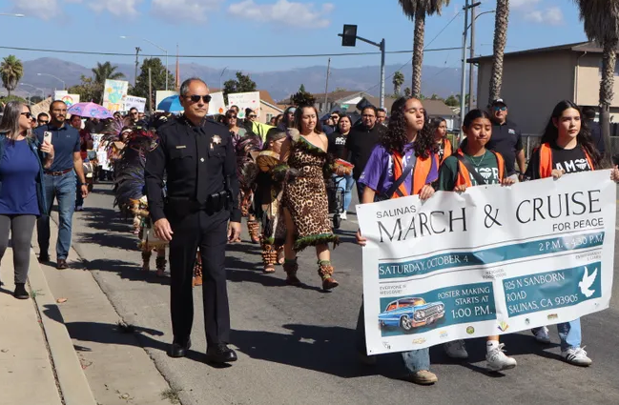
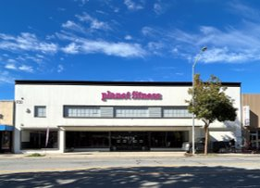
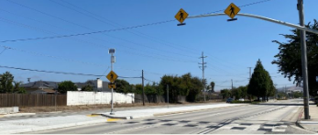
Draft Annual Progress Report Highlights
900 Northridge Mall
Design Concepts for Chinatown
March for Peace
930 S Main St
Main St/Lamar Crosswalk

Slide 5
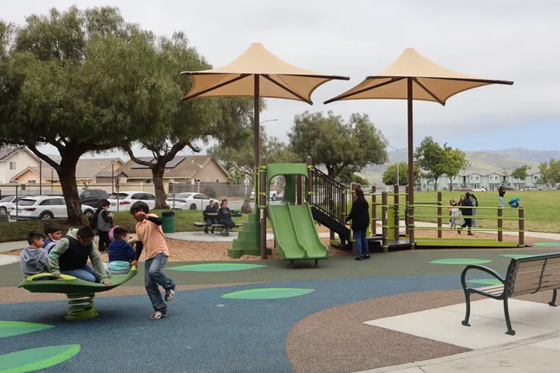
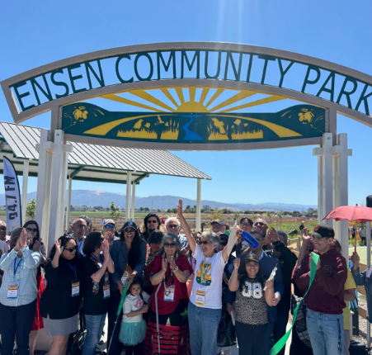
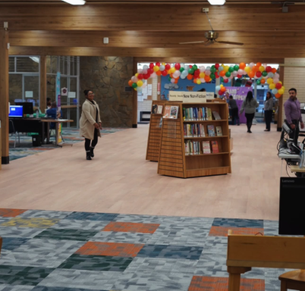
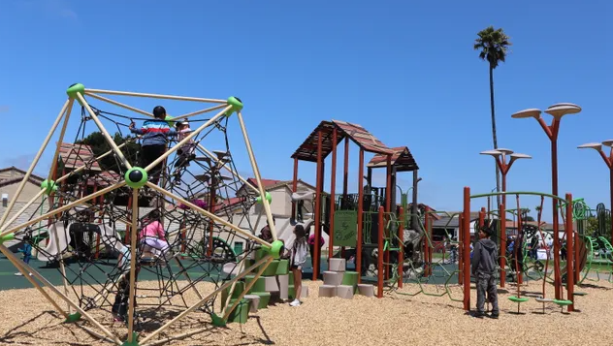
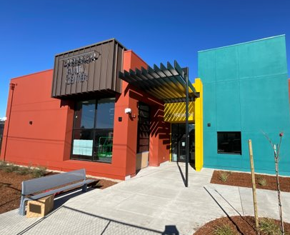
Draft Annual Progress Report Highlights
Steinbeck Library
New Flooring
Williams Ranch Park
Ensen Community Park
Northgate Park
Hebbron Family Center

Slide 6

Visión Salinas 2040 Progress
First Public Review Draft released in December 2025
Study sessions
  Economic Development Element
  Joint City Council-Planning Commission Planning Commission – Public Review Draft
Economic Development shareholder meetings
Administrative Drafts
Climate Action Plan
GP Environmental Impact Report

Slide 7
General Plan Update 2026 Timeline
Jan-March
July-September
April-June
October-December
First Public Review Draft comment period
Workshop event – 3/7
Prepare public review draft EIR
Prepare updated EDE
Release first public review draft CAP
Revise General Plan based on comments
Release Second Public Review Draft General Plan with CAP and EIR for 45-day comment period
Study sessions/briefings on EIR, CAP, and revised General Plan and approval process
Revise documents following comment period
Publish revised General Plan, CAP, and EIR
Start approval process
Monterey County Airport LU Commission
Planning Commission
Traffic and Transportation Commission
City Council certification and adoption
Notes:
We are in the final stages of that selection process, negotiating with the preferred team, and will take a resolution to Council probably the first meeting of May. It’s critical to get that process going concurrent with the end of the of the General Plan Update for compliance with state laws and consistency with the new plan. We are almost at the end of the first quarter of 2025, and in the next we aim to complete and release a Public Review Draft of the General Plan, and continue engagement on that and the Climate Action Plan in Q3, as well as release public review drafts of the CAP and Environmental Impact Report. Depending on release dates and comments received our goal is launch the adoption process in Q4.

Slide 8
Recommended Motion:
To approve a resolution accepting the 2025 General Plan Annual Progress Report and authorize its submittal to the California Department of Housing and Community Development (HCD) and the Governor’s Office of Land Use and Climate Innovation (LCI).
Notes:
That concludes my presentation. We do have a resolution attached with the report today to recommend that City Council accept the 2024 APR and authorize its submittal to the state. I turn the floor back over to you for questions and comments.

Slide 9
Questions?
For more information,- Jonathan Moore, Senior Planner, APPI
(831) 775-4247
jonathan.moore@salinas.gov

