Slide 1

APPLICATION TO THE CALIFORNIA DEPARTMENT OF HOUSING AND COMMUNITY DEVELOPMENT FOR THE PROHOUSING INCENTIVE PROGRAM ROUND 3
David Vigil, Administrative Analyst
Community Development Department
November 26, 2024

Slide 2

Background
April 2023 - Prohousing Designation
August 15, 2024 - PIP Round 3 NOFA Release
$8,000,000 Statewide
First time PIP applicants will be prioritized
Notes:
Period Award: up to $6,041,082

Slide 3

Discussion
City Eligible - $1,250,000
PIP Selected Activities
      Homelessness activities, including homeless prevention and the preservation of permanent and transitional housing.
      Affordable rental and ownership housing for households earning up to 150% AMI

Slide 4
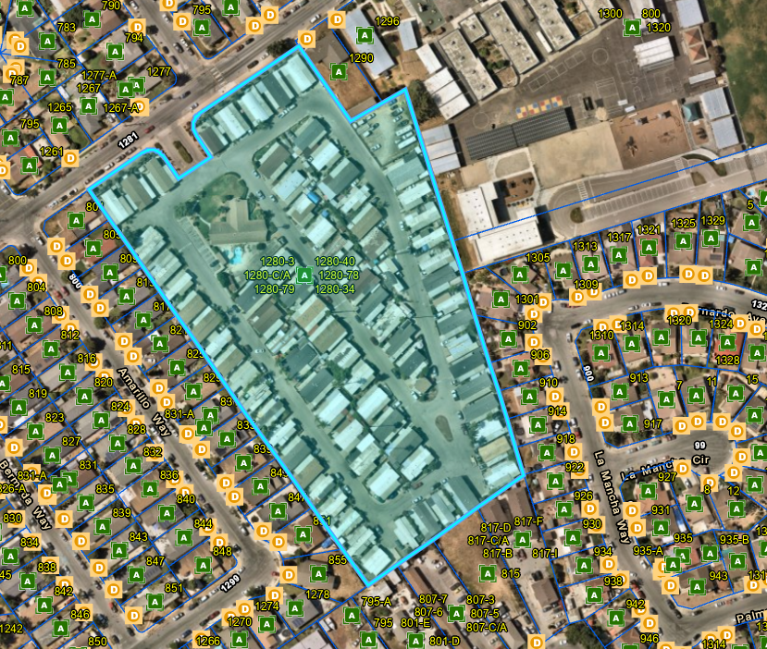
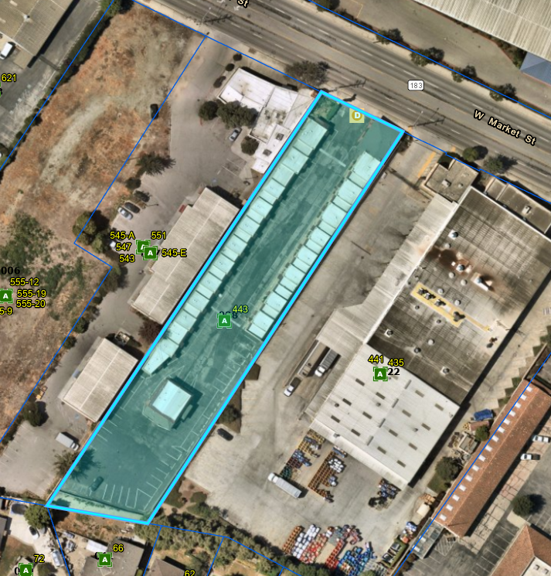
Option 1 | Option 2 | Option 3
PIP Activity II and/or VI | PIP Activity II and/or VI | PIP Activity II
Acquisition of Alisal Country Estates 1280 Rider Ave, Salinas, CA 93905 | Operational needs for emergency shelter at El Rey Motel 443 West Market St, Salinas CA 93901 | Gap financing for affordable multifamily rental housing project(s)
 |  | Project and location to be determined

Slide 5
PIP Round 3 Application Timeline
HCD NOFA Release
August 15, 2024
City HLUC Consideration November 26, 2024
City Council Approval December 3, 2024
Expected Award Notifications
April 2025
Application Deadline December 31, 2024

Slide 6
Recommended Motion
It is recommended that the Housing and Land Use Committee supports the approval of a City Council resolution authorizing the submittal of the PIP Round 3 Application to the California Department of Housing and Community Development on or before December 31, 2024.

Slide 7
Questions & Comments

