Slide 1

Special Curb Markings
Policy Update
Adriana Robles, City Engineer
Public Works Department
August 22, 2023

Slide 2
Motion &
Executive Summary
A motion to approve a Resolution implementing the Salinas Blue Curb Marking Policy and to adopt an Ordinance amending Article VI of Chapter 20 (Stopping, Standing and Parking) of the Salinas Municipal Code
• March 21, 2023 City Council approved a Resolution directing staff to review the blue curb marking policy
• City staff surveyed other city policies and compiled data

Slide 3
Background
Surveyed Policies from other Jurisdictions
16 Jurisdictions Surveyed
94% Required Proof of Disabled Placard
94 % Required a Garage
94% Reviewed Driveway
63% Reviewed On-Street Parking
31% Reviewed Path of Travel
25% Charged a Fee

Slide 4
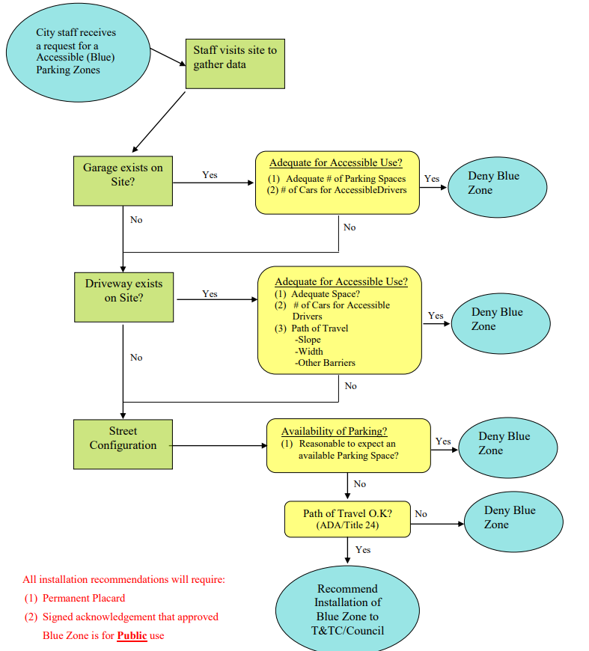
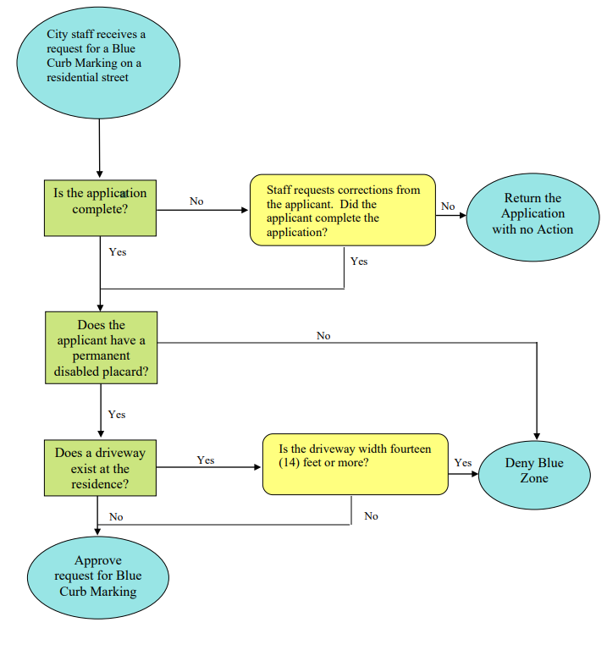
Discussion
Policy Update
2006 Policy
Proposed Policy

Slide 5
Discussion
Ordinance Update
• Delete reference to Parking Meters
• Add/Update Establishment of Parking Zones
° Grant authority to the City Engineer to establish & maintain curb markings
° Grant authority to the Traffic & Transportation Commission to hear protests
• Update Removal of Vehicles
° Grant authority to the Chief of Police to remove vehicles
• Delete Parking prohibitions on certain streets between 3:00 a.m. and 5:00 a.m.

Slide 6
CEQA Consideration
Strategic Plan Initiative
Fiscal Impact
Not a Project
Youth and Seniors
Implementation Cost = $800 (2023) per request

Slide 7
Recommended Motion
A motion to approve the Proposed Salinas Blue Curb Markings Policy and to adopt an Ordinance amending Article VI of Chapter 20 (Stopping, Standing and Parking) of the Salinas Municipal Code

