Slide 1
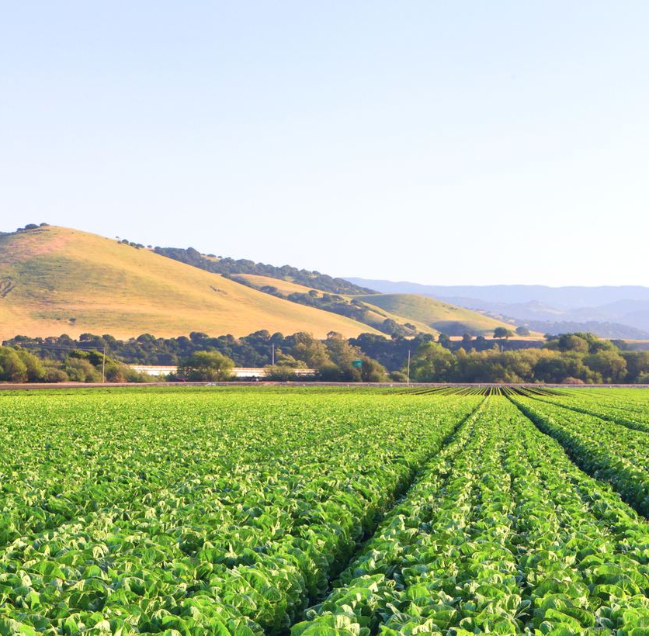
One Water
Roadmap
City of Salinas
City Council Meeting
June 30, 2026

Slide 2

Definition of One Water
One Water is a collaborative planning and implementation approach that fosters integrated and equitable management of water resources for long-term resilience and reliability, meeting both community and ecosystem needs.
Source: WRF Study #4969 (February 2024)

Slide 3
One Water Roadmap Goal
Identify how the City can best collaborate with other partners and invest time, energy and money into more sustainable water solutions to help prepare for a changing future.
Notes:
Overall goal for the Roadmap

Slide 4
One Water Roadmap Timeline
June
2025
August
2025
December
2025
February
2026
April
2026
May
2026
June
2026
Gaps and Needs Summary from Document Review and Stakeholder Interviews
Stakeholder Workshop #1
Draft
One Water Roadmap
Stakeholder Workshop #2
Final
One Water Roadmap
Stakeholder Interviews, Review of Water Management Documents
Notes:
Overview of the timeline for the City’s initial efforts for this One Water initiative

Slide 5
Data and Documents Review
Initial efforts involved reviewing 30 documents authored by the City and other local water-related agencies.
Developed an understanding of the previous and ongoing water-related studies, plans, policies, and goals in the City and Salinas Valley.
Notes:
Initially reviewed a number of documents provided by the City

Slide 6


Stakeholder Interviews
Interviews were conducted with 8 regional stakeholders responsible for different aspects of water management throughout the Salinas Valley.
Purpose was to gain a comprehensive understanding of the regional water management challenges and collaboration opportunities related to water management.
INTERVIEW PARTICIPANTS (alphabetically)
Alco Water Company (Alco)
City of Salinas
California Water Company (Cal Water)
Monterey County Board of Supervisors
Monterey County Farm Bureau (Farm Bureau)
Monterey County Water Resources Agency (MCWRA)
Monterey One Water (M1W)
Salinas Valley Basin Groundwater Sustainability Agency (SVBGSA)
Notes:
And to supplement this doc review, conducted stakeholder interviews

Slide 7
Water Management Issues Identified
Regional Storage and Conveyance: Difficulty in delivering adequate water to the right locations at the right times.
Water Quality: Maintaining water quality amidst ongoing contaminant concerns.
Seawater Intrusion: Groundwater contamination risk in key basins.
Lack of Infrastructure Investment: Historical underinvestment in water infrastructure.
Financial Concerns and Costs: High costs for both existing infrastructure and future projects.
Siloed Perspectives: Lack of trust and siloed perspectives limiting regional collaboration.
Notes:
It was noted that the following water management issues were expressed amongst multiple stakeholders

Slide 8
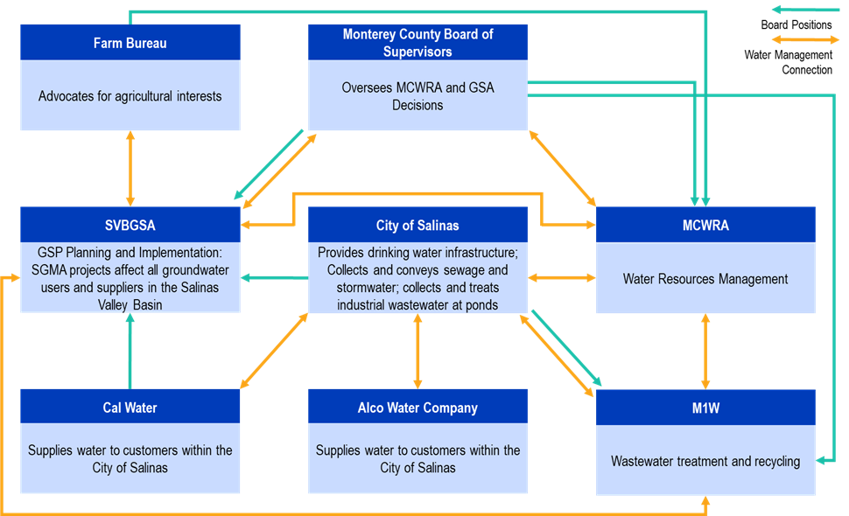
Stakeholder Connections
Stakeholder Interviews
Notes:
Following the interviews, the following connections were noted amongst the different stakeholders interviewed

Slide 9
One Water Opportunities
Ideas initially developed from data review and stakeholder interviews
Ideas categorized into 3 categories:
Internal City Projects and Programs
Institutional Programs and Initiatives
Studies and Capital Projects

Slide 10
One Water Opportunities, Continued
At Stakeholder Workshop #1, ideas generated were presented, discussed, and categorized.
Timelines for the ideas refined:
  Near-term
    Within the Next Year
    Between the Next 2 to 3 Years
    Within the Next 4 to 5 Years
  Mid-term (in the next 5-10 years)
  Long-term (in the next 10 or more years)
At Stakeholder Workshop #2, these ideas were discussed and expanded upon.

Slide 11
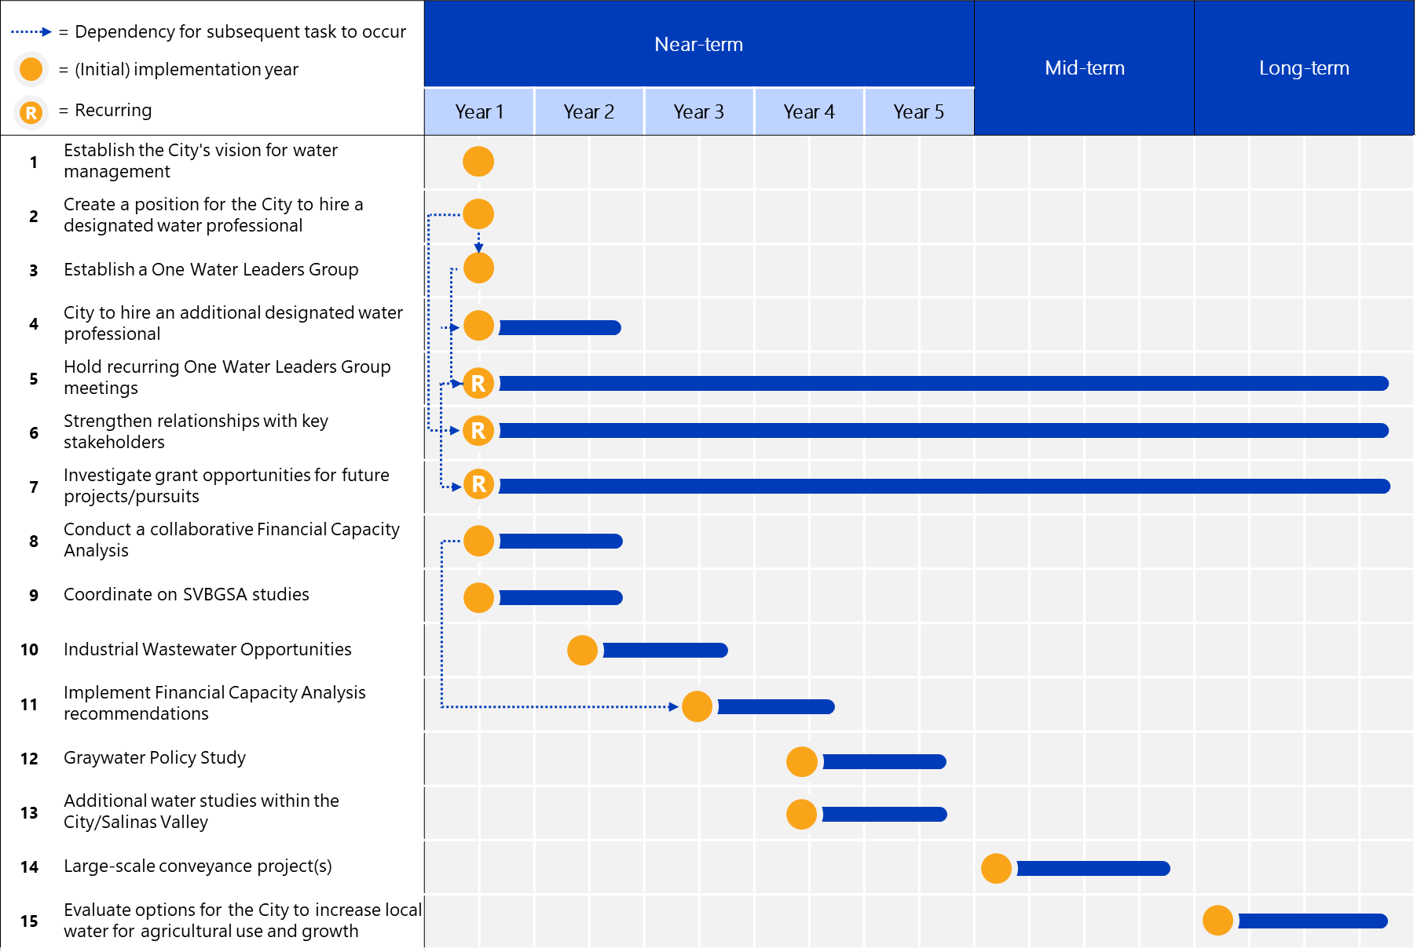
One Water Roadmap
15 recommended projects/efforts
All near-term projects can be started early but projects were divided into groups from Year 1 - 5 to spread out workload
Notes:
A total of 15 One Water recommendations are ultimately presented in the Roadmap.

Slide 12
Immediate Efforts #1-9 (Year 1)
Establish City vision
Create and Hire City water professional position(s)
Establish One Water Leaders Group
Hold Recurring Meetings
Strengthen Relationships
Investigate grant opportunities
Conduct Financial Capacity Analysis
Coordinate on SVBGSA studies

Slide 13
Near-term Efforts #10-11 (Years 2-3)
Pursue industrial wastewater reuse opportunities
Implement Financial Capacity Analysis
Near-term Efforts #12-13 (Years 4-5)
Graywater Policy Study
Conduct additional water studies not covered by previous efforts

Slide 14
Mid-term & Long-term Efforts #14-15
Large-Scale conveyance projects
Increase local water for ag use and growth

Slide 15
One Water
Roadmap
City of Salinas
City Council Meeting
June 30, 2026
QUESTIONS?

