Slide 1


General Plan Update:
Public Safety and
Health & Environmental Justice Study Session
City Council
April 23, 2024

Slide 2
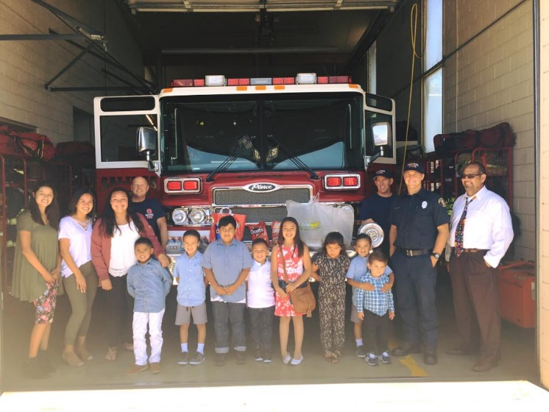
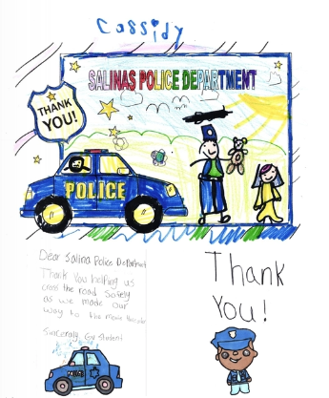
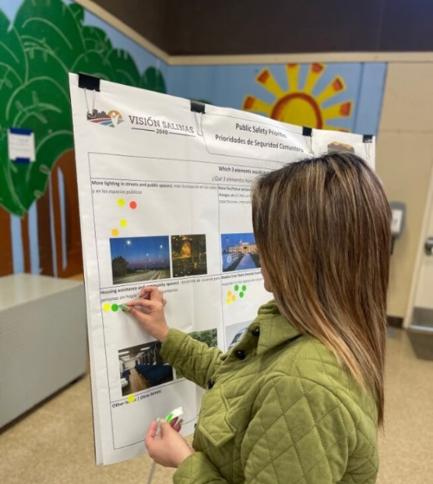
Study session purpose
Give Council an opportunity to shape draft policy
Share update on HEJ and PS engagement
HEJ and PS are closely related as topics and in state law

Slide 3
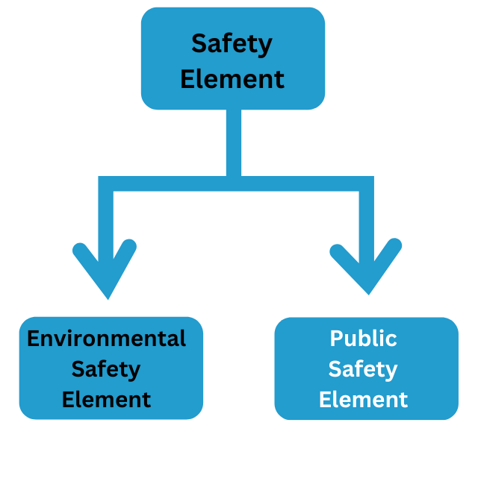
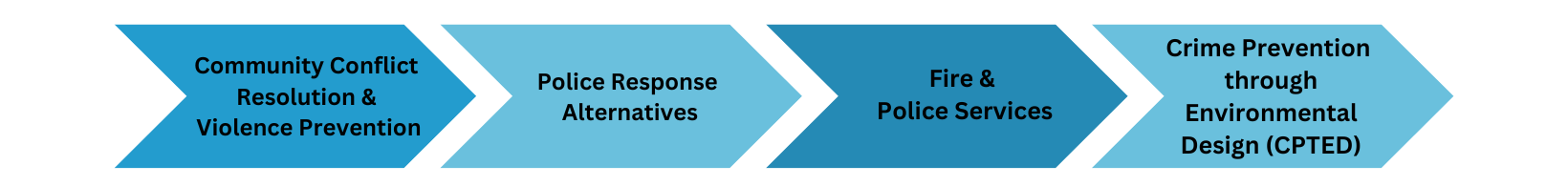
Public Safety Element Structure
The previous General Plan held the concept of safety as a broader concept which included safety from natural and human made hazards and how to mitigate and address them.

Slide 4
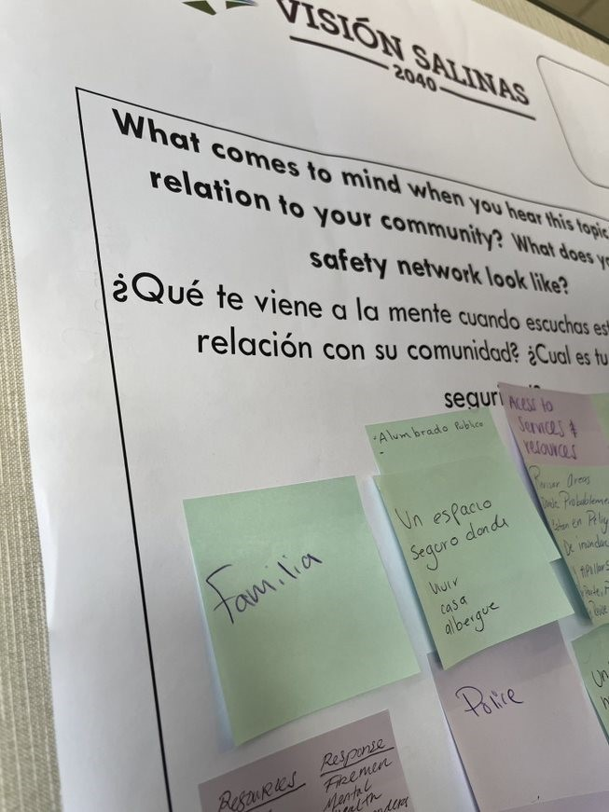
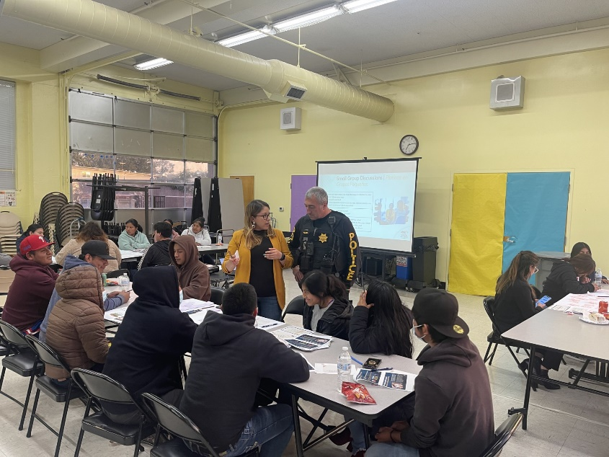
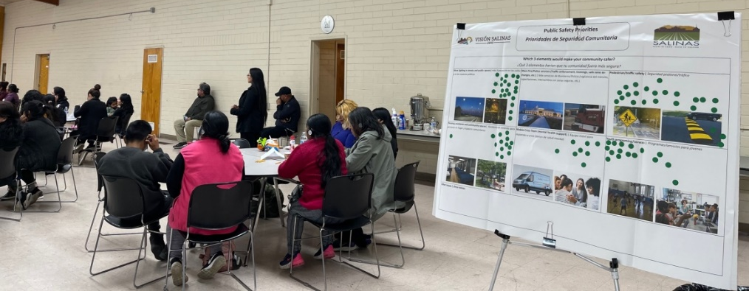
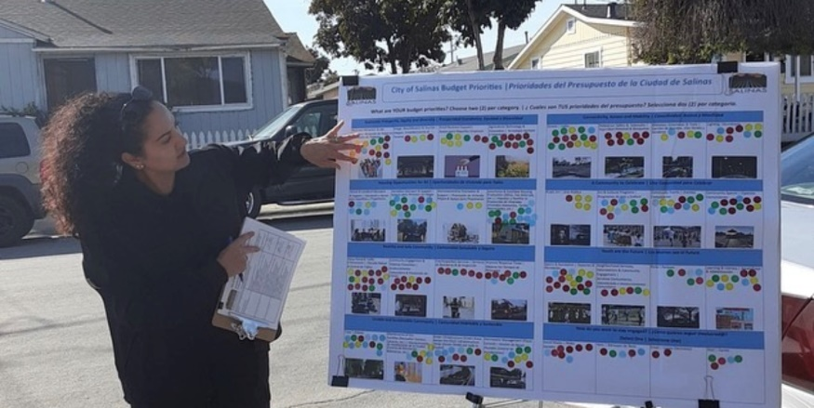
Public Safety Engagement
4,500+ residents engaged
Engagement sources:
  (2) Community Workshops
  (4) Pop-up Activities
  Youth Survey
  Budget Survey

Slide 5
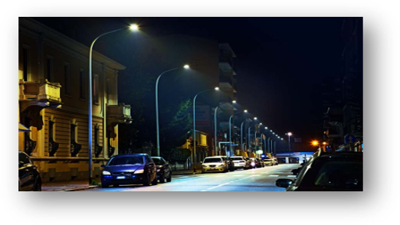
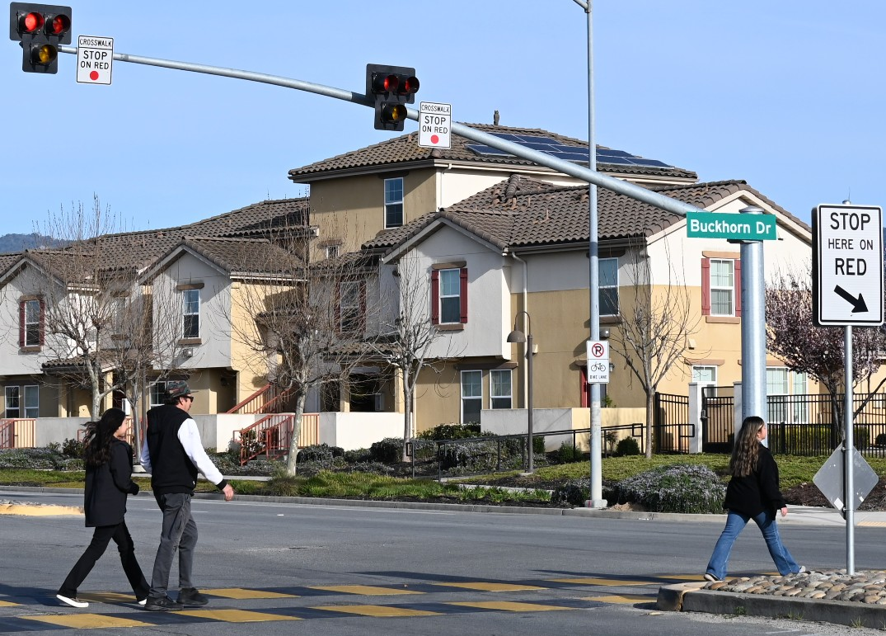
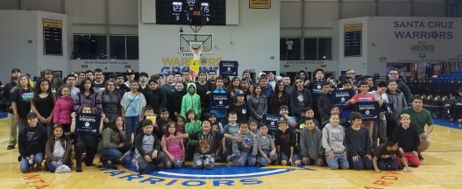
Feedback
Pop-up Activity:
  (1) More lighting in streets and public spaces, (2) Pedestrian traffic safety, and (3) Youth programming and services
Youth Survey:
  More lighting on the streets and in public places, more police/fire services, programs and services for youth
General Recurring Themes:
  More community engagement, communication w/ underserved communities.
  Programs for youth, safety trainings
  Mental health support, mobile crisis unit

Slide 6
Public Safety Policies
PS Goal 1: Continue to play a central role in the creation and maintenance of a community that resolves its problems in non-violent ways.
  Improve community safety through civic engagement and relationship building.
  Implement alternative policing methods.
PS Goal 2: Provide effective and responsive police and fire services to ensure a safe and vibrant community.
  Ensure residents have effective and responsive emergency services.
  Improve facilities and access to equipment and technology.
  Foster collaboration with other departments, outside agencies/organizations to improve community reach.
  Provide a range of services to support community education and non-emergency situations.

Slide 7
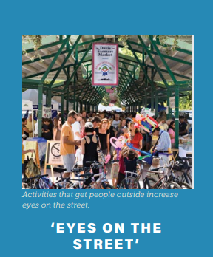
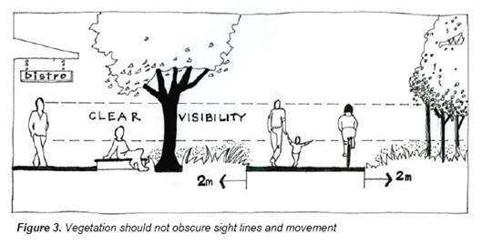
Public Safety Policies
PS Goal 3: Create a safer community through the use of design techniques for existing spaces, new developments and reuse/revitalization projects.
  Promote the use of Crime Prevention through Environmental Design techniques and strategies.
  Cultivate a safe and clean neighborhood environment.

Slide 8

Health and EJ Background
First HEJ Element for the City of Salinas
The (Health) Environmental Justice Element is the result of Senate Bill 1000
What is Environmental Justice?
  The fair treatment of people of all races, cultures, and incomes with respect to the development, adoption, implementation, and enforcement of environmental laws, regulations, and policies. (CalEPA)

Slide 9
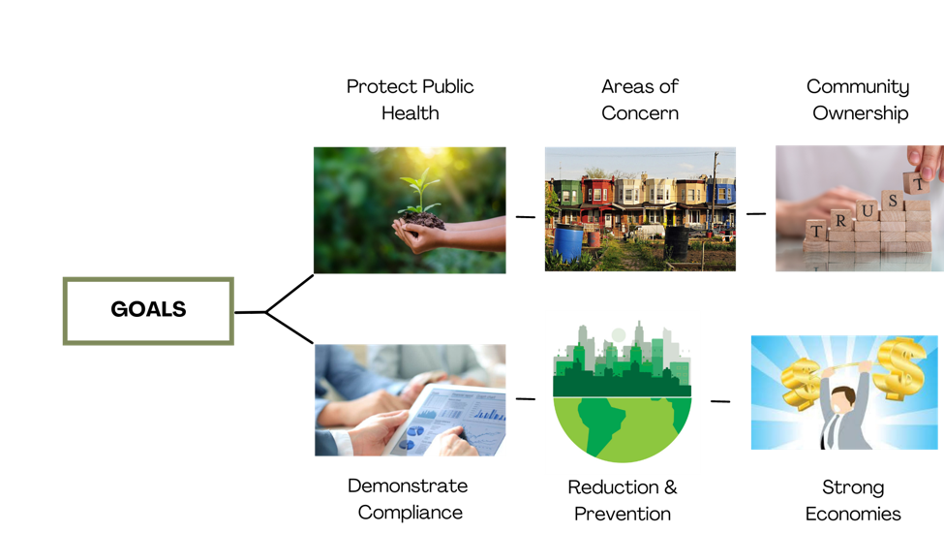
Health and EJ Background
SB 1000 Policy Objectives

Slide 10
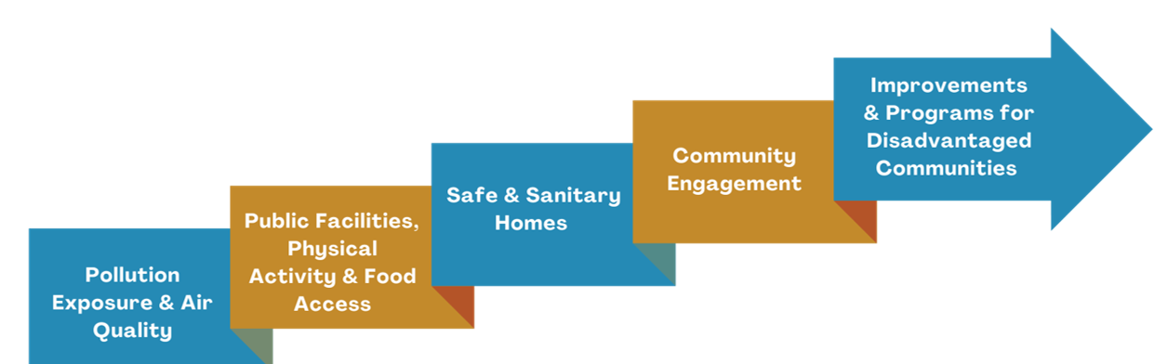
Health and EJ Background
Policies must address:

Slide 11
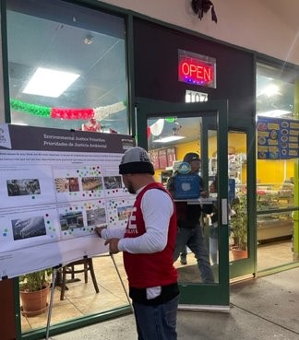
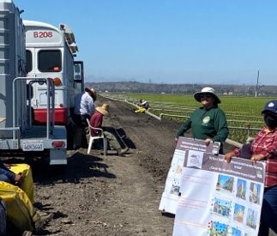
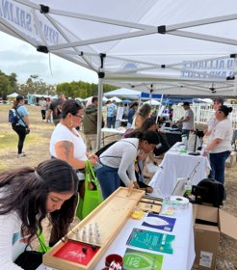
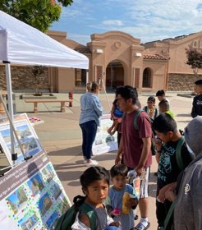
Health and EJ
Engagement
1,900 residents engaged total
540 residents reached
  2 Workshops, one English and one Spanish
  6 Pop-up Activities
  Focus groups/Presentations
Top three areas of concern:
Health care access
Access to safe/healthy housing
Access to healthy food and grocery stores.

Slide 12
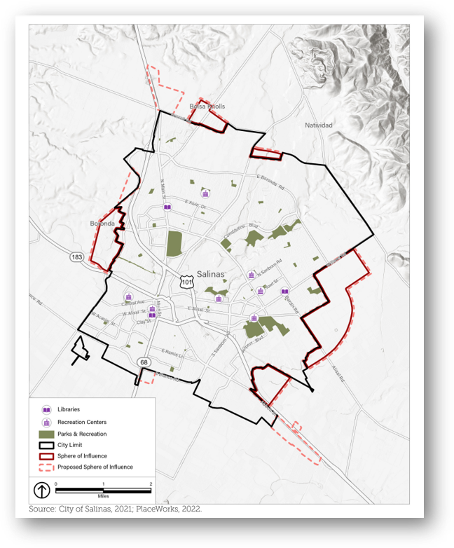
Health and Environmental Justice Recurring Themes
More open/public space
Unsafe housing
Water quality, creek restoration
Lack of green space
Pesticide exposure
A safe walkable/bikeable community

Slide 13
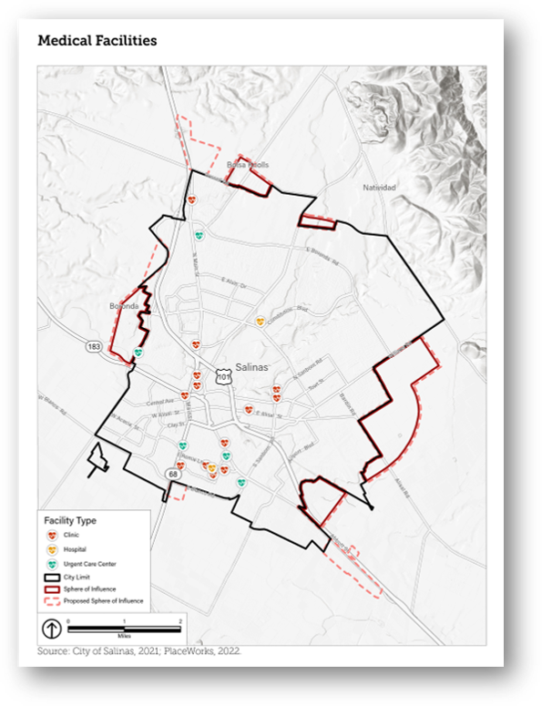
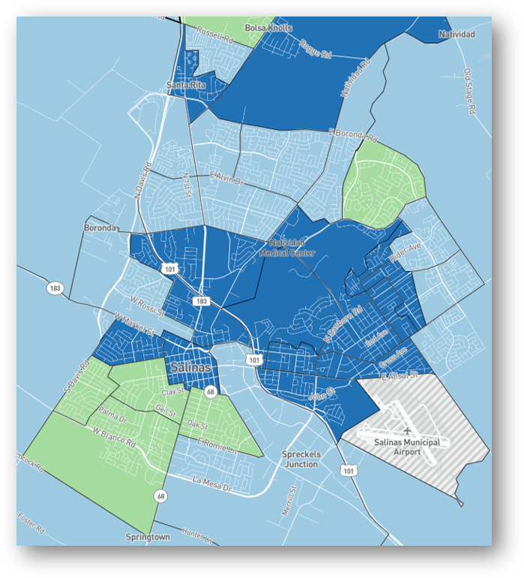
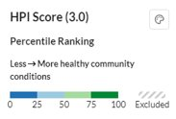
Recurring Themes
Notes:
Healthy Place Index

Slide 14
Health and EJ Draft Policies
HEJ Goal 1: Improve the quality of the built and natural environments to support healthy lifestyles & reduce health inequities.
  Improve the built environment through land use policies and programs.
  Ensure that sensitive land uses are not negatively impacted by hazardous materials.
HEJ Goal 2: Provide and maintain a range of community services, programs, and institutional facilities to equitably meet the needs of the community.
  Expand access to high quality childcare.
  Provide resources for seniors, persons with diverse abilities and other vulnerable populations.
  Strengthen the capacity and sustainability of community-based organizations (CBOs).

Slide 15
Health and EJ Draft Policies
HEJ Goal 3: Ensure all Salinas’ residents have access to purchase and grow healthy, affordable, and culturally diverse relevant foods.
  Reduce food insecurity and promote healthier eating habits through community programs and education.
HEJ Goal 4: Ensure safe and sanitary homes.
  Work to eliminate health risks associated with lead-based paint, mold and other contaminants.
HEJ Goal 5: Promote spaces for physical activity.
  Create and maintain safe and accessible spaces to encourage physical activity.
  Provide resources for youth and seniors to engage in safe physical activity.

Slide 16
Health and EJ Draft Policies
HEJ Goal 6: Encourage Robust Civic Engagement and the Development of Resident Leaders Committed to Shaping the City's Future.
  Create a welcoming environment for community engagement.
  Build resident leadership.
HEJ Goal 7: Improve existing and create new programs that address the needs of disadvantaged communities.
  Continue to provide services to stabilize unhoused population.
  Reduce disparities among different race/ethnicities, income levels and LGBTQ+ communities.

Slide 17
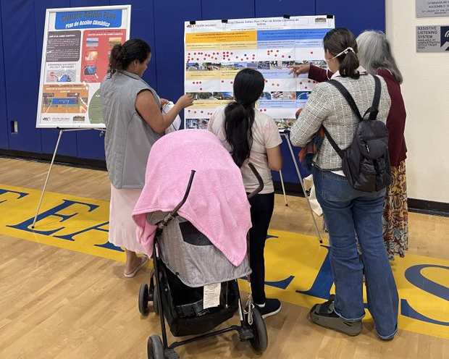
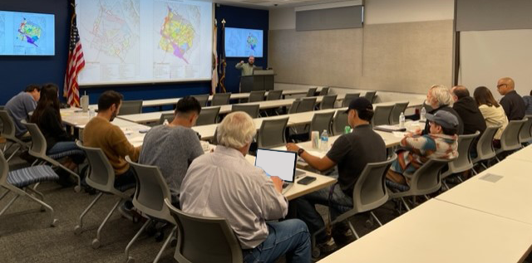
2024 Upcoming Engagement and Review
General Plan Open House and Climate Action Plan Webinar in Spring 2024
City Council and Planning Commission study sessions
Draft General Plan early summer, draft EIR and CAP late summer

Slide 18
Questions & Comments

