Slide 1

SUBSTANTIAL AMENDMENTS TO UNITED STATES DEPARTMENT OF HOUSING AND URBAN DEVELOPMENT ANNUAL ACTION PLANS FOR HEBBRON FAMILY CENTER
Francisco Brambila, Acting Planning Manager
Community Development Department – Housing Division
December 5, 2023

Slide 2
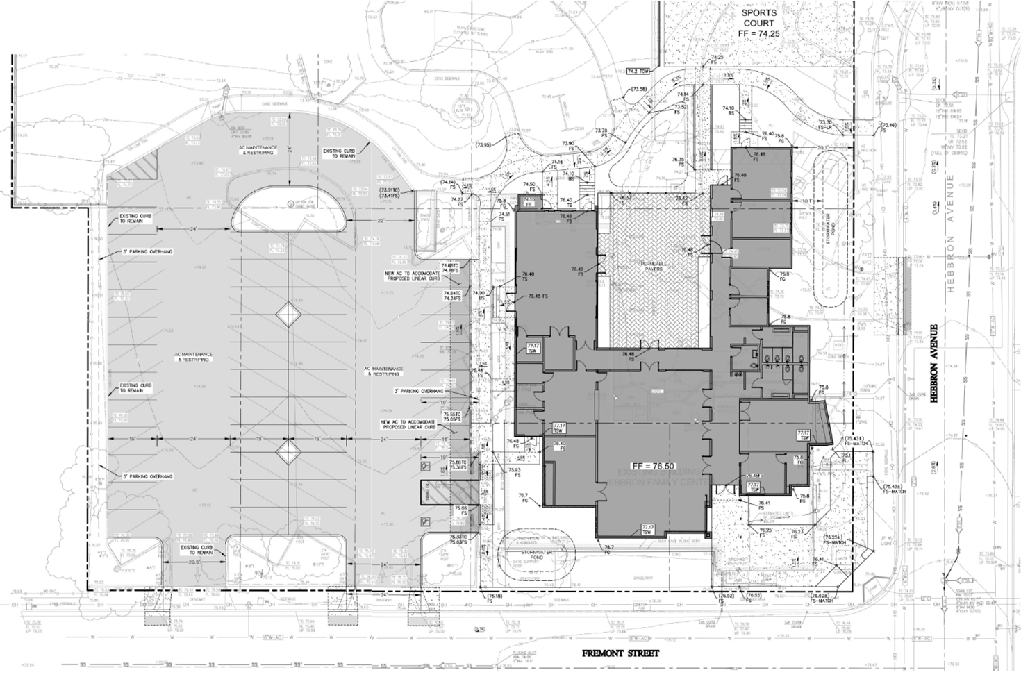
Background
Current CDBG HFC funds = $1,647,115
HFC funding shortfall = $3.6 million
Proposed reallocation = $1,410,00
Total CDBG HFC funds = $3,054,115
Funding from prior FYs completed or unimplemented projects
Requires Substantial Amendment
  Exceeds 25% threshold of existing project funds

Slide 3
Available Funds
AAP FY | CDBG Project Name | Available Per Project | Available Per FY
2017-18 | Housing Services | $117,435 | $692,929
 | Moon Gate Plaza Commercial Floor | $575,494
2018-19 | Moon Gate Plaza Commercial Floor | $453,862 | $453,862
2019-20 | Housing Services | $97,712 | $101,415
 | Grid Alternatives | $3,703
2020-21 | CDBG Administration | $161,794 | $161,794
 | Total Additional Funds to HFC Project | $1,410,000 | $1,410,000

Slide 4
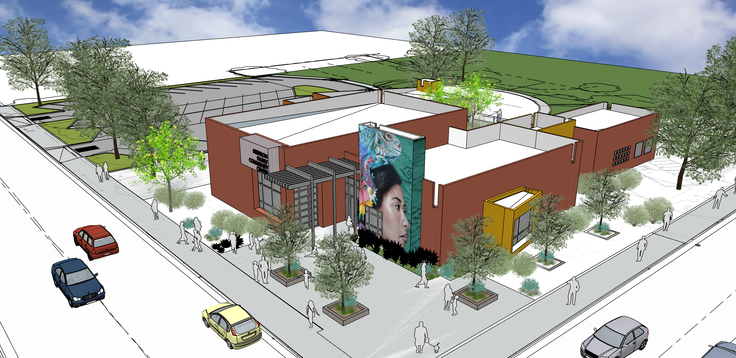
Citizen Participation Plan
30-day Notice of Public Hearing and Public Comment Period
November 3 – December 5, 2023
Draft Amendment Summary for Public Review
Notice of Public Hearing posted:
  Published in The Monterey Herald
  Posted on City’s website
  Posted at Community Development Department, City Hall, Libraries
  Distributed to CDD Housing Division Email List and per email request

Slide 5
CEQA Consideration
Departmental Coordination
  Finance
  Legal
  Library and Community Services
  Public Works
  The project is exempt from the California Environmental Quality Act (CEQA) Guidelines Section 15302 et al., Class 2 because the project proposes the replacement and reconstruction of an existing structure.

Slide 6
Strategic Plan Initiative
  Infrastructure and Environmental Sustainability
  Public Safety
  Youth and Seniors
  Effective and Culturally Responsive Government
  Parks Recreation and Libraries Master Plan
  Alisal Vibrancy Plan
Fiscal and Sustainability Impact
  No General Fund Impact
  Project funded with CDBG Entitlement Funds

Slide 7
Recommended Motion
Approve a Resolution authorizing:
  the submission of Substantial Amendments to the United States Department of Housing and Urban Development for Fiscal Year 2017-18, 2018-19, 2019-20, 2020-21, and 2022-23 Annual Action Plans;
  the allocation of an additional $1,410,000 in available Community Development Block Grant program funds to the Hebbron Family Center project; and
  the Mayor or designee to execute, for and on behalf of the City, any agreements or related documents (e.g., grant contracts, grant certifications, etc.) applicable to the Substantial Amendments and the allocation of additional CDBG funds to the Hebbron Family Center project.

Slide 8
Questions & Comments

