Slide 1

ARPA GRANT FUNDING AGREEMENT WITH EDEN HOUSING, INC. FOR A PROPOSED 100% AFFORDABLE MULTIFAMILY RENTAL HOUSING PROJECT AT 855 EAST LAUREL DRIVE
March 14, 2023
HOUSING AND LAND USE COMMITTEE
Presented by: Luis Ochoa, Sr. Community Development Analyst

Slide 2
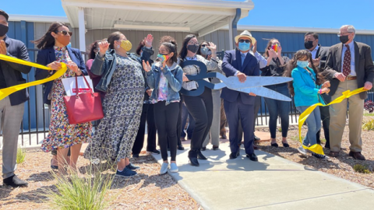
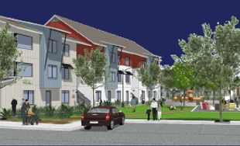
Background
Memorandum of Understanding
    construction and operation
      permanent homeless shelter
      permanent supportive and transitional housing project
    Projects
    SHARE Center
    100% Affordable Multifamily Rental Housing Project
Notes:
MOU between City and County
Conversation started 2017
Develop formal Agreement: September 25, 2018
MOU Executed: June 22, 2021
Salinas Housing Advancement Resources and Education Center (SHARE Center)
845 E. Laurel Drive
Housing Project
1. at 1220 Natividad Road

Slide 3

Background
May 6, 2022
City and County joint RFQ released
October 4, 2022
City and County joint selection of Eden Housing, Inc
February 7, 2023
BS approves execution of Exclusive Negotiating Agreement
March 21, 2023
CC approves execution of ARPA Grant Funding Agreement
Notes:
Developer, Eden Housing, was selected for the construction of the project.
Their proposal is for 180 units for low and very low-income residents.
These units will consist of 1, 2, and 3 bedroom units
Joint RFQ
Minimum Units: 50
100 % Affordable Housing Project
Ground Lease: At least 55 Years
Affordability Restriction – 55-Years

Slide 4
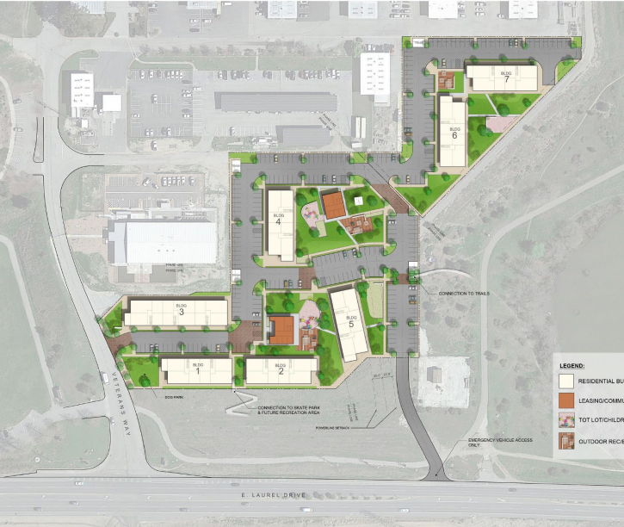
Project’s Specs
Phases I & II
132 Units
  50% 2-BR
  25% 1-BR
  25% 3-BR
Project under 5 acres
  Exempted under CEQA
Ground Lease – 99 Years
Notes:
Developer, Eden Housing, was selected for the construction of the project.
Their proposal is for 180 units for low and very low-income residents.
These units will consist of 1, 2, and 3 bedroom units

Slide 5
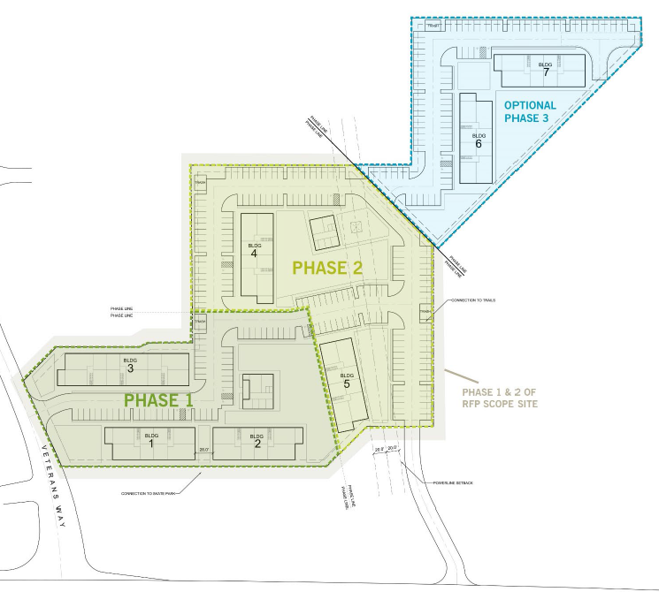
Pre-Development Timeline
Task | Start Date | End Date
Due Diligence | February 2023 | April 2023
Community Outreach | April 2023 | July 2023
Preliminary Design | February 2023 | April 2023
Schematic Design | July 2023 | September 23
Zoning + Environmental Approvals | April 2023 | July 2024
Design Development + Contract Documents | August 2025 | July 2026
Soft Debt Financing Applications | July 2024 | July 2025
Tax Credit Application | February 2026 | July 2026
Construction Loan Closing (First Phase) | July 2026 | January 2027

Slide 6

Pre-development Budget
Funding Entity | Funding Source | Funding Amount
City of Salinas | ARPA* | $500,000
County of Monterey (Fee Waiver) | TBD | $26,024
Eden Housing Inc. (Line of Credit) | Bank/Financial Entity | $1,717,509
 | Total | $2,243,533
*ARPA funds are anticipated to cover the cost of the following scope of work: architectural design, landscape architecture, engineering, and environmental consulting and technical studies.

Slide 7
ARPA Funding
Affordable Housing Production Fund
Funding Entity | Project Address | Funding Amount
City of Salinas | 403 E. Romie Ln | $1,454,755
City of Salinas | 855 E. Laurel Drive | $ 500,000
Total Funds Awarded |  | $ 1,954,755
Total Affordable Housing Production Fund | $ 7,000,000
Affordable Housing Production Funds Awarded | $ 1,954,755
Total Funds Remaining | $5,045,245
Notes:
1,454,755.40 (Include cost of unit, appraisal, home inspection, and escrow fee)

Slide 8
Discussion
Execute $500,000 ARPA Grant Funding Agreement with the Developer for predevelopment
Monterey County expressed the desire to process entitlements for the Project
Deviation from Salinas Zoning Code - Zoning Code Section 37-10.180
Notes:
1. Execute a reimbursement-based ARPA Grant Funding Agreement with the Developer in an amount of $500,000 to support costs associated with pre-development phase of the Project.
2. Monterey County expressed the desire to process entitlements for the proposed Project since it is located on County-owned property and is willing to follow the City’s zoning as closely as it’s feasible for the project.
3. In Support ENA and ARPA Funding Agreement & Facilitate and expedite the Project’s entitlement process
4. City Council through Zoning Code Section 37-10.180 has the authority to deviate from “development standards contained in this Zoning Code if it can be established that the deviation is necessary in the interest of public health and safety or is required as part of environmental mitigation.”
Salinas Zoning Code Section 37-10.080 normally requires land owned by Monterey County “to be subject to the regulations contained in this Zoning Code, unless otherwise provided by law.”
The 100% Affordable Housing Rental Project at 855 E. Laurel Drive is proper and in the public interest and shall not be subject to additional land use approvals, permits, or entitlements from the City

Slide 9
Recommendation
The Housing and Land Use Committee supports:
1. the one-time deviation from the City of Salinas Zoning Code to allow the County of Monterey to process entitlements for the project
2. the execution of a $500,000 ARPA Grant Funding Agreement with Eden Housing, Inc for pre-development costs

Slide 10
Questions & Comments

