Slide 1
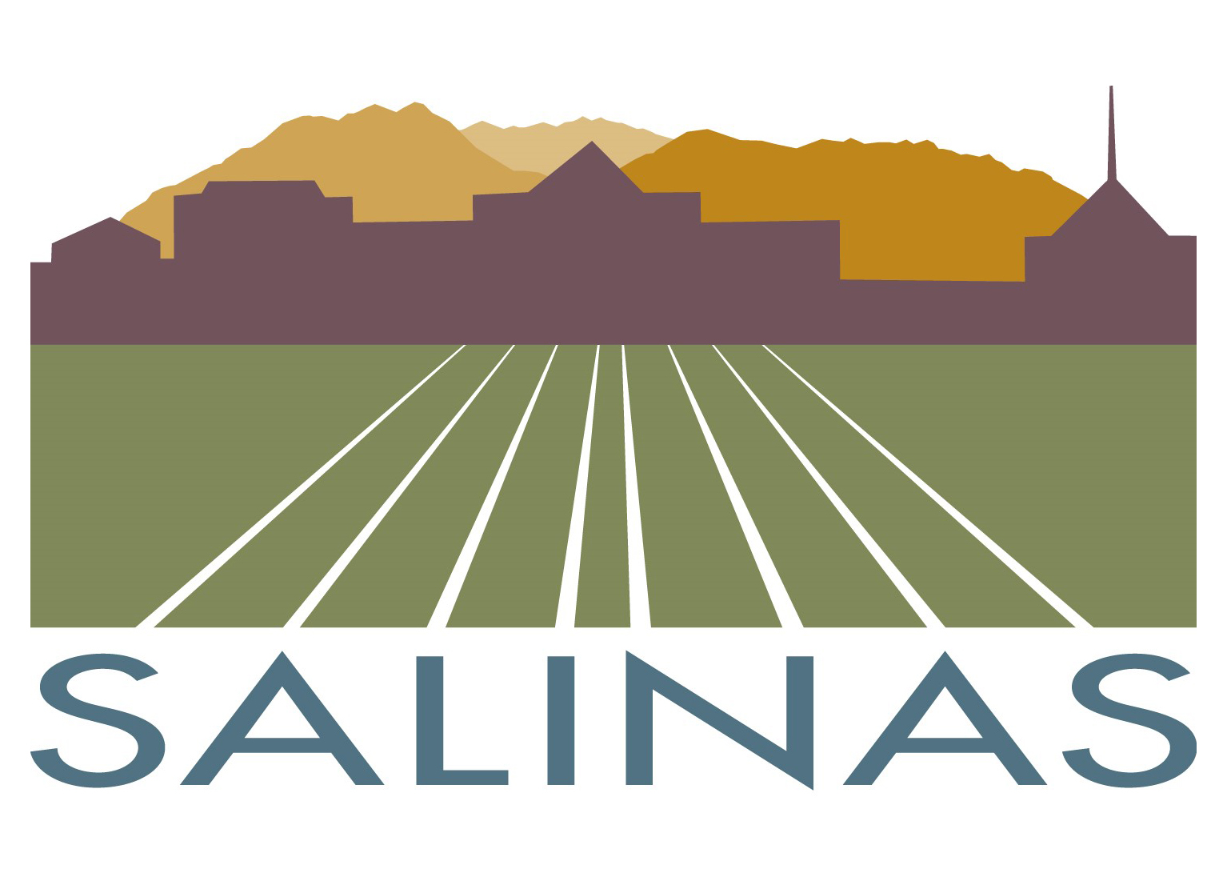
Adoption of the Salinas
Emergency Operations Plan 2026
City Council briefing
October 2026
Notes:
Sources: City of Salinas Emergency Operations Plan 2026; Adoption administrative report dated October 1, 2026.

Slide 2
Why the plan is being updated
The 2015 plan predates major changes in risk, technology, public warning, and continuity planning.
Uses current Salinas hazard and exposure information
A current Citywide framework for emergencies
Addresses cyber incidents, public health emergencies, utility failures, and severe weather
Defines how every City department supports EOC operations
Aligns City operations with SEMS, NIMS, and the Incident Command System
2
Notes:
Sources: City of Salinas Emergency Operations Plan 2026, sections 1–5; adoption administrative report, Background and Executive Summary. The statement about the 2015 plan is a date-based comparison, not a line-by-line redline.

Slide 3
Emergency management standards
The 2015 plan did not expressly identify SEMS or the Incident Command System as the City’s operating doctrine.
SEMS
California’s Standardized Emergency Management System for multi-agency coordination, mutual aid, and communication among field, City, Operational Area, regional, and state levels
The 2026 plan makes the operating framework explicit
NIMS and ICS
National standard command structure for field operations, including common terminology, manageable span of control, and scalable incident organization
City EOC
Coordinates policy, information, resources, continuity, public communications, and regional support while field command retains tactical control
The updated plan also establishes activation levels, operational periods, EOC Action Plans, resource tracking, and standardized documentation.
3
Notes:
Sources: City of Salinas Emergency Operations Plan 2026, sections 1, 3, and 4. Comparison to the 2015 plan reflects the City’s review that SEMS and ICS were not expressly identified in that plan.

Slide 4
How the plans work together
MONTEREY COUNTY MULTI-JURISDICTIONAL HAZARD MITIGATION PLAN
SALINAS EMERGENCY
OPERATIONS PLAN
Identifies and assesses Salinas hazards, community exposure, and long-term projects that reduce risk before disasters occur.
Directs how the City organizes, communicates, protects residents, obtains resources, maintains services, and recovers during emergencies.
Two adopted plans with different but connected purposes
The 2026 EOP uses the mitigation plan’s Salinas risk assessment as its planning basis and includes operational annexes for:
Earthquake and liquefaction
Flood, severe weather, and El Niño
Dam failure
Wildfire, smoke, heat, and drought.
Cyber attack and utility interruption
Public health and water contamination
Targeted violence and civil disturbance
Airport emergencies
4
Notes:
Sources: City of Salinas Emergency Operations Plan 2026, sections 1 and 2 and Hazard Annexes M through T; Monterey County Multi-Jurisdictional Hazard Mitigation Plan as adopted by the City Council.

Slide 5

Salinas hazard priorities
Highest Threat and Hazard Identification and Risk Assessment (THIRA) scores
HIGH
13.6 Drought
13.3 Earthquake
12.7 Cyberattack
SUBSTANTIAL
Seven additional hazards score from 10.1 to 11.7
Scores combine extent, likelihood, severity, and impact. Maximum score: 16.
CITY OF SALINAS EOP UPDATE
MJHMP Annex J, Table J-2
4
Notes:
Use the City planning team's rankings to set plan and exercise priorities. The ranking is not a response dispatch matrix; lower-ranked hazards can still require immediate protective action.
Sources:
MJHMP Volume 2, Annex J, Table J-2

Slide 6
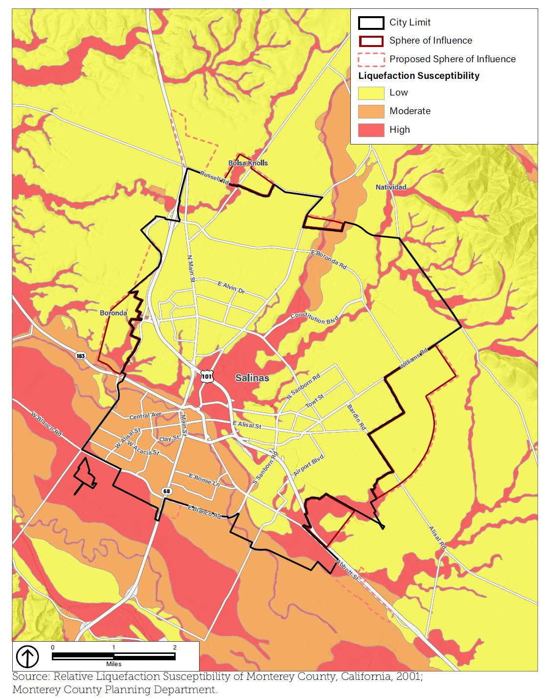

Earthquake risk is citywide
Liquefaction concentrates additional risk in former wetlands and alluvial soils
32,057
buildings potentially exposed
$12.42B
combined building value
40,954
people in high liquefaction susceptibility
High susceptibility areas include 2 emergency response facilities, 5 medical facilities, 24 government facilities, 67 communication facilities, 5 rail miles, and about 80 road miles.
CITY OF SALINAS EOP UPDATE
MJHMP Annex J, Table J-4 and Figure J-2
5
Notes:
The entire City may experience direct or indirect earthquake consequences. The EOP should assume access restrictions, simultaneous fires, medical surge, and extended utility impacts.
Sources:
MJHMP Volume 2, Annex J, pages J-8 to J-9

Slide 7
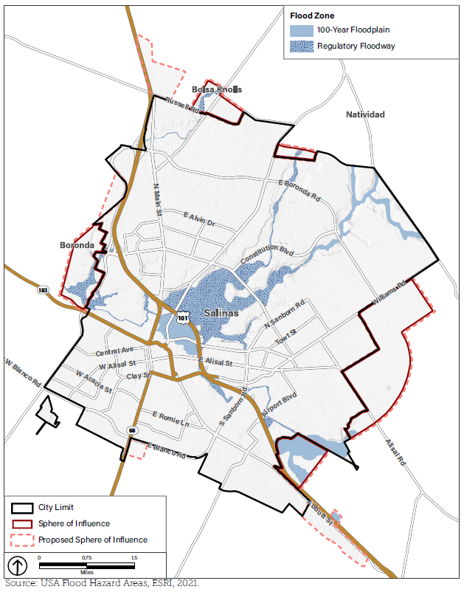
Flooding follows known corridors
Creeks, Carr Lake, the Reclamation Ditch, and drainage constraints shape local operations
15,415
people in the 1% annual chance floodplain
$723M
residential and nonresidential property in that floodplain
21 mi
of roadway in the 1% annual chance floodplain
Known problem areas include Carr Lake, Cesar Chavez Park, Gabilan, Natividad and Alisal Creeks, Kern, Market, Merced and Williams, and the Reclamation Ditch.
CITY OF SALINAS EOP UPDATE
MJHMP Annex J, Table J-5 and Figure J-3
6
Notes:
The plan identifies Sherwood Park Mobile Home Park and areas downstream of Carr Lake as a particular concern. Portions of the airport and critical facilities also lie in the 1 percent annual chance floodplain.
Sources:
MJHMP Volume 2, Annex J, pages J-10 to J-11

Slide 8
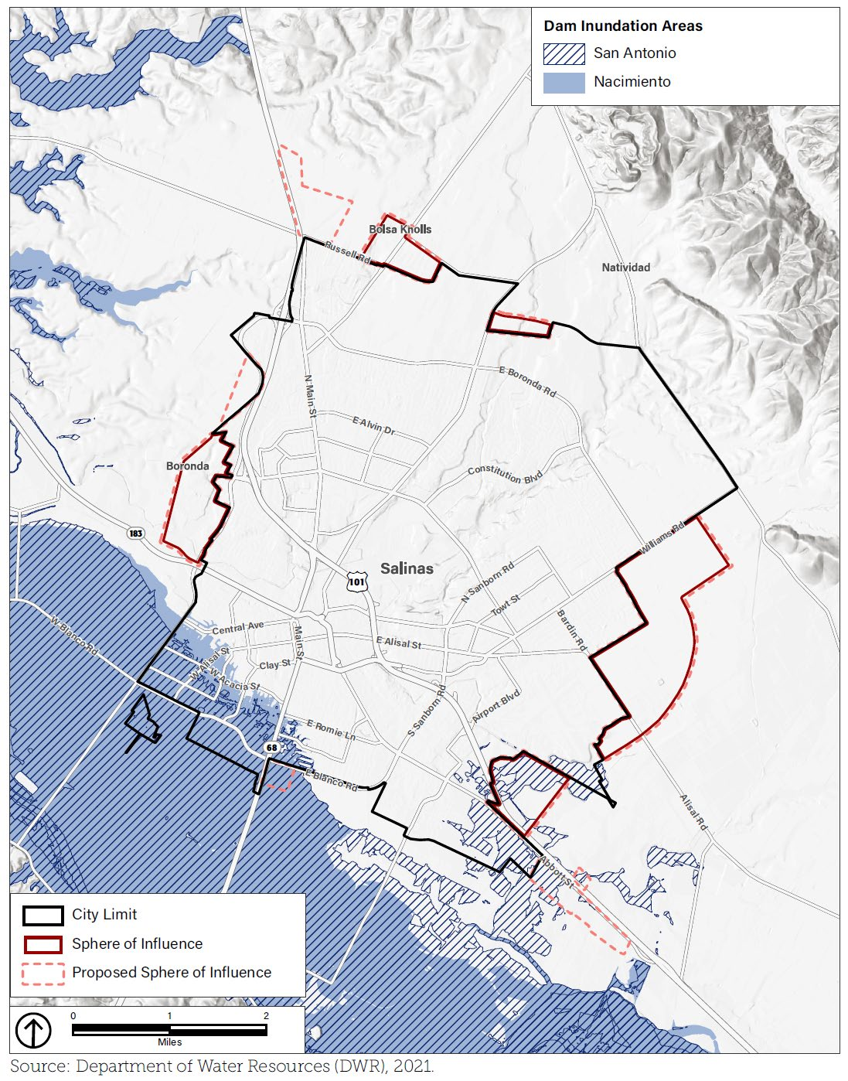

Dam failure requires route-based evacuation planning
Nacimiento and San Antonio scenarios affect the south and west sides of Salinas
10,545
people exposed in the Nacimiento dam failure scenario
8,825
people exposed in the San Antonio dam failure scenario
Potentially exposed routes include Blanco, Davis and Harkins Roads, Highways 68, 101 and 183, and Abbott Street.
CITY OF SALINAS EOP UPDATE
MJHMP Annex J, Table J-3 and Figure J-1
8
Notes:
The evacuation annex should connect warning receipt, route status, transportation assistance, public warning, shelter, and reentry.
Sources:
MJHMP Volume 2, Annex J, pages J-6 to J-7

Slide 9
Hazardous materials and transportation corridors
82,575
Sources
Agricultural refrigerants and pesticides, fixed facilities, Highway 101, Union Pacific rail, and surface streets
residents in the modeled mobile source exposure area
Protective actions
Shelter in place or evacuation based on substance, quantity, weather, and route conditions
74,602
Coordination
Regional HazMat team activation, unified command, law enforcement, public health, hospitals, and facility operators
residents in the modeled fixed source exposure area
Continuity
Plan for power, water, communications, or transportation disruption during the release
Exposure figures use one mile planning buffers and do not predict the impact area of a specific release.
CITY OF SALINAS EOP UPDATE
MJHMP Annex J, Table J-6
9
Notes:
The EOP should reflect the current Monterey County regional hazardous materials response structure and the City's OES Type 1 capability. Protective action distances remain incident specific.
Sources:
MJHMP Volume 2, Annex J, pages J-11 to J-12

Slide 10
Other Salinas hazards require dedicated procedures
Several substantial risks can interrupt government and community services
CYBERATTACK 12.7
PUBLIC HEALTH 11.7
City systems, dispatch support, records, public information, and restoration priorities
Disease outbreak, workforce continuity, medical surge, health guidance, and mass care
WATER CONTAMINATION 11.1
UTILITY INTERRUPTION 10.6
Rapid warning, alternate water, public health coordination, and vulnerable populations
Critical facilities, communications, transportation, fuel, housing, and restoration priorities
TARGETED VIOLENCE 10.3
AGRICULTURAL EMERGENCY 11.5
Unified command, security, family assistance, victim services, and continuity
Economic disruption, worker health and safety, water supply, and regional coordination
CITY OF SALINAS EOP UPDATE
MJHMP Annex J, Table J-2
11
Notes:
The EOP can address these hazards with a combination of functional annexes and concise hazard annexes. Cyber, public health, and utility disruption also affect the City's ability to communicate.
Sources:
MJHMP Volume 2, Annex J

Slide 11
Principal changes in the 2026 update
Planning area | 2026 update
Hazards | Salinas-specific annexes and exposure data for earthquake, flood, dam failure, cyber, public health, utilities, and other threats
EOC operations | Activation levels, final department assignments, operational cycles, and position checklists
Public warning | English and Spanish messaging, accessible formats, redundant channels, and rumor control
Continuity and recovery | Essential-service priorities, damage assessment, cost documentation, reimbursement, and early recovery planning
Plan maintenance | Quarterly roster checks, annual review, updates after activations and exercises, and comprehensive review every three years
Areas added or strengthened since the 2015 plan
5
Notes:
Source: City of Salinas Emergency Operations Plan 2026. These are confirmed elements of the 2026 plan described as added or strengthened; no claim is made that this slide is a complete redline of the 2015 document.

Slide 12
How Salinas will operate
FIELD RESPONSE
CITY EOC
Incident Command System
Coordination and support
Tactical operations and life safety
Operations • Planning • Logistics
Finance • Public Information
One scalable system from field response to City policy
The City Manager serves as Director of Emergency Services
The EOC connects departments with the Monterey County Operational Area
Recovery, continuity, damage, and cost tracking begin during response
6
Notes:
Source: City of Salinas Emergency Operations Plan 2026, Concept of Operations and SEMS/NIMS Organization and EOC Operations.

Slide 13
Local risk and public protection
13.6
32,057
15,415
Drought and water shortage
hazard score
Buildings in the earthquake
planning inventory
Residents in the 1% annual-chance
floodplain
Salinas data guides planning and public communication
Every emergency message states
What happened and who is affected
What residents should do and where verified help is available
When the City will issue the next update
English and Spanish messages are released together whenever time permits, with accessible and backup communication methods.
7
Notes:
Sources: City of Salinas Emergency Operations Plan 2026, Salinas Hazard Profile and Information, Communications, and Public Warning; adoption administrative report, Salinas-Specific Hazard Basis and Public Information and Community Protection.

Slide 14
Council action
Recommended motion
Adopt the City of Salinas Emergency Operations Plan 2026 and direct staff to maintain the Plan through annual reviews, updates following activations and exercises, and a comprehensive review every three years from the date of adoption.
Adopt the City of Salinas Emergency Operations Plan 2026
Adoption has no immediate fiscal impact, and no appropriation is requested
The Plan supersedes prior City emergency operations plans upon approval
Questions ?
8
Notes:
Source: Adoption administrative report dated October 1, 2026, Recommended Motion and Fiscal and Sustainability Impact; City of Salinas Emergency Operations Plan 2026, Promulgation and Approval.

