Slide 1
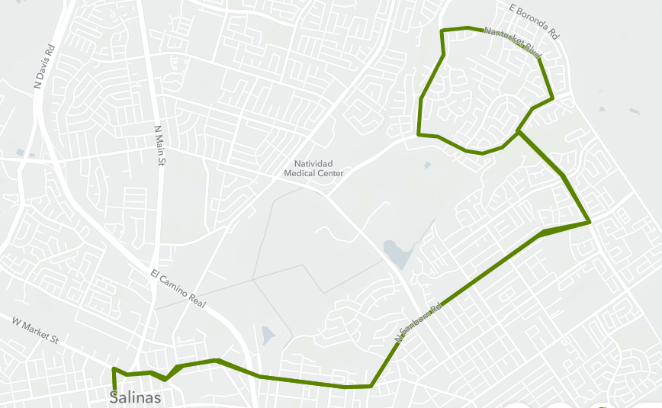
Nantucket Blvd & Independence Blvd
Nantucket Blvd & Hemingway Dr
Nantucket Blvd & Declaration St
Constitution Blvd & Nantucket Blvd
Constitution Blvd & Beacon Hill Drive
New bus stops to be installed

Slide 2
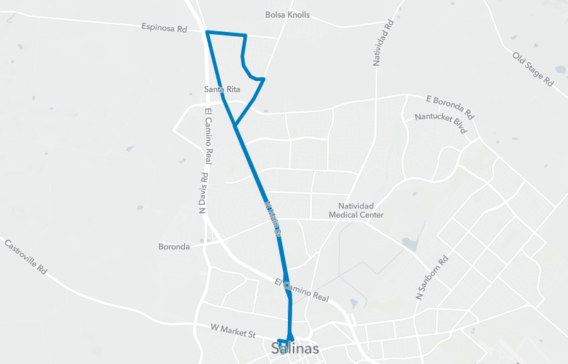
Russell Rd & Main St
Van Buren Ave & Russell Rd
Van Buren Ave & Eisenhower St
Old bus stops to be reinstated

Slide 3
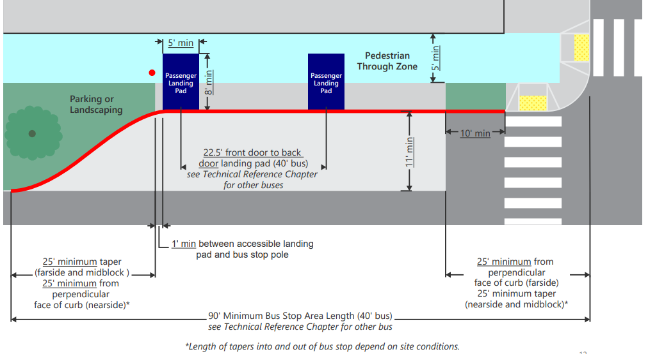
Red curb should be sufficient length to accommodate bus stop and pull out. MST Designing for Transit Guidelines indicates 90 feet.

