Slide 1

Economic Development Element Target Area K Agreements
Ferrasci Business Center Specific Plan
Lisa Brinton, Community Development Assistant Director
Salinas City Council
May 24, 2022

Slide 2
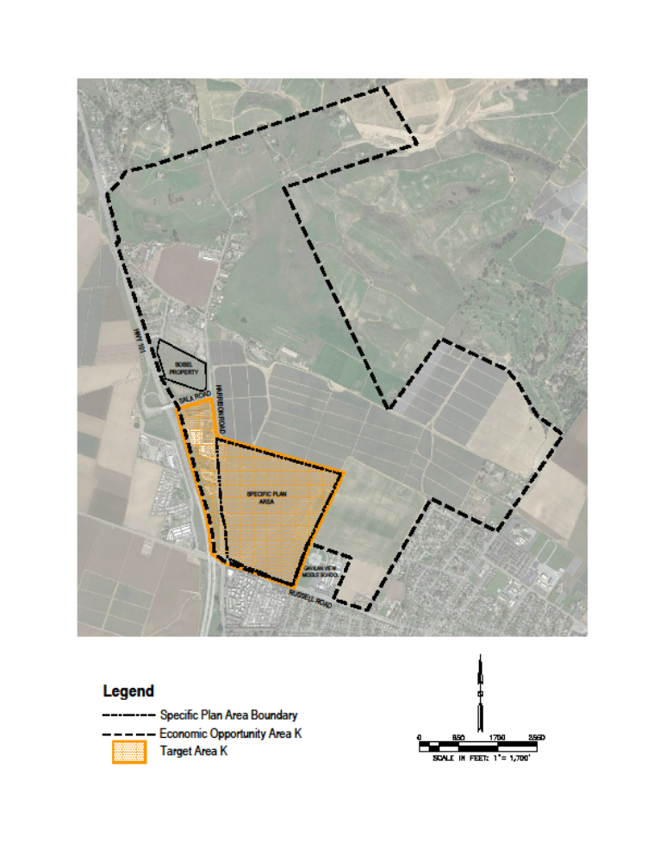
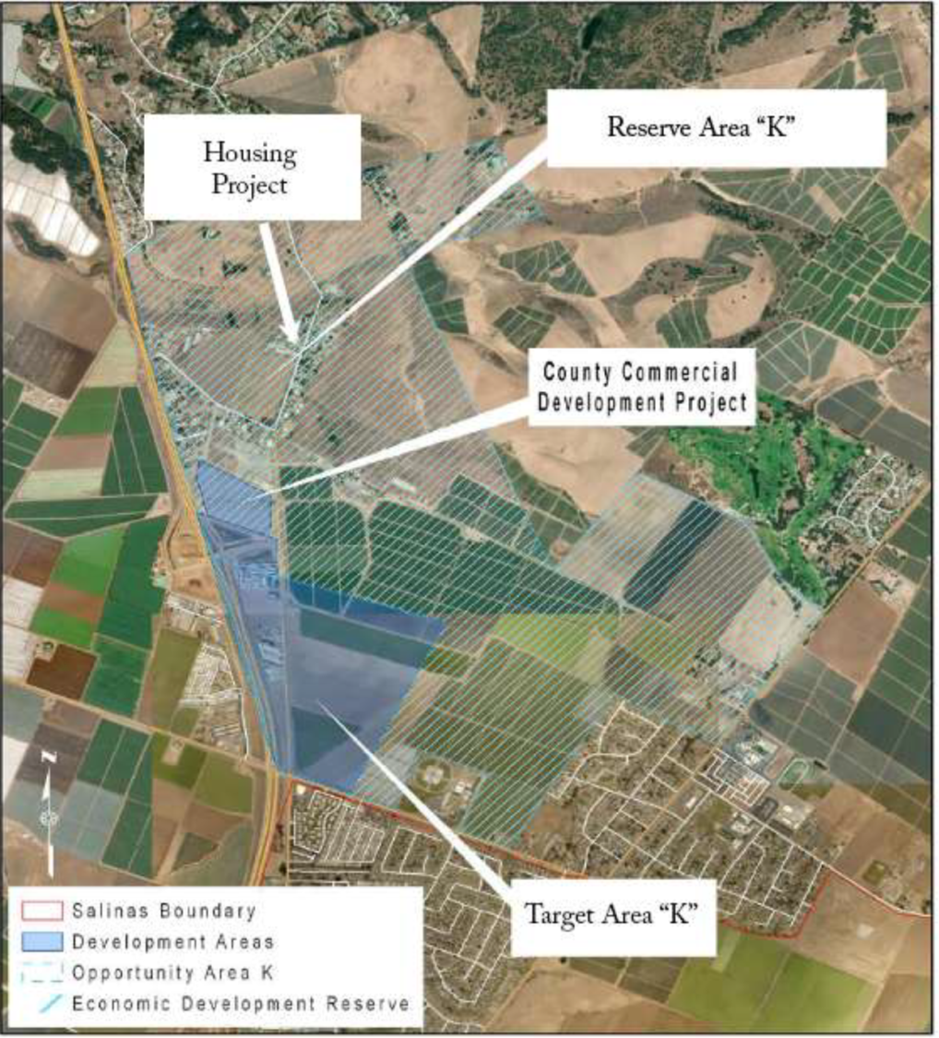
EDE Target Area K

Slide 3
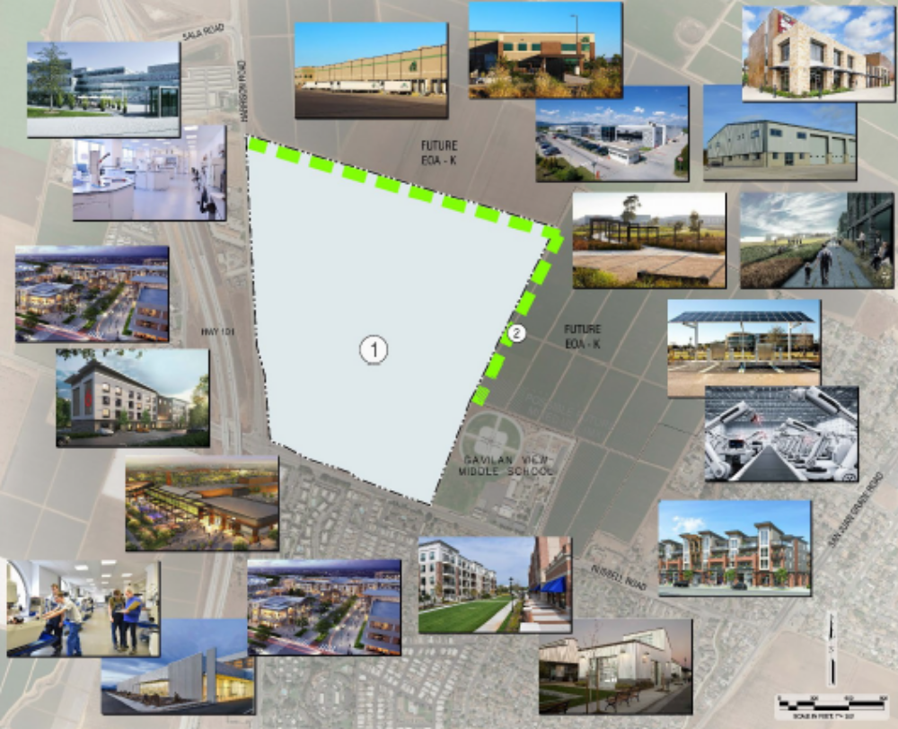
Ferrasci Business Center Specific Plan

Slide 4
Funding Agreement
Follows format, terms and conditions of recent agreements
Applicant agrees to reimburse City for cost and expenses associated with
  Consultant’s work (planning and environmental)
  City staff time (project management and processing)
Initial Deposit of $75,000; balance may not drop below $75,000
City to invoice applicant monthly.
Stop Work will be ordered if insufficient funds available to cover work
Notes:
Funding Agreement
Any remaining balance returned within 60 days of completion of work.

Slide 5
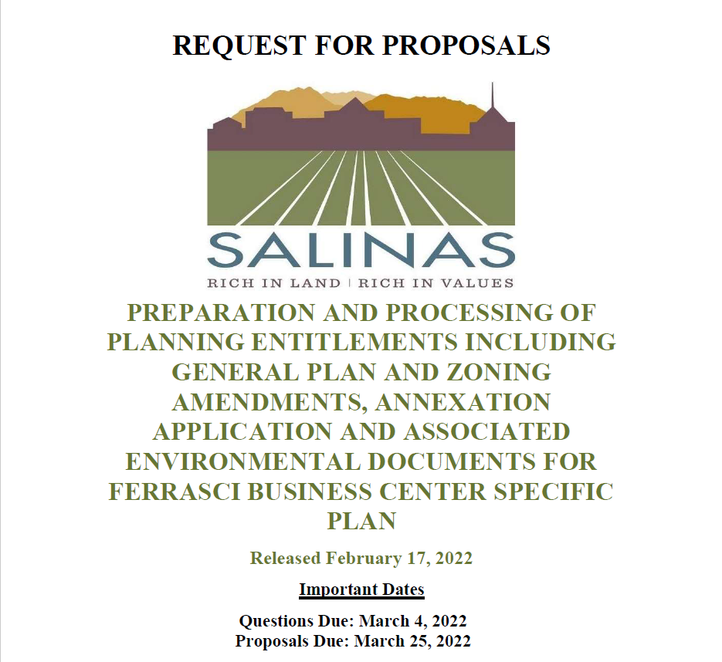
CEQA Compliance – Environmental Impact Report and Technical Studies
Technical Planning Support
Graphics and Final Document Packaging
Notes:
technical project support with the preparation and packaging of planning entitlements, including General Plan Amendment, Prezoning, Sphere of Influence and Annexation applications, Specific Plan and the preparation of associated Initial Study and required technical studies. It is anticipated that the environmental reivew of the Project can tier off of the EDE Program EIR (2017) which analyzed enviromental impacts in Target Area K. The ultimate determination of the appropriate environmental document required in accordance with the California Environmental Quality Act (CEQA) will be determined by the City based on the conclusions of the prepared Initial Study analysis.
CEQA Compliance – Environmental Impact Report and Technical Studies
Technical Planning Support
Graphics and Final Document Packaging
Support City staff completeness and technical review of the applications submitted for the General Plan Amendment, Specific Plan, Pre-Zoning, Sphere of Influence and Annexation.
Processing activities include reviewing applications, drafting review comments, consistency analysis, and other technical recommendations
Support staff to prepare for and participate in meetings with applicant to review project application comments and response to comments.
Public Hearing Preparation

Slide 6
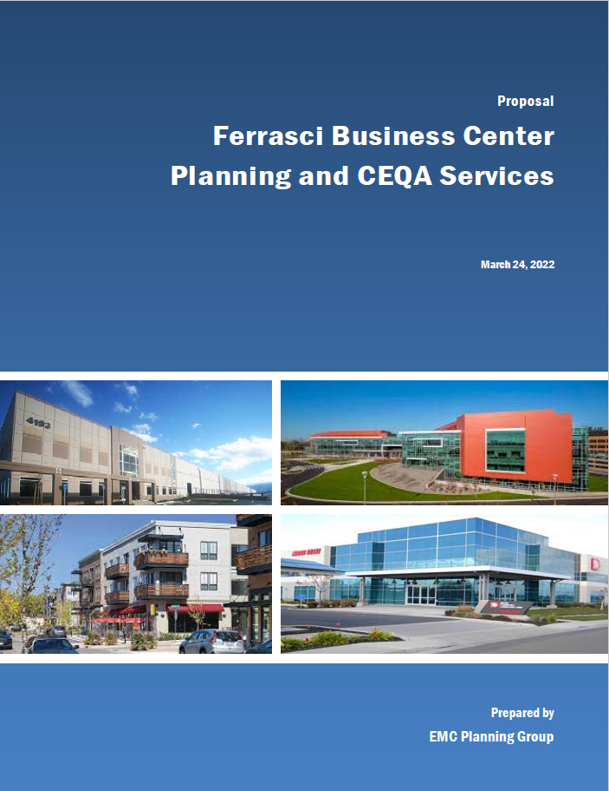
EMC Scope and Budget
Qualifications/Experience
  EDE EIR
  Salinas Travel Center
  Salinas Ag Industrial Specific Plan
Team
  EMC
  Kimley-Horn
  WJV Acoustics
  Illingworth & Rodkin
Budget: $486,128.50 Term: May 1, 2024
Notes:
Projects – Staff support/Technical review and project packaging, CEQA compliance (I/S and EIR), LAFCO (Annexation)

Slide 7
Housing and Land Use Committee
Desire to incorporate housing or have a commercial linkage fee/community benefit agreement tied with the proposed Project.
Adding residential uses would require additional CEQA analysis.
Approved a motion recommending that the City Council approve the execution of both Agreements.

Slide 8
Recommendation Action
Establish a new CIP for processing of the Ferrasci Business Center Specific Plan
Authorize execution of Funding Agreement with the Developer to reimburse City for all Project costs
Appropriate $500,000 for Project costs and budgeting the initial deposit of $75,000 and reimbursement revenue from the Developer to Fund 5203
Authorize execution of an Agreement with EMC Planning Group for an amount not to exceed $486,128.50 for planning and environmental services.
The execution of the Agreements does not constitute approval of the Ferrasci Business Center Specific Plan.

