Slide 1


Final 2023-2031 Housing Element Adoption
(General Plan Amendment 2023-002)
City Council
December 5, 2023

Slide 2
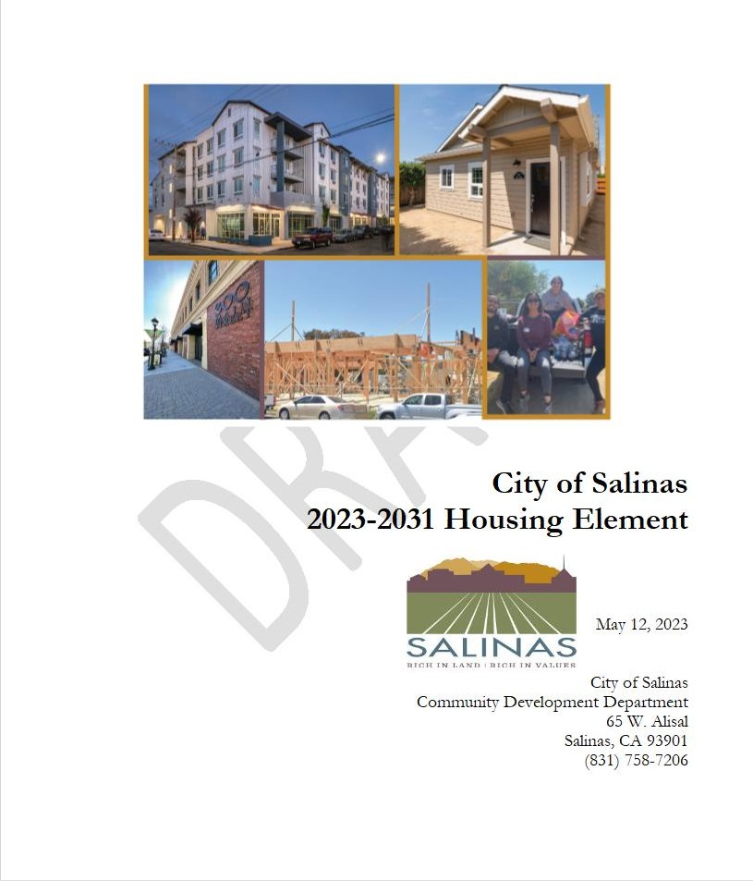
The Housing Element . . .
Establishes City Housing goals and policies
Eight year update
Due to HCD by December 2023
Required to apply for various HCD funding opportunities

Slide 3
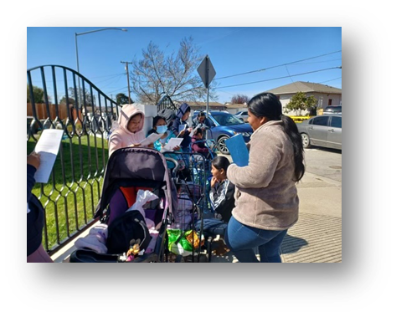
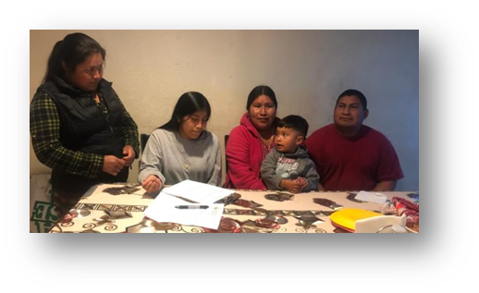
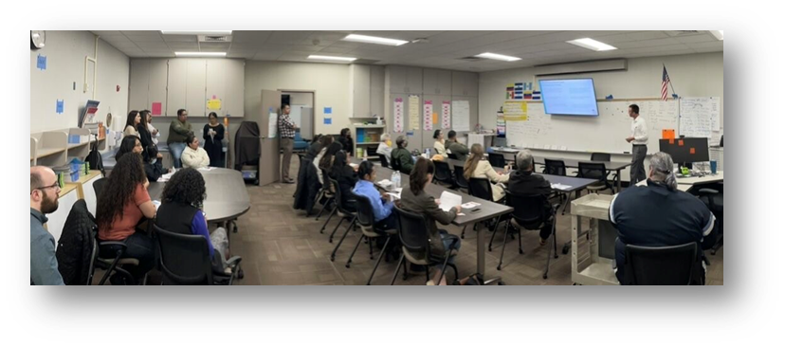
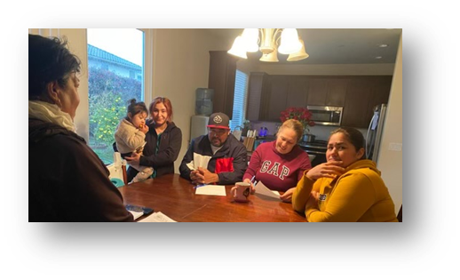
Community Engagement
Housing Element Workshops (3)
Participants (60+)
Mixteco interpretation
GPU Ambassadors:
House Meetings (101)
Farmworkers reached (340+)
Meetings conducted in Mixteco (19)

Slide 4
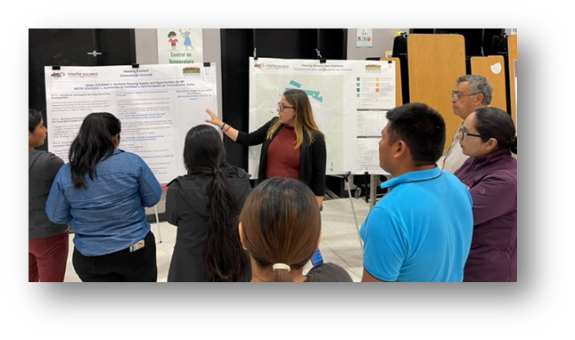
Recurring Themes
Need for more housing
Affordability
Need to maintain existing housing/neighborhoods
Housing for disadvantaged populations
Renter resources
Housing for farmworkers
Be innovative

Slide 5
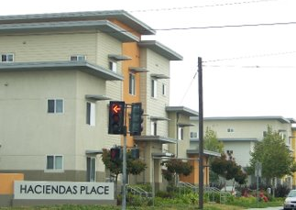
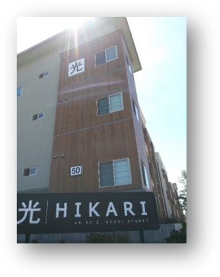
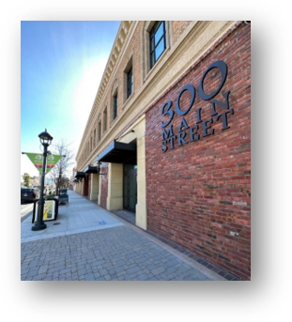
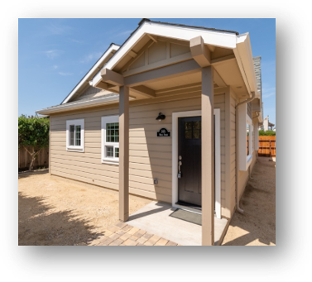
Housing Goal 1
Increase Housing Supply and Opportunities for All
Incentivize/support production
Encourage/facilitate ADUs
Encourage diverse housing types
Notes:
Provide Adequate Sites for Housing
Financial Assistance and Gap Financing
Prohousing Designation and Resources
Facilitate Accessory Dwelling Units
East Area Specific Plan Development
General Plan and Zoning Code Update
Reduce Fees and Housing Production Constraints

Slide 6
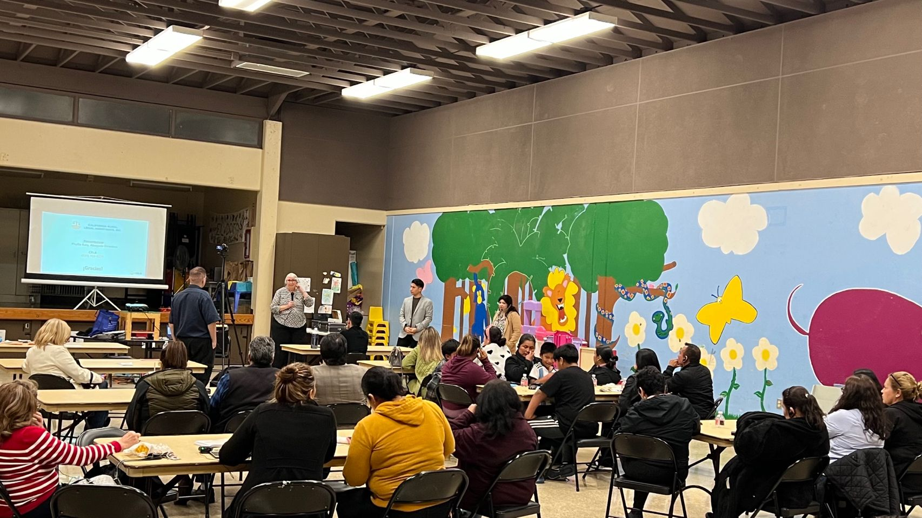
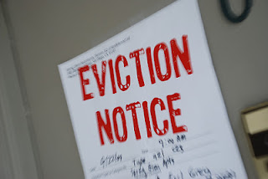

Housing Goal 2
Provide Tenant Protections
Policies/programs to prevent displacement
Develop tenants' rights programs
Provide education and connect tenants to legal services
Notes:
Housing Services Program
Residential Rental Registration
Fair Housing Education, Outreach, and Services
Meeting image is from the Tenants' rights townhall organized by Councilmember Rocha.

Slide 7
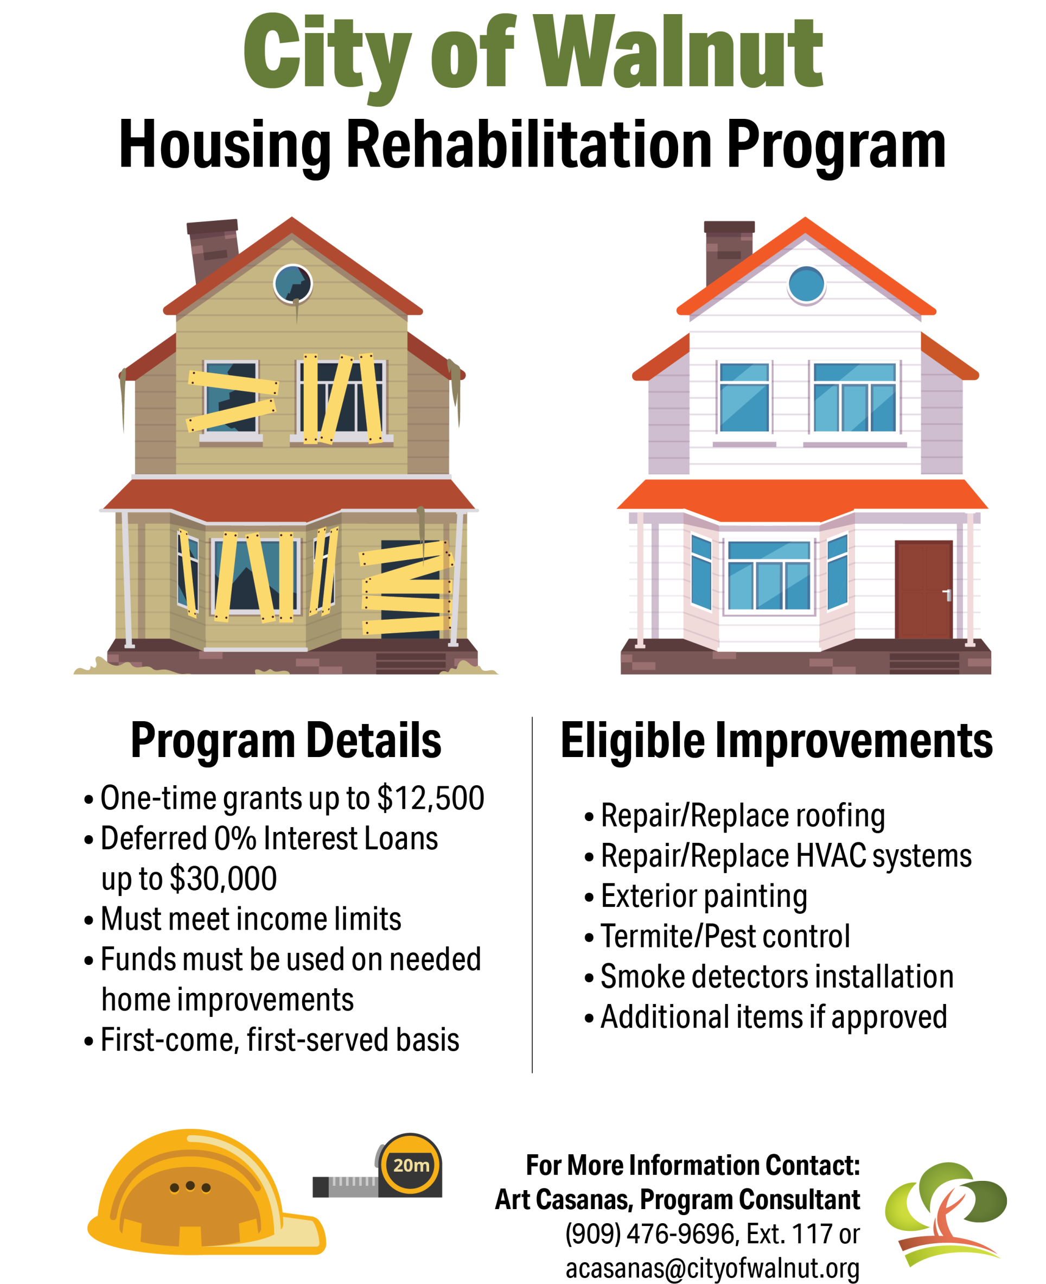
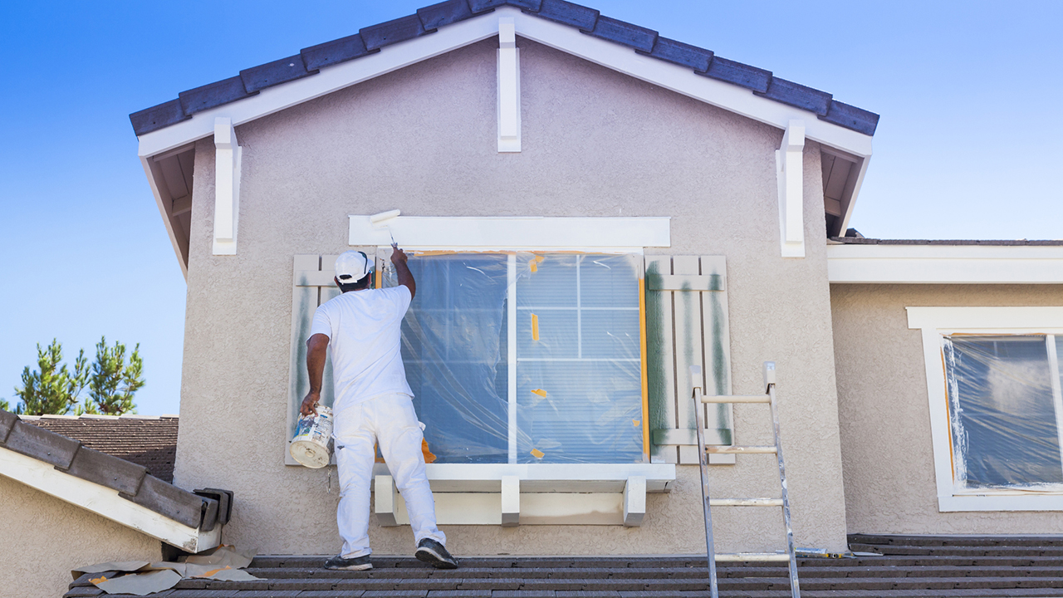

Housing Goal 3
Access to Safe and Healthy Housing for all Residents
Improve the quality and condition of rental housing
Promote rehabilitation of housing
Promote sustainable and healthy housing
Notes:
Use Code Enforcement Strategically. Reduce blight by using code enforcement, nuisance abatement, and receivership to address significant problem properties.
Educate Residents and Community partners on Code Enforcement through a variety of platforms such as social media, printed materials and workshops.

Slide 8


Housing Goal 4
Advance Housing Affordability and Opportunity at all Income Levels
Advance rent stabilization
Facilitate production of affordable housing
Connect residents to financial resources
Provide assistance to special populations
Notes:
Housing Vouchers
Homebuyer Resources
Housing and Services for Persons with Disabilities
Equitable Housing and Service Access for Unhoused Individuals and Families
Preservation Affordable Housing At-Risk of Conversion
Local Workforce Housing
Farmworker Housing

Slide 9



Housing Goal 5
Stabilize and Support Neighborhoods
Collaborate with residents to improve neighborhoods
Leverage code enforcement strategies
Encourage preservation and restoration of historic neighborhood resources
Work to reverse patterns of discrimination
Notes:
Invest in Disadvantaged Neighborhoods
Chinatown Revitalization Plan
Alisal Vibrancy Plan
Historic Resources
Programs to support preservation of historic buildings
Image is from a clean up part of the Alisal Ambassador Program in collaboration with AMOR Salinas and SUBA.

Slide 10
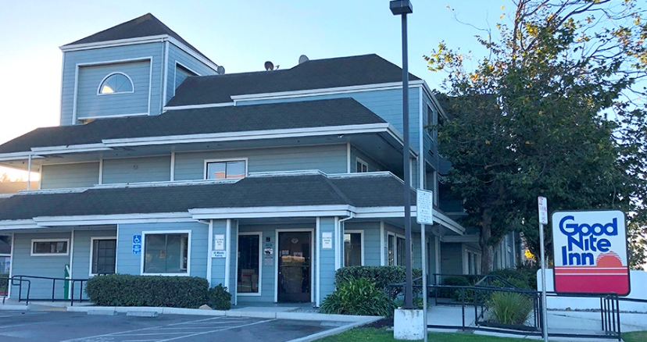

Housing Goal 6
Homeless Programs and Services
Lead Me Home Plan implementation
Enhanced focus on Street Outreach and Navigation Services
Facilitate the development of housing focused shelter operations and permanent housing through new construction and innovative conversion

Slide 11
General Plan Amendment and CEQA
Needed because the Housing Element is part of the General Plan
  Housing Element is found to be consistent with the General Plan and the update necessary to comply with State law.
CEQA Exemption

Slide 12
Timeline
July | August-September | October | November | December | HCD Review | Certification
Draft sent to HCD - 90 days to review | Initial HCD comments received. Second Draft Housing Element issued. | Official HCD Comments received. Final Housing Element prepared. | Public review: Steering Committee, Planning Commission and Housing and Land Use Committee Review. | City Council Adoption – December 5. Submission to HCD for review no later than December 15. | 60-Day HCD review and non-policy related revisions. | Deadline for Certification is 120 days after adoption deadline – April 15, 2024

Slide 13
Recommendation
Approve a resolution to adopt the 2023-2031 Housing Element (General Plan Amendment 2023-002), authorize staff to submit the 2023-2031 Housing Element to the State of California Department of Housing and Community Development (HCD) for certification, and authorize staff to make non-policy revisions to the Housing Element in response to future HCD comments.

Slide 14
Questions & Comments

