Slide 1

EXTRATERRITORIAL WASTEWATER SERVICE AND REIMBURSEMENT AGREEMENTS
BETWEEN CITY AND SALINAS 101 LLC
AND
PREANNEXATION AGREEMENT FOR PORTION OF EOA K
BETWEEN THE CITY OF SALINAS AND THE COUNTY OF MONTEREY
Lisa Brinton, Assistant Director
Housing and Land Use Committee
March 29, 2022
Notes:
This item was presented to the City Council on March 22, 2022. Council referred the consideration of the Agreements to the HLUC for recommendation.

Slide 2
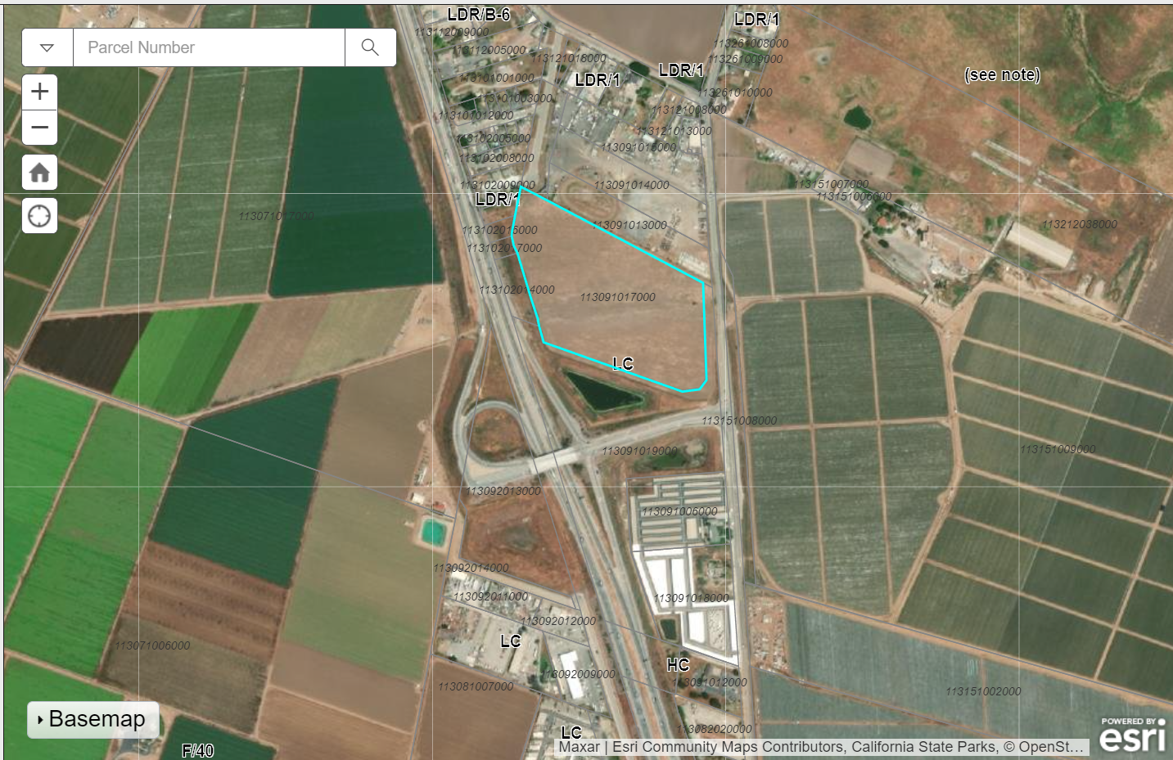
Notes:
Salinas 101 LLC proposes to develop a commercial retail project in the County at the Sala Road/Harrison Road 101 interchange
County zoning for the site is light commercial
Surrounding uses include agriculture, storage facility, HWY 101 and a mobile home park

Slide 3
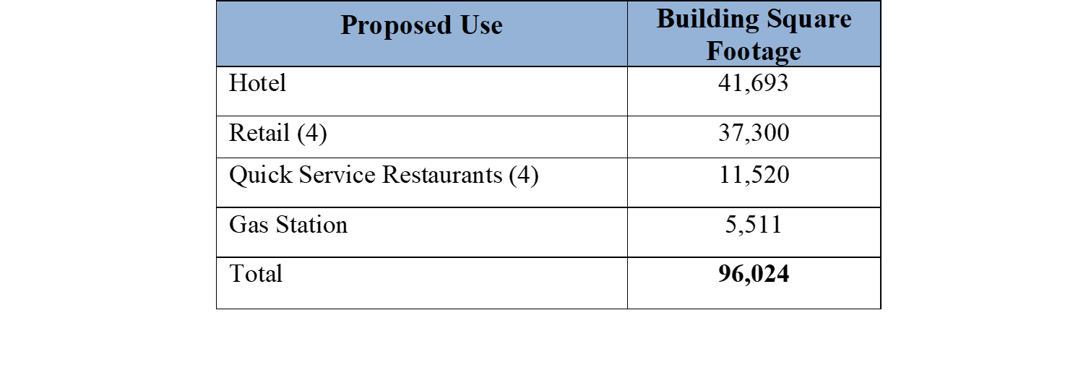
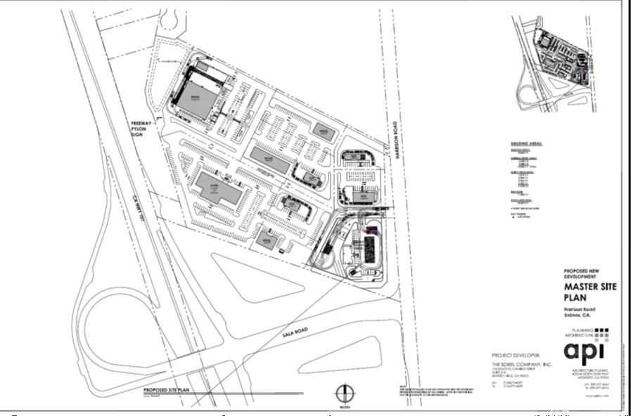
Notes:
County is lead for processing the proposed project according to their standards and regulations.
Proposed uses are allowed in Light Commercial.
County lead for entitlement and CEQA compliance processing.
As a responsible agency, the City has opportunity/obligation to review and comment
Except for Wastewater/Sewer, all utilities are available for proposed project to connect to and receive service from.
The County does not have a WW collection and disposal system. The project is required to provide a WW treatment plan for the application to be deemed complete. (On site or connect to city system)
Owner approached the city to connect with its collection and disposal system and has requested a will serve letter for the County to deemed the application complete.

Slide 4
Sewer Agreement – Terms and Conditions
Owner shall:
Support future annexation
obtain all permits and pay all fees to construct New Sewer Line and private connection
pay a one-time development impact fee in the amount of $64,600
pay fees for Disposal System service
City shall:
provide written “will serve” assurance
ensure that Monterey One Water will accept the wastewater and provide service
process future annexation application(s) at its sole expense
Notes:
City policy – tied to annexation application, support of future annexation, or farmworker housing.
In response to request, City staff worked with the Owner to develop sewer agreement – terms and conditions for connection
The Effective Date of the Sewer Agreement is when appropriate County approvals and entitlements and CEQA documents are prepared, approved and a Notice of Determination is filed by the County Housing and Community Development Department.
Without the “will serve” letter, nothing further can proceed.

Slide 5
Reimbursement Agreement –Terms and Conditions
Owner shall:
complete construction of New Sewer Line
provide evidence of Actual Costs
have right to reimbursement of its Actual Costs based on a wastewater flow proration.
City shall:
collect reimbursement from future users
promptly pay Owner reimbursement
provide Owner with annual financial accounting of reimbursement collected.
Notes:
Infrastructure – construction of a new line is costly ($2M) – cost of infrastructure is a key factor in the feasibility of development moving forward.
Future users will be required to reimburse prior to connection to new line – owner reimbursed for pro-rata share of actual costs

Slide 6
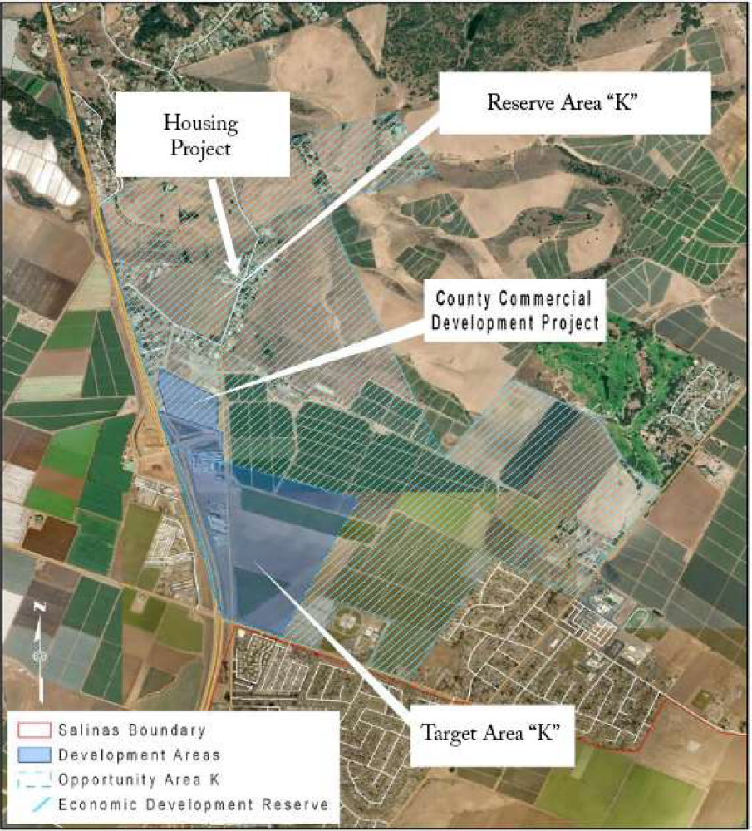
Notes:
Provided commercial retail project and new line are developed, City would have the option of including retail site in future annexation application to LAFCO, should it choose to do so. Future annexation would lead to future growth, development and increase revenues for the City.

Slide 7
Pre-Annexation Agreement
acknowledges the foreseeable annexations
reaffirms coordination of land use entitlement and CEQA compliance as agreed to in the GSA-MOU 2019 Addendum, and
analyzes the property tax and revenue sharing formulas between the City and the County.
Notes:
Again, City policy – tied to annexation application, support of future annexation, or farmworker housing. Owner agreed to support
City/County have drafted a pre-annexation agreement, which is a preliminary step. No commitment, states will work in good faith, roles and responsibilities, and future analysis to be undertaken
COUNTY APPROVED PREANNEXATION AGREEMENT AT ITS 3/22 Meeting
Duration: Five (5) years from the Effective Date with the ability to extend an additional five (5) years upon mutual agreement.

Slide 8
CEQA Consideration
Execution of the proposed Agreements is not a project as defined by the California Environmental Quality Act (CEQA). Section 15061 (b) (3) of CEQA Guidelines and does not constitute project approval.
The Effective Date of the Sewer Agreement is when appropriate County approvals and entitlements and CEQA documents are prepared, approved and a Notice of Determination is filed by the County Housing and Community Development Department.
Provided the Sala Road Project is constructed, the City intends to apply to LAFCO to annex Target Area K and the Sala Road Project. Should the City proceed with an annexation application, it will be the lead agency for the application and associated CEQA compliance.
Notes:
Agreement is not considered a project
County lead for Commercial Retail project
City lead for Annexation Application

Slide 9
Fiscal Impact
Sala Road Project
Owner, at no cost to the City, is to construct New Sewer Line
Owner to pay City $64,600 fee for downstream infrastructure impacts
City may incur future capital expenditures and other maintenance costs associated with the New Line and Disposal System upgrades
Pre-annexation Agreement
City would receive new revenue from generated by future development in the proposed annexation area
Notes:
Upon future annexation, the City would receive new revenue from sales tax, transient occupancy tax and a percentage share of property tax generated by development in the annexation area. The amount of future revenue would be dependent on future development and the property tax revenue sharing percentage split with the County. The term of the 2008 Master Tax Agreement ends January 1, 2023,therefore the City and County have agreed to further discuss and analyze the Master Tax Agreement consist with LAFCO laws and procedures and as provided in the GSA-MOU 2019 Addendum.

Slide 10
Recommendation
Recommend that the City Council approve a resolution authorizing the Mayor to execute a Sewer Agreement and associated Reimbursement Agreement (Agreements) with Salinas 101 LLC (Owner) to establish the terms and conditions under which the City would allow connection to its wastewater collection and disposal system.
Recommend that the City Council approve a resolution authorizing the Mayor to execute a Pre-Annexation Agreement with the County of Monterey for portions of Economic Development Element Economic Opportunity Area K (EDE EOA K).

