Slide 1

SECOND AMENDMENT TO PLANNED UNIT DEVELOPMENT PERMIT 1969-003 (PUD 2023-001) TO ALLOW RESIDENTIAL ADDITIONS FOR 124 EXISTING SINGLE FAMILY DETACHED DWELLING UNITS LOCATED IN LAS CASITAS UNITS 1 AND 2 (TRACTS 607 AND 615) PURSUANT TO RESIDENTIAL LOW DENSITY (R-L-5.5) ZONING DISTRICT DEVELOPMENT STANDARDS
Thomas Wiles, Senior Planner
Community Development Department
City Council Hearing March 5, 2024

Slide 2
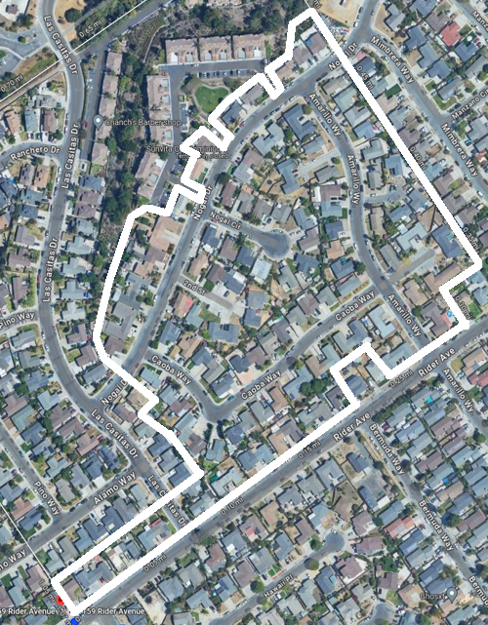
Background
Hernan and Armida Perez, Applicant
  Martina Espino, Property Owner
    747 Amarillo Way
Requested a residential addition
  PUD 1969-003 does not allow additions
  Second Amendment to PUD 1969-003
  Allow residential additions
    124 existing single family detached dwelling units
    Zoned – R-L-5.5
  Las Casitas Units 1 and 2
    Tracts 607 and 615
  Pursuant to R-L-5.5 standards
  68 of 124 property owners signed application

Slide 3
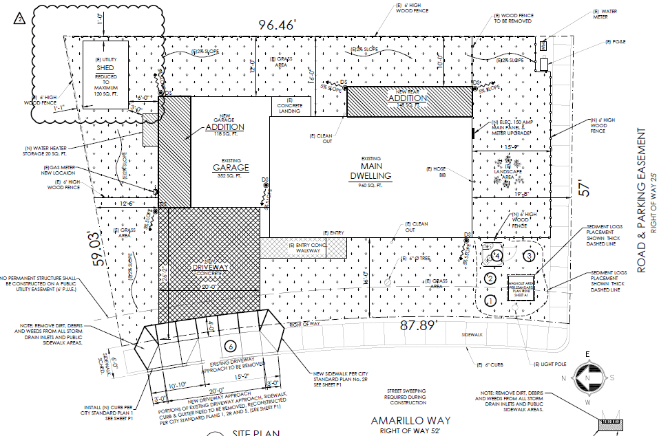
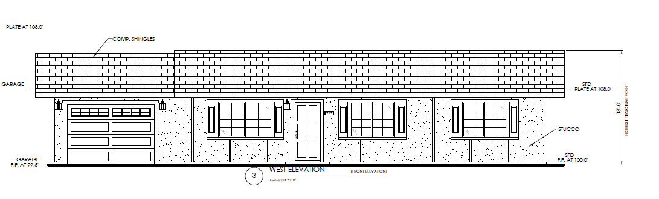
Plans for 747 Amarillo Way

Slide 4
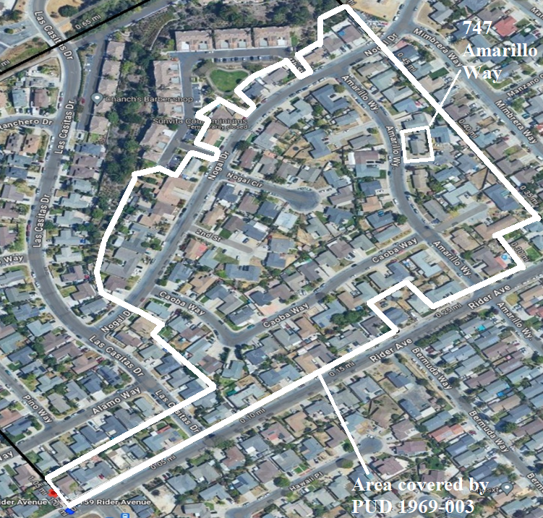
Background
PUD 1969-003
  Approved on October 6, 1969
    252-lot subdivision & compact homes
    42.25-acres
  PUD 1972-002
    58 compact homes
    9.804-acres
  PUD 1978-001
    65 single-family dwellings
    13.93-acres
  PUD 1984-013
    42 single-family homes & 45 condos
Surrounding uses are residential

Slide 5
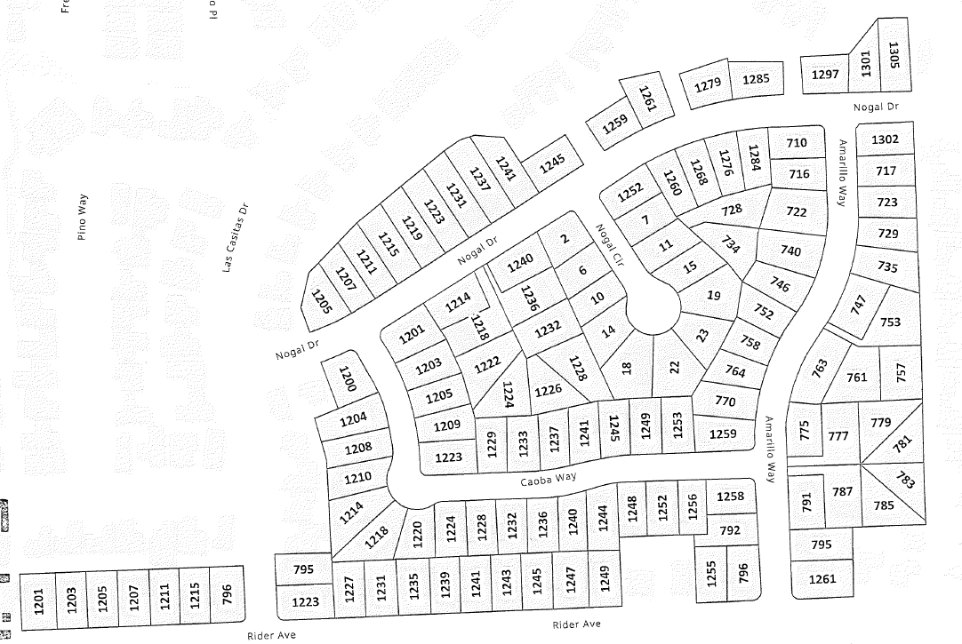
Analysis
PUD 1969-003
  No specific development standards
R-L-5.5 Zoning District:
  Lot Size - 5,500 sf.
Yards - minimum
  Front yard 20 ft.
  Interior side 5 ft.
  Corner side 15 ft.
  Rear (ft.)10 ft.
  Distance between structures 6 ft.
Legally created lots subject to R-L-5.5
  No changes to number of lots
  No changes in lot size
Additions per R-L-5.5 regulations
  Development Standards
  Design Standards; and
  Residential Design Review (RDR)

Slide 6
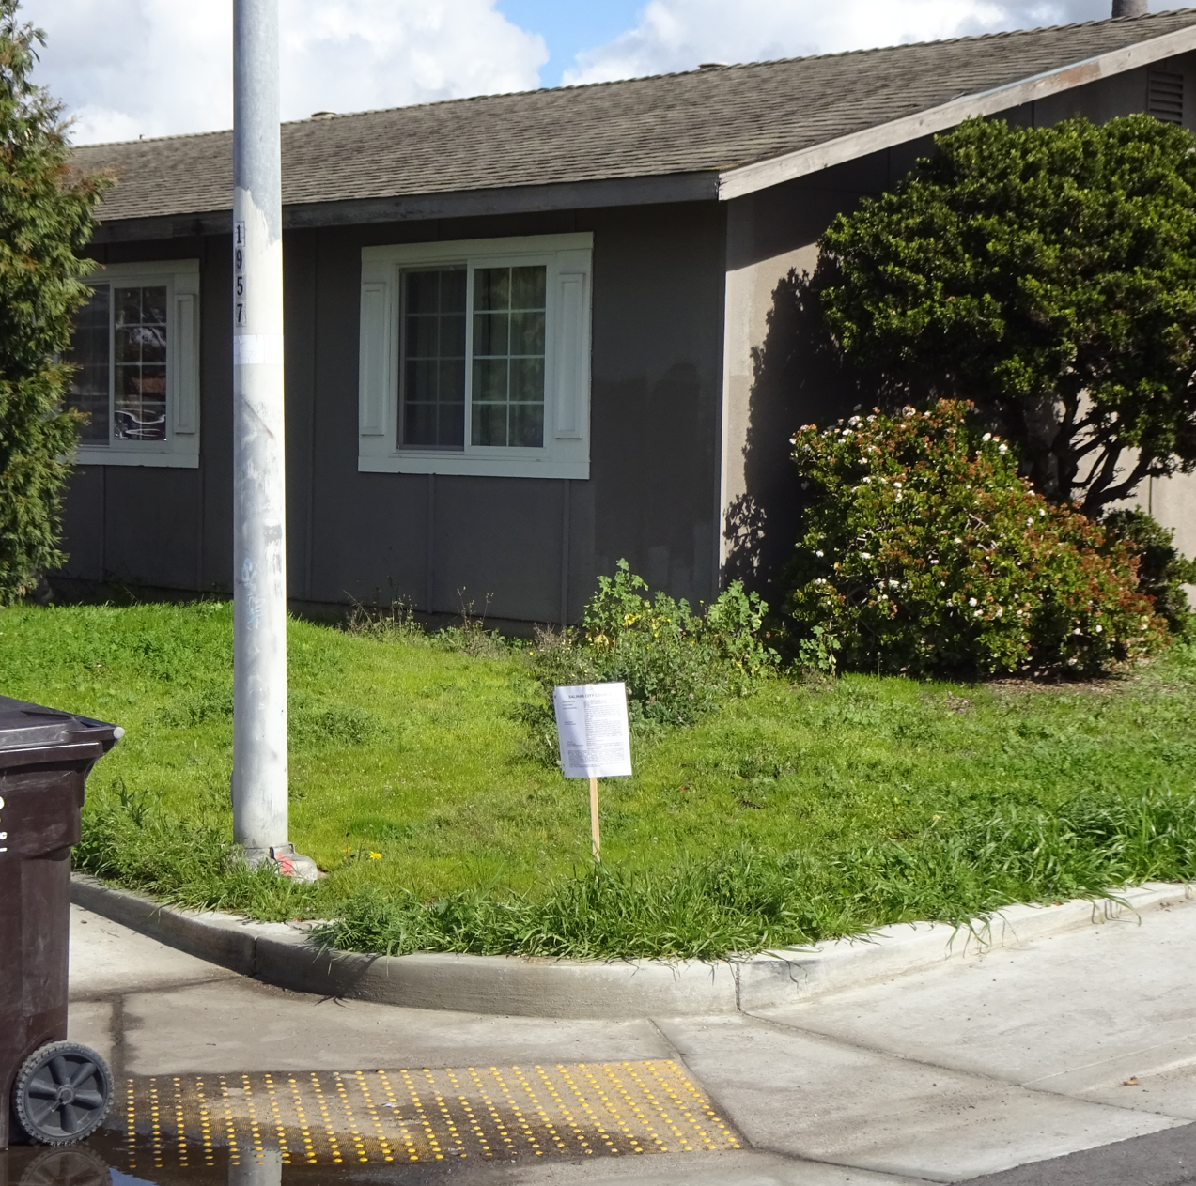
Recommendation
February 7, 2024 - Planning Commission
  Recommended City Council:
  Exempt PUD 2023-001 from CEQA
    Section 15305
  Approve PUD 2023-001 with modifications:
    Require RDR for 2nd-story additions
    Consistent with:
      General Plan; &
      Zoning Code
Public Notice:
  Posted & Mailed 2/21/24; &
  Published Monterey Herald 2/22/24

