Slide 1

City Development Impact Fee
Annual Adjustment
Recommended City Council Motion:
Approve a Resolution increasing City development impact fees by 8.0% effective July 1, 2022
Adriana Robles, City Engineer
Department of Public Works
April 26, 2022

Slide 2
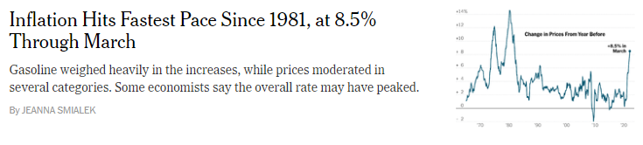
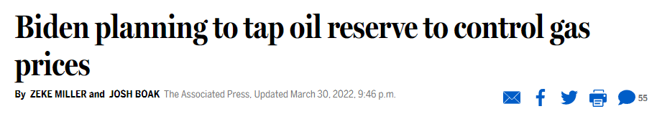
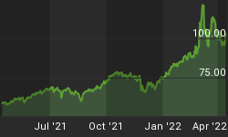
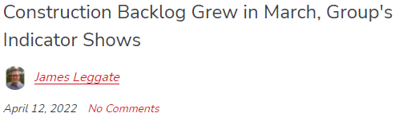

Background

Slide 3
Development Impact Fees Purpose and Benefits
Purpose
  Pay proportionate cost of improvements to capital infrastructure and facilities required to accommodate and service a new development.
  No single development must finance a capital improvement project or new public facility.
Benefits Community and Developers
  Community can improve facilities impacted by growth
  Developers can mitigate impacts on a “Fair Share Basis”
  Developers don’t have to do extensive studies to identify impacts.

Slide 4
Development Impact Fees
Residential
Commercial/Industrial
• Street Tree Fee (often waived) • Park Impact Fee
• Storm Sewer Main Line Fee • Citywide
• Sanitary Sewer Main Line Fee • Central Area (Future Growth Area)
• Traffic Fee (TFO) • West Area (Future Growth Area)
• Fire Impact Fee • Library Impact Fee
• Police Impact Fee • Recreation Impact Fee
Credit provided for existing use.
No development fees are assessed for additions.
No development fees assessed on ADU.
Per Exhibits A and B
Notes:
CA Govt Code 66000 requires a reasonable relationship between fees and cost of associated improvements.

Slide 5
Annual Inflation Adjustment
Article V, Section 9-42 of City Code:
  9-42 (a) “…fees shall be reviewed on July 1 of each year. …shall be compared to the Engineering News Record (ENR) Construction Cost Index.”
  9-42 (b) “…may be changed in accordance with the percentage change in the ENR index”
ENR index number
  Based on average construction costs among 20 major US metropolitan areas
  Factors in average labor rates and material costs
  2021-2022 ENR Construction Cost Index was 8.0%

Slide 6
Fiscal Impact
Estimate Fund Balance February 28, 2022: $16.5M
Fee Category | 2022 Balance | Revenues March 2021 to Feb. 2022 | Expenditures March 2021 to Feb. 2022
Sanitary Sewer & Storm Drain | $2.6M | $157K | $1.0M
Parks | $1.1M | $46K | $23K
Library | $170K | $41K | $0
Street Trees | $19K | $7,119 | $0
Traffic | $11.3M | $488K | $115K
Fire | $158K | $75K | $2K
Police | $1.0M | $139K | $0
Total | $16.5M | $956K | $1.1M

Slide 7
Recommendation
CEQA
Not a Project. Project is categorically exempt from CEQA pursuant to Section 15378 and 15061(b)(3).
Approve a Resolution to increase City Development Impact Fees by 8.0%, effective July 1, 2022, based on the Engineering News Record construction cost index increase over the last year.

